Slide 1
Power Line Communication System for Home Automation
Group 12
April 30, 2010
Copyright © 2010 Nexus Technologies. All Rights Reserved.

Slide 2
Nexus Technologies Team
Kevan Thompson (CEO) – Software
Master Controller Software
User Interface Design (Controller Webpage)
Kia Filsoof (CRO) - Hardware
Power Line Communication Modem Design
Line Coupling Circuitry
Copyright © 2010 Nexus Technologies. All Rights Reserved.

Slide 3
Nexus Technologies Team
Mike Kubanski (CTO) – Software / Hardware
Device Controller Software
Device Controller Circuitry
Pranil Reddy (CFO) – Hardware
Power Line Communication Modem Design
Line Coupling Circuitry
Copyright © 2010 Nexus Technologies. All Rights Reserved.

Slide 4
Nexus Technologies Team
Yalda Hakki (COO) - Hardware
Power Line Communication Modem Design
Line Coupling Circuitry
Copyright © 2010 Nexus Technologies. All Rights Reserved.

Slide 5
Presentation Outline
Introduction and Background
System Overview
Power Line Communication Modem Design
Master and Device Controller Design
Business Aspects
Budget and Financing
Competition
Project Timeline
Summary
Learning Outcomes
Future Improvements
Conclusion and Acknowledgements
Copyright © 2010 Nexus Technologies. All Rights Reserved.

Slide 6
Introduction and Background
Copyright © 2010 Nexus Technologies. All Rights Reserved.

Slide 7
Motivation
Introduction and Background
System Overview
PLCM Design
Master / Device Controller Design
Business Aspects
Budget and Financing
Competition
Project Timeline
Summary
Learning Outcomes
Future Improvements
Conclusion/Acknowledgements
Problem:
Forgot to turn on the light before leaving to vacation?
Too lazy to go downstairs and turn on/off the light or the coffee maker?
Solution:
A simple and affordable home control system!!
Copyright © 2010 Nexus Technologies. All Rights Reserved.

Slide 8
Goals
Introduction and Background
System Overview
PLCM Design
Master / Device Controller Design
Business Aspects
Budget and Financing
Competition
Project Timeline
Summary
Learning Outcomes
Future Improvements
Conclusion/Acknowledgements
Control devices from an IP network across a power line network
Simple installation
Simple user interface
Affordable hardware!
Copyright © 2010 Nexus Technologies. All Rights Reserved.

Slide 9
Our Product
Prometheus Home Control System
The ability to monitor and control building devices from anywhere in the world with internet.
Uses the existing building’s electrical power grid to communicate with the devices
Affordable PLCMs and Device Controllers
Introduction and Background
System Overview
PLCM Design
Master / Device Controller Design
Business Aspects
Budget and Financing
Competition
Project Timeline
Summary
Learning Outcomes
Future Improvements
Conclusion/Acknowledgements
Copyright © 2010 Nexus Technologies. All Rights Reserved.

Slide 10
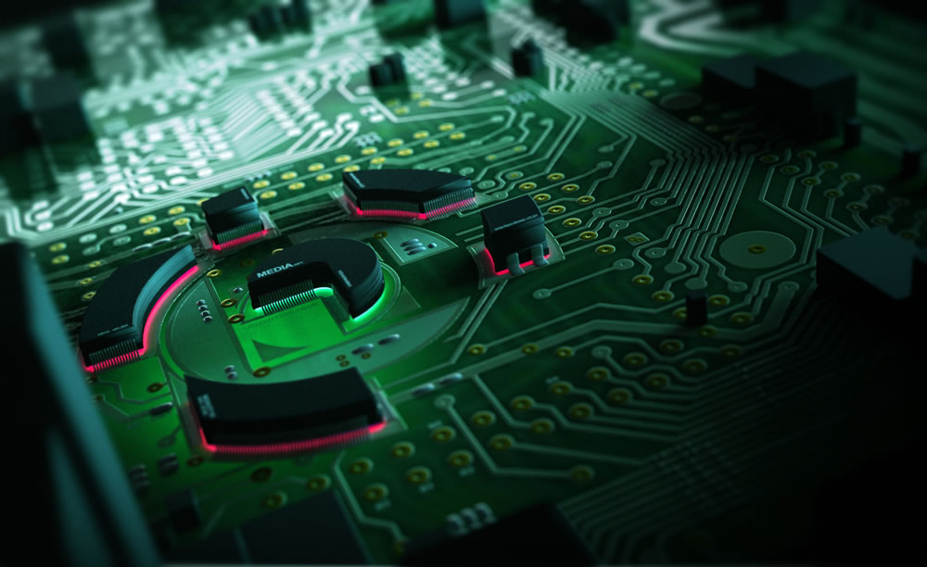
System Overview
Copyright © 2010 Nexus Technologies. All Rights Reserved.

Slide 11
System Overview
Introduction and Background
System Overview
PLCM Design
Master / Device Controller Design
Business Aspects
Budget and Financing
Competition
Project Timeline
Summary
Learning Outcomes
Future Improvements
Conclusion/Acknowledgements
Copyright © 2010 Nexus Technologies. All Rights Reserved.

Slide 12
Power Line Communication Modem
Purpose of the PLCM
Act as a MODEM between the master microcontroller and the device controller
Modulate the digital transmitting signals and couple them over the power line
Decouple the receiving signals from the power line and demodulate them to their digital format
Introduction and Background
System Overview
PLCM Design
Master / Device Controller Design
Business Aspects
Budget and Financing
Competition
Project Timeline
Summary
Learning Outcomes
Future Improvements
Conclusion/Acknowledgements
Copyright © 2010 Nexus Technologies. All Rights Reserved.

Slide 13
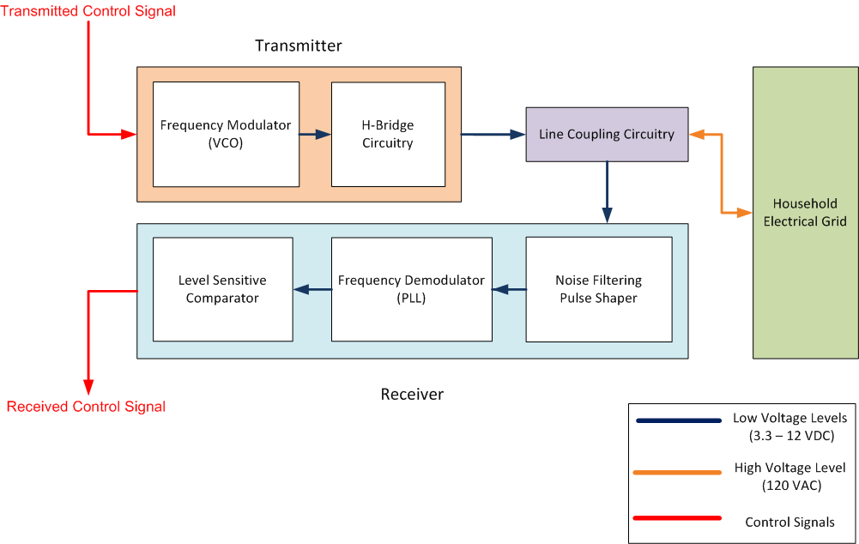
Power Line Communication Modem
PLCM Block Diagram
Introduction and Background
System Overview
PLCM Design
Master / Device Controller Design
Business Aspects
Budget and Financing
Competition
Project Timeline
Summary
Learning Outcomes
Future Improvements
Conclusion/Acknowledgements
Copyright © 2010 Nexus Technologies. All Rights Reserved.

Slide 14
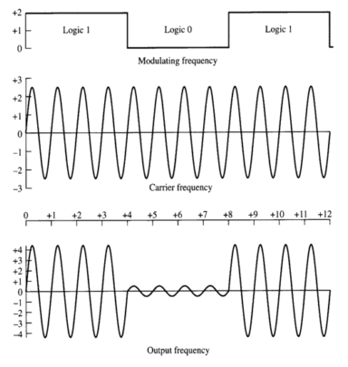
Transmitter – Why FSK vs. AM
Introduction and Background
System Overview
PLCM Design
Master / Device Controller Design
Business Aspects
Budget and Financing
Competition
Project Timeline
Summary
Learning Outcomes
Future Improvements
Conclusion/Acknowledgements
Amplitude Modulation
Logic 1’s provide larger amplitudes
Logic 0’s provide smaller amplitudes
Affected by Power Line noise and signal loss
Copyright © 2010 Nexus Technologies. All Rights Reserved.

Slide 15
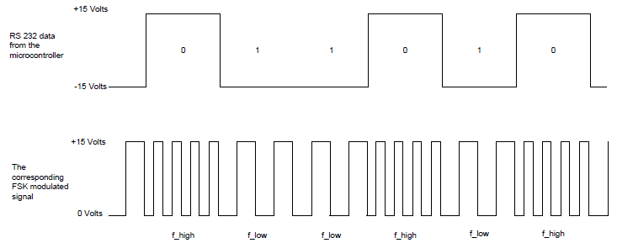
Transmitter – Why FSK vs. AM
Frequency-Shift Keying
Logic 1’s generate high frequency
Logic 0’s generate low frequency
Immune to power line noise, uses frequency to recover signals
Introduction and Background
System Overview
PLCM Design
Master / Device Controller Design
Business Aspects
Budget and Financing
Competition
Project Timeline
Summary
Learning Outcomes
Future Improvements
Conclusion/Acknowledgements
Copyright © 2010 Nexus Technologies. All Rights Reserved.

Slide 16
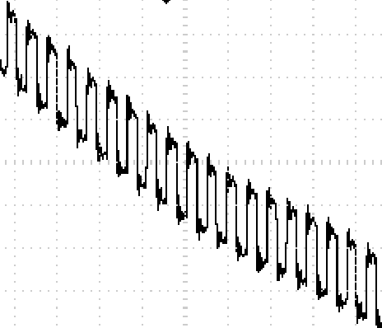
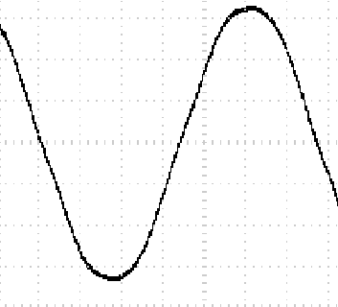
FSK Signals from PLCM
Introduction and Background
System Overview
PLCM Design
Master / Device Controller Design
Business Aspects
Budget and Financing
Competition
Project Timeline
Summary
Learning Outcomes
Future Improvements
Conclusion/Acknowledgements
What does the coupled signal look like?
Copyright © 2010 Nexus Technologies. All Rights Reserved.

Slide 17
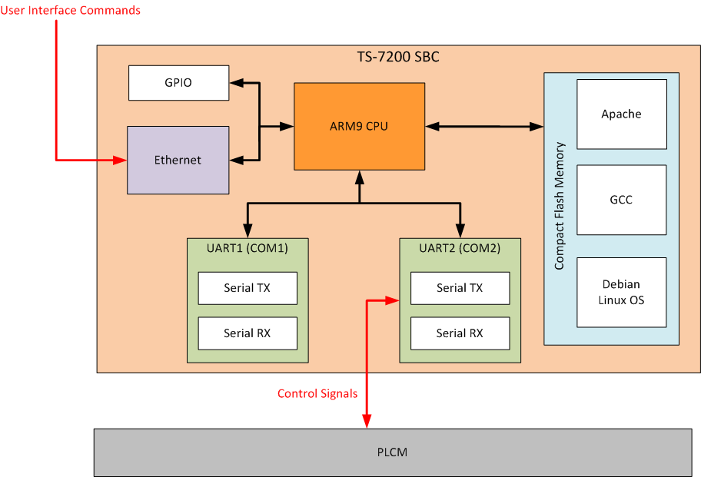
Master Controller Design
Master Controller Block Diagram
Introduction and Background
System Overview
PLCM Design
Master / Device Controller Design
Business Aspects
Budget and Financing
Competition
Project Timeline
Summary
Learning Outcomes
Future Improvements
Conclusion/Acknowledgements
Copyright © 2010 Nexus Technologies. All Rights Reserved.

Slide 18
Master Controller Design
Introduction and Background
System Overview
PLCM Design
Master / Device Controller Design
Business Aspects
Budget and Financing
Competition
Project Timeline
Summary
Learning Outcomes
Future Improvements
Conclusion/Acknowledgements
Copyright © 2010 Nexus Technologies. All Rights Reserved.

Slide 19
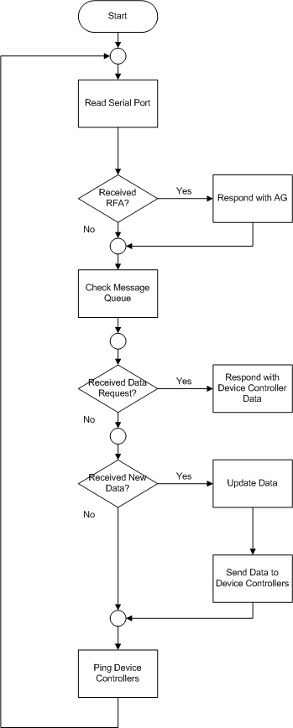
Master Controller Software Flowchart
Introduction and Background
System Overview
PLCM Design
Master / Device Controller Design
Business Aspects
Budget and Financing
Competition
Project Timeline
Summary
Learning Outcomes
Future Improvements
Conclusion/Acknowledgements
Copyright © 2010 Nexus Technologies. All Rights Reserved.

Slide 20
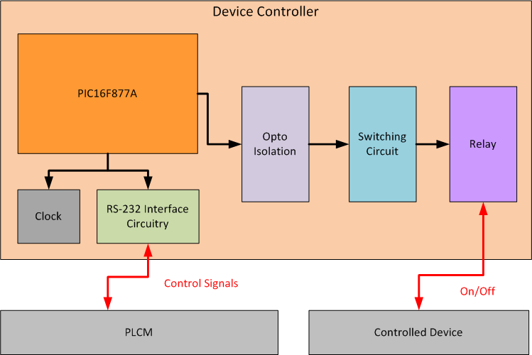
Device Controller Design
Device Controller Block Diagram
Introduction and Background
System Overview
PLCM Design
Master / Device Controller Design
Business Aspects
Budget and Financing
Competition
Project Timeline
Summary
Learning Outcomes
Future Improvements
Conclusion/Acknowledgements
Copyright © 2010 Nexus Technologies. All Rights Reserved.

Slide 21
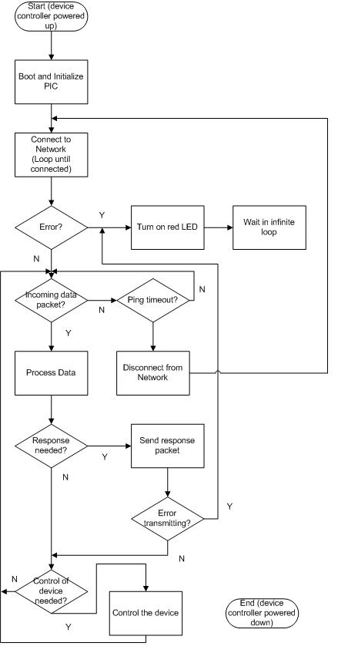
Device Controller Software Flowchart
Introduction and Background
System Overview
PLCM Design
Master / Device Controller Design
Business Aspects
Budget and Financing
Competition
Project Timeline
Summary
Learning Outcomes
Future Improvements
Conclusion/Acknowledgements
Copyright © 2010 Nexus Technologies. All Rights Reserved.

Slide 22
Business Aspects
Copyright © 2010 Nexus Technologies. All Rights Reserved.

Slide 23
Sources of Funding
Introduction and Background
System Overview
PLCM Design
Master / Device Controller Design
Business Aspects
Budget and Financing
Competition
Project Timeline
Summary
Learning Outcomes
Future Improvements
Conclusion/Acknowledgements
Primary sources of funding
ESSEF - $350.00
IEEE Mini-Grant - $500.00
Granted to students beginning a design project
Required statement of endorsement from faculty member
Submit an application paper upon completion
Department Funding - $50.00
Total Funding Available: $900.00
Copyright © 2010 Nexus Technologies. All Rights Reserved.

Slide 24
Budget
Introduction and Background
System Overview
PLCM Design
Master / Device Controller Design
Business Aspects
Budget and Financing
Competition
Project Timeline
Summary
Learning Outcomes
Future Improvements
Conclusion/Acknowledgements
Prototype: Initial Budget
Equipment | Estimated Cost
TS-7200 SBC (ARM9 Processor) | $ 120.00
Power Line Communication Modem | $ 70.00
Controlled Devices | $ 20.00
Appliance Interfacing | $ 30.00
System Chassis | $ 22.00
15% Contingency Plan | $ 38.00
Total Cost | $ 300.00
Prototype: Actual Budget
Equipment | Quantity | Unit Cost | Actual Cost
TS-7200 SBC (ARM9 Processor) | 1 | $228.85 | $228.85
Power Line Communication Modem | 3 | $21.14 | $63.43
Device Controller | 2 | $28.78 | $57.56
Controlled Devices | 1 | $0.00 | $0.00
High Voltage Enclosure | 3 | $34.32 | $102.97
Total Cost |  | $313.10 | $452.81
Copyright © 2010 Nexus Technologies. All Rights Reserved.

Slide 25
Market Analysis
Introduction and Background
System Overview
PLCM Design
Master / Device Controller Design
Business Aspects
Budget and Financing
Competition
Project Timeline
Summary
Learning Outcomes
Future Improvements
Conclusion/Acknowledgements
Primary users for power line communication
Home Automation
Home Networking (Broadband)
Security Systems (Alarms)
Copyright © 2010 Nexus Technologies. All Rights Reserved.

Slide 26
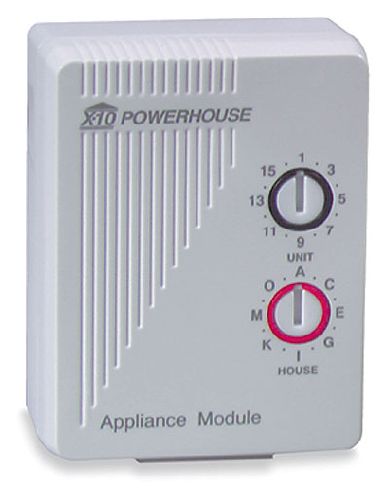
Competition – X10
Introduction and Background
System Overview
PLCM Design
Master / Device Controller Design
Business Aspects
Budget and Financing
Competition
Project Timeline
Summary
Learning Outcomes
Future Improvements
Conclusion/Acknowledgements
X10 is a international standard for communication between electronic devices used for home automation.
Advantages:
Supports 1 and 3 phase power
Disadvantages:
Transmits at the 60Hz zero crossing
Slower Data Rates (20bit/s)
User Interface is not simple to use
Signal loss through high impedance transformers
Copyright © 2010 Nexus Technologies. All Rights Reserved.
Notes:
(SOURCE: WIKIPEDIA)
Compatibility with installed wiring and appliances
One problem with X10 is excessive attenuation of signals between the two live conductors in the 3-wire 120/240 volt system used in typical North American residential construction. Signals from a transmitter on one live conductor may not propagate through the high impedance of the distribution transformer winding to the other live conductor. Often, there's simply no reliable path to allow the X10 signals to propagate from one phase wire to the other; this failure may come and go as large 240 volt devices such as stoves or dryers are turned on and off. (When turned on, such devices provide a low-impedance bridge for the X10 signals between the two phase wires.) This problem can be permanently overcome by installing a capacitor between the phase wires as a path for the X10 signals; manufacturers commonly sell signal couplers that plug into 240 volt sockets that perform this function. More sophisticated installations install an active repeater device between the phases, while others combine signal amplifiers with a coupling device. A repeater is also needed for inter-phase communication in homes with three-phase electric power. In many countries outside North America, entire houses are typically wired from a single 240 volt single phase wire so this problem does not occur.
An RCD/GFCI can attenuate X10 signals passing through the device. This means that X10 signals passing through an RCD may not be strong enough to provide reliable communication.
Other problems: TVs or wireless devices may cause spurious off or on signals. Noise filtering (as installed on computers as well as many modern appliances) may help keep external noise out of X10 signals, but noise filters not designed for X10 may also filter out X10 signals traveling on the branch circuit to which the appliance is connected.
Also, certain types of power supplies used in modern electronic equipment (such as computers, television sets, and satellite receivers) "eat" passing X10 signals by providing a low impedance path to high frequency signals. Typically, the capacitors used on the inputs to these power supplies short the X10 signal from line to neutral, suppressing any hope of X10 control on the circuit near that device. Filters are available that will block the X10 signals from ever reaching such devices; plugging offending devices into such filters can cure mysterious X10 intermittent failures.
Some X10 controllers may not work well or at all with low power devices (below 50 watts) or devices like fluorescent bulbs that do not present resistive loads. Use of an appliance module rather than a lamp module may resolve this problem.
Commands getting lost
X10 signals can only be transmitted one command at a time, first by addressing the device to control, and then sending an operation for that device to perform. If two X10 signals are transmitted at the same time they may collide or interleave, leading to commands that either cannot be decoded or that trigger incorrect operations.
Relatively slow
The X10 protocol is also slow. It takes roughly three quarters of a second to transmit a device address and a command. While generally not noticeable when using a tabletop controller, it becomes a noticeable problem when using 2-way switches or when utilizing some sort of computerized controller. The apparent delay can be lessened somewhat by using slower device dim rates. With more advanced modules another option is to use group control (lighting scene) extended commands. These allow to adjust several modules at once by a single command.
Limited functionality
X10 protocol does support more advanced control over the dimming speed, direct dim level setting and group control (scene settings). This is done via extended message set, which is an official part of X10 standard ^{[1]}. However support for all extended messages is not mandatory, and a lot of cheaper modules implement only the basic message set. These require adjusting each lighting circuit one after the other, which can be visually unappealing and also very slow.
Interference and lack of encryption
The standard X10 power line and RF protocols lack support for encryption, and can only address 256 devices. Unless filtered, power line signals from close neighbours using X10 may interfere with each other if the same device addresses are used by each party. Interfering RF wireless signals may similarly be received, with it being easy for anyone nearby with an X10 RF remote to wittingly or unwittingly cause mayhem if an RF to power line device is being used on a premises.

Slide 27
Competition – INSTEON
Introduction and Background
System Overview
PLCM Design
Master / Device Controller Design
Business Aspects
Budget and Financing
Competition
Project Timeline
Summary
Learning Outcomes
Future Improvements
Conclusion/Acknowledgements
INSTEON is similar X10 but design to improve on X10 design.
Advantages:
Combines RF wireless and home’s existing wiring
Faster communication speed (9600 baud)
Easy installation (Plug and Tap)
Disadvantages:
3 phase power unsupported
Expensive
Signal loss through high impedance transformers
Copyright © 2010 Nexus Technologies. All Rights Reserved.

Slide 28
Our Product
Introduction and Background
System Overview
PLCM Design
Master / Device Controller Design
Business Aspects
Budget and Financing
Competition
Project Timeline
Summary
Learning Outcomes
Future Improvements
Conclusion/Acknowledgements
Prometheus Home Control System
Advantages:
Fast communication rate (9600 – 19200 Baud)
Simple user interface
Inexpensive
Works over the internet
Disadvantages:
Signal loss through high impedance transformers
Copyright © 2010 Nexus Technologies. All Rights Reserved.

Slide 29
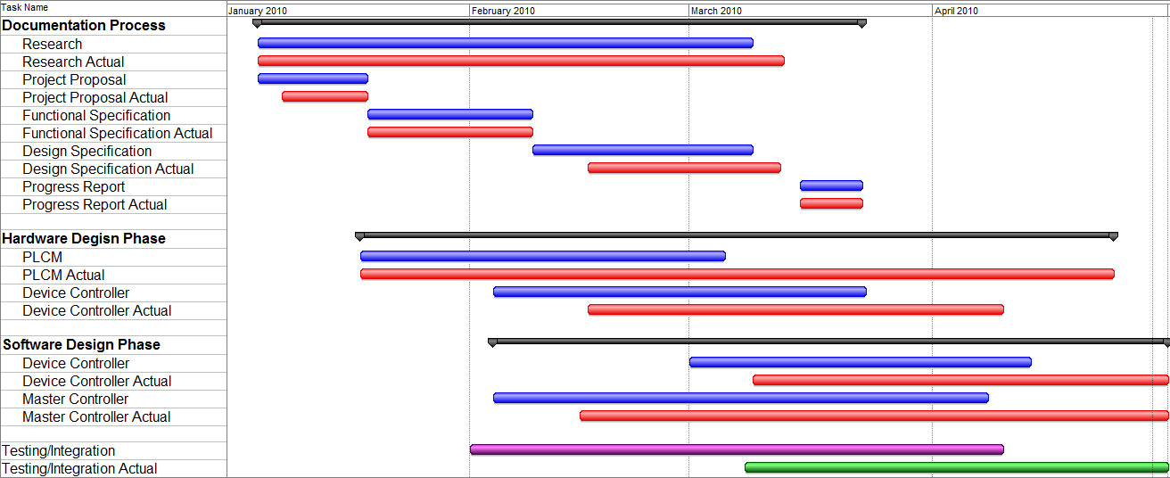
Project Timeline
Introduction and Background
System Overview
PLCM Design
Master / Device Controller Design
Business Aspects
Budget and Financing
Competition
Project Timeline
Summary
Learning Outcomes
Future Improvements
Conclusion/Acknowledgements
Copyright © 2010 Nexus Technologies. All Rights Reserved.

Slide 30
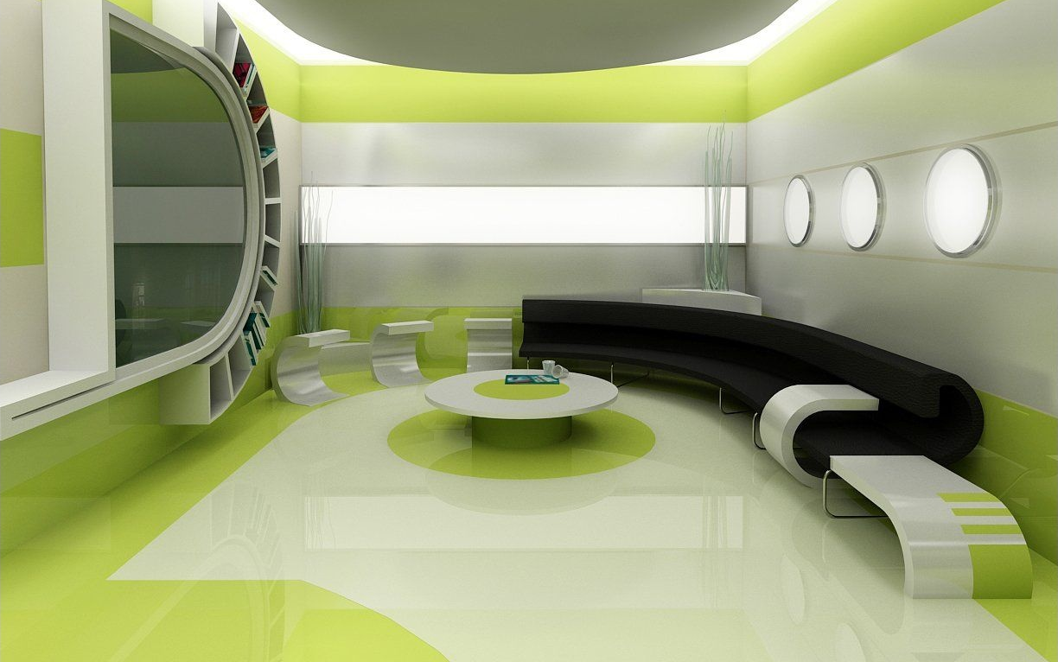
Summary
Copyright © 2010 Nexus Technologies. All Rights Reserved.

Slide 31
Learning Outcomes
Debugging and troubleshooting skills
Team dynamics and professionalism
Project and time management
Research skills
Proper part procurement
Budget management
Importance of project integration
Introduction and Background
System Overview
PLCM Design
Master / Device Controller Design
Business Aspects
Budget and Financing
Competition
Project Timeline
Summary
Learning Outcomes
Future Improvements
Conclusion/Acknowledgements
Copyright © 2010 Nexus Technologies. All Rights Reserved.

Slide 32
Future Improvements
Optimize power consumption and efficiency
Create PCB for the Master/Device Controller
Improve filtering techniques for noise removal
Faster communication speeds
Controllability of more complex devices
Introduction and Background
System Overview
PLCM Design
Master / Device Controller Design
Business Aspects
Budget and Financing
Competition
Project Timeline
Summary
Learning Outcomes
Future Improvements
Conclusion/Acknowledgements
Copyright © 2010 Nexus Technologies. All Rights Reserved.

Slide 33
Conclusion
We were able to create a PLC network
Can send bidirectional data on PLC network
Can control electrical devices on the via web interface
Introduction and Background
System Overview
PLCM Design
Master / Device Controller Design
Business Aspects
Budget and Financing
Competition
Project Timeline
Summary
Learning Outcomes
Future Improvements
Conclusion/Acknowledgements
Copyright © 2010 Nexus Technologies. All Rights Reserved.

Slide 34
Acknowledgements
ESSEF (Funding)
IEEE (Funding)
SFU Engineering Faculty
Dr. Andrew Rawicz
Steve Whitmore
Lakshman (Lucky) One
BCIT Engineering Faculty
Mr. Mark Lane
Mr. Robert Trost
Dr. Ron Jones
Introduction and Background
System Overview
PLCM Design
Master / Device Controller Design
Business Aspects
Budget and Financing
Competition
Project Timeline
Summary
Learning Outcomes
Future Improvements
Conclusion/Acknowledgements
Copyright © 2010 Nexus Technologies. All Rights Reserved.

Slide 35
IMG Source: Deviantart.com
Questions and Answers Session
Copyright © 2010 Nexus Technologies. All Rights Reserved.

Slide 36
Demonstration
Copyright © 2010 Nexus Technologies. All Rights Reserved.

Slide 37
Technical Design Information and Financials
Copyright © 2010 Nexus Technologies. All Rights Reserved.

Slide 38
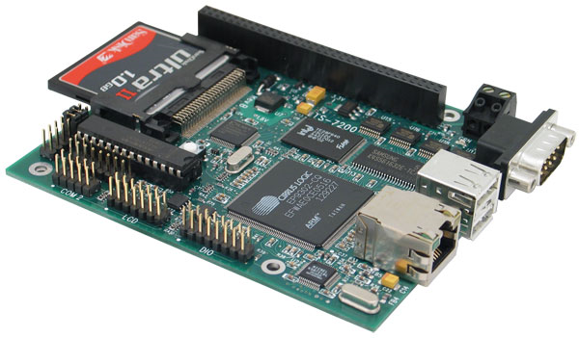
Financials: Prototype Master Controller
Description | Supplier | Quantity | Price | Extended Cost
Master Controller
TS-7200 SBC (ARM9 Processor) | Tecnologic Systems | 1 | $ 228.85 | $ 228.85
Total |  |  |  | $ 228.85
Copyright © 2010 Nexus Technologies. All Rights Reserved.

Slide 39
Financials: Prototype PLCM
Description | Supplier | Quantity | Price | Extended Cost
PLCM
Phase Locked Loop - CD4046 | Texas Instruments | 6 | $ 0.54 | $ 3.24
H-Bridge - L298 | STMicroelectronics | 3 | $ 4.34 | $ 13.02
5V Regulator - LM7805 | Fairchild Semiconductor | 3 | $ 0.60 | $ 1.80
Votlage Feedback Amp - LM6171 | National Semiconductor | 3 | $ 2.83 | $ 8.49
Op Amp - LF356 | National Semiconductor | 15 | $ 1.09 | $ 16.35
Zener Diode (4.7V) - 1N4732 | Fairchild Semiconductor | 3 | $ 0.51 | $ 1.53
General Purpose Diode - 1N4148 | Fairchild Semiconductor | 9 | $ 0.12 | $ 1.08
Fast Acting Fuses - 120V @ 250mA | Cooper/Bussmann | 6 | $ 0.31 | $ 1.86
Inline Fuse Holders 30mm | Cooper/Bussmann | 6 | $ 1.14 | $ 6.84
Pulse Transformers - 10mH | Schurter | 3 | $ 2.74 | $ 8.22
Various Resistors (Lab Stock) | Panasonic | 60 | $ - | $ -
Various Capacitor (Lab Stock | Panasonic | 21 | $ - | $ -
Total |  |  |  | $ 62.43
Copyright © 2010 Nexus Technologies. All Rights Reserved.

Slide 40
Financials: Prototype Device Controller
Description | Supplier | Quantity | Price | Extended Cost
Device Microcontroller
PIC16F877 | Microchip | 2 | $ 6.72 | $ 13.44
Optoisolator Darlington - 4N33836Q | Fairchild Semiconductor | 2 | $ 0.64 | $ 1.28
Switching Transistor - TIP122 | Fairchild Semiconductor | 2 | $ 0.61 | $ 1.22
RS-232 Interface - MAX232 | Maxim | 2 | $ 3.31 | $ 6.62
Crystal Oscillator | ECS | 2 | $ 0.50 | $ 1.00
Relay Socket | N/A | 2 | $ 8.50 | $ 17.00
Relay 12VDC - 5A/250VAC | Song Chuan | 2 | $ 8.50 | $ 17.00
Light Socket - (Free) | N/A | 2 | $ - | $ -
Various Resistors (Lab Stock) | Panasonic | 18 | $ - | $ -
Various Capacitor (Lab Stock) | Panasonic | 12 | $ - | $ -
Total |  |  |  | $ 57.56
Copyright © 2010 Nexus Technologies. All Rights Reserved.

Slide 41
Financials: Prototype High Voltage Chassis
Description | Supplier | Quantity | Price | Extended Cost
High Voltage Enclosure
3 Prong Chassis Plug | Generic Brand | 3 | $ 1.99 | $ 5.97
PCB Terminal Blocks 10 / PKG | Generic Brand | 3 | $ 6.74 | $ 20.22
Metal Chassis | Hammond | 3 | $ 16.98 | $ 50.94
Nylon Standoffs 10 / PKG | Generic Brand | 1 | $ 4.73 | $ 4.73
Prototype Boards | Generic Brand | 1 | $ 8.51 | $ 8.51
Binding Posts - Black/Red Pack | Generic Brand | 3 | $ 4.20 | $ 12.60
Total |  |  |  | $ 102.97
Copyright © 2010 Nexus Technologies. All Rights Reserved.

Slide 42
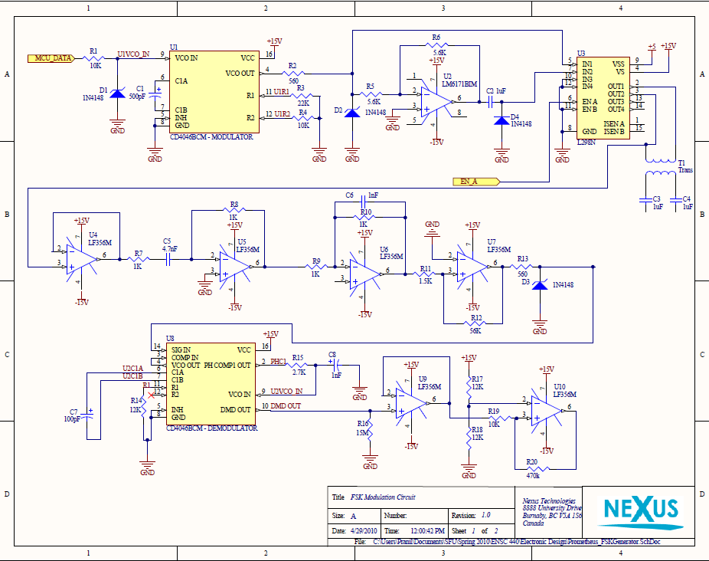
PLCM Circuit Diagram
Copyright © 2010 Nexus Technologies. All Rights Reserved.

Slide 43
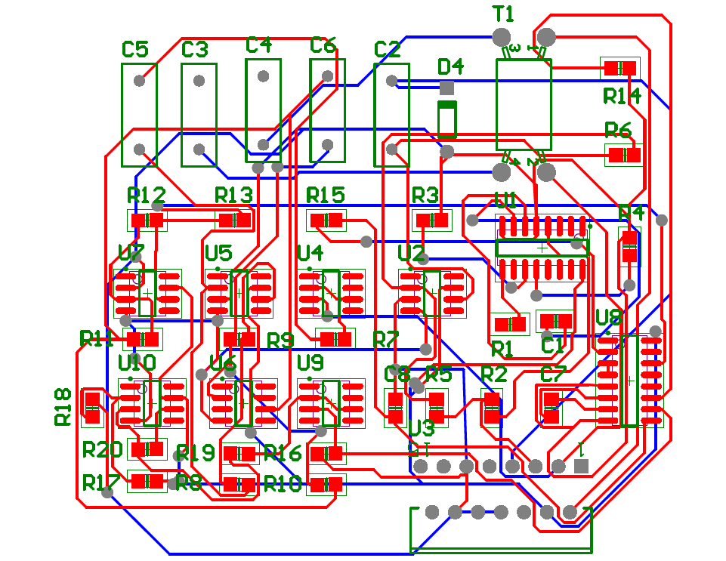
PLCM PCB
Copyright © 2010 Nexus Technologies. All Rights Reserved.

Slide 44
PLCM PCB
Top View
Back View
Copyright © 2010 Nexus Technologies. All Rights Reserved.

Slide 45
Backup Demonstration
Copyright © 2010 Nexus Technologies. All Rights Reserved.

