Slide 1
ENSC 440/305 Presentation
Rollada
Xotro – Group 13
Henry Kam – Chief Executive Officer
Jeff Ip – Chief Creative Officer
Benjamin Chen – Chief Finance Officer
Chuck Lee – Chief Operating Officer
Nathaniel Seung – Chief Technical Officer
April 30, 2010

Slide 2
Table of Contents
Introduction
System Overview
High-level System Design
Market and Consumers
Prototyping and Budget
What We Learned
Team Dynamics
Conclusion/Future Implementations
Acknowledgements & Questions

Slide 3
Introduction
What is a rollator?
  Wheeled walker
  Commonly used for assisting with balance while walking
  Acts as a portable seat
  Optional basket helps carry items

Slide 4
Motivation
Demand for a walking aid for people with balance problems or minor mobility issues
Current rollator designs have only basic mechanical features

Slide 5
Introduction - Problem
The problem with rollators these days:
  Lack of resistance braking
  Self Closing Doors
  Unexpected Obstacle
  Low Visibility Environment

Slide 6
Introduction - Solution
We offer the Rollada as a solution to these problems:
  Dynamic braking to provide resistance on slopes
  Door wheels help hold the door open during passage
  Ultrasonic obstacle sensor detects walls or obstacles
  Lighting system illuminates dark paths and increases night-time visibility

Slide 7
System Overview.
Key features:
  Automatic Braking System
  Sonar System
  LED Lighting System
  Door Bumpers

Slide 8
Automatic Braking System
Senses angle of tilt and changes resistance
Senses speed and brakes if limit is exceeded
Force sensors detects braking force exerted
Adjustable speed limit via turn knob

Slide 9
Obstacle Detection System
Detects objects at a distance (within 5 meters)
Alerts user with beeps accordingly when objects are within 0.5 meter
Feature can be switched off manually

Slide 10
Lighting System
Increases visibility to other road users at night
Lights up the path when environment is dim
Has a manual switch for turning the system off

Slide 11
Door Bumpers
Modified extensions that soften door/wall collisions
Will not leave marks on most surfaces
Can be used to push open doors that are not locked
Useful for doors that have door closers

Slide 12
High-level System Design
Automatic Braking System
  Accelerometer detects tilt
  Microcontroller controls motors to apply corresponding braking resistance
  Force sensors provide feedback control
Obstacle Detection System
  Ultrasonic sensors detects distance from obstacle
  Microcontroller processes information and emits audio when necessary

Slide 13
High-level System Design (cont.)
Lighting System
  Photo-resistor circuit detects ambient light
  Ultra-bright light-emitting diodes illuminates when required

Slide 14
Market and Consumers
Mainly aimed for individuals with minor mobility problems
Potential uses for rehabilitation from injury or surgery
Elderly people with balance issues
Resistance training or anger management

Slide 15
Prototyping
Brackets for motors made from aluminum shaft
Door contacts made using common hardware
Brake pad mechanism fabricated using raw materials and basic tools
Most electronics soldered onto proto-board using plugs for easier maintenance

Slide 16
Prototyping Budget
Proposed costs:
  Electronics and transducers: $319.20
  Hardware: $657.20
  Total: $976.40
Actual costs:
  Electronics and transducers: $390.70
  Hardware: $291.30
  Total: $682.00
Funding received:
  ESSEF: $500.00

Slide 17
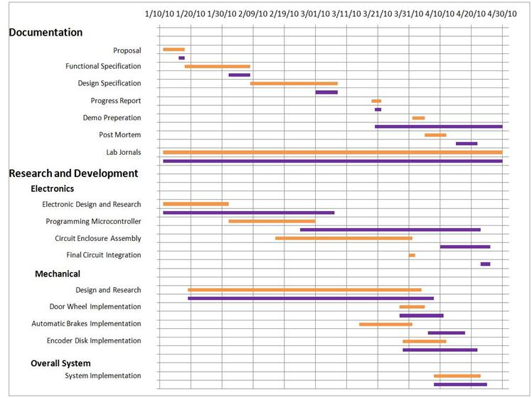

Project Timeline

Slide 18
What we learned
Workshop fabrication skills
Embedded microcontroller programming
Usage of sensors and actuators
Real-time hardware and software debugging
Circuitry design
Leaderships skills and respect for colleagues

Slide 19
Team Dynamics
Work within the group was divided as follows:
CEO (Henry Kam): Oversees the project progress and aids with any issues members encounter
COO (Chuck Lee): Helps manage the group and organize meetings
CCO (Jeff Ip): Uses creative skills and hardware knowledge to develop the project
CFO (Benjamin Chen): Manages finances and the budget for the project
CTO (Nathaniel Seung): Provides technical advice

Slide 20
Conclusion/Future implementations
Improved battery life and performance
Reduce weight
Graphic user interface to display information

Slide 21
Acknowledgements
Instructors:
  Andrew Rawicz, Steve Whitmore, Patrick Leung
TA’s:
  Ali Ostadfar
Support:
  Doug Gayton (GF Strong - Assistive Technology)
  Ian Denison (GF Strong – Equipment Evaluation)
  Century House

Slide 22
Questions?

Slide 23
Hardware - Microcontroller
Atmel Atmega328 @ 16 MHz
16 kb flash memory
1 kb SRAM
Input voltage: 7-12V
USB A to Mini-B Interface connector

Slide 24
Hardware – Sonar scanners
DFRobot URM V3.2 Ultrasonic Sensor
Input Voltage: 5V
Minimum distance: 4 cm
Maximum distance: 500 cm
Resolution: 1 cm

Slide 25
Hardware – Motor Driver
EasyDriver Stepper Motor Driver
A3967 microstepping driver chip
Adjustable current control: 150 mA/phase to 750 mA/phase
Input voltage: 7V – 30V

Slide 26
Hardware –Accelerometer
Memsic 2125 Dual-axis accelerometer
Measures +/- 3 g on each axis
100 Hz PWM output signal
Input voltage: 3.3 – 5V

Slide 27
Hardware - Force Sensitive Resistors
Interlink 0.2” Circular Force Sensitive Resistor
Force sensitivity range: <100 g to >10 kg
Force resolution: Better than 0.5% full scale
Break force (turn-on force): 20 g to 100 g
Device rise time: 1-2 ms
Lifetime: >10 million actuations

Slide 28
Hardware – Linear Stepper Actuators.
Bipolar stepping
Operating voltage: 2.33V – 12V
Weight: 241 g
Power consumption: 7W
Current/phase: 290 mA to 1.5 A
Exerts up to 50 lbs

Slide 29
Software - Arduino
Arduino programming language
Programming language based on C/C++
Sequential coding within a main loop
Programmed using Arduino IDE:
  Force Sensitive Resistors
  Motor Drivers
  Obstacle Sensors
  Encoders
  Accelerometer

