Slide 1

Biomedical Monitoring System
Presentation for ENSC 440/305
Instructors: Dr. Andrew Rawicz, Steve Whitmore
Department of Engineering Science
Simon Fraser University
Biomedical Embedded Systems Technology

Slide 2

Outline
Team Members
Motivation
System Overview
Hardware
Software
Budget
Business Plan
Scheduling
Problems Encountered
Future Extensions
Questions

Slide 3
Team Members
Alireza Rahbar (CEO)
Farzad Abasi (CTO)
Sam Sayfollahi (VP of Marketing)
Parna Niksirat (VP of Operation)
Shaghayegh Hosseinpour (VP of R&D)

Slide 4
Motivation
28.5 % of all death in U.S. are caused by cardiovascular diseases in 2002
  World Health Organization
In 2006, heart disease was the leading cause of death in U.S.
  American Heart Association
Every minute CVD cause one death in U.S. American Heart Association

Slide 5
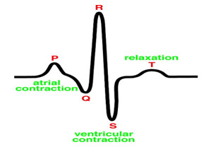
Electrocardiogram (ECG)
Analyzing the heartbeat
Measure, amplify and record the natural electrical potential created by the heart
ECG Signal Bandwidth: o.5Hz ~ 100 Hz
ECG Signal Amplitude:~1mV

Slide 6
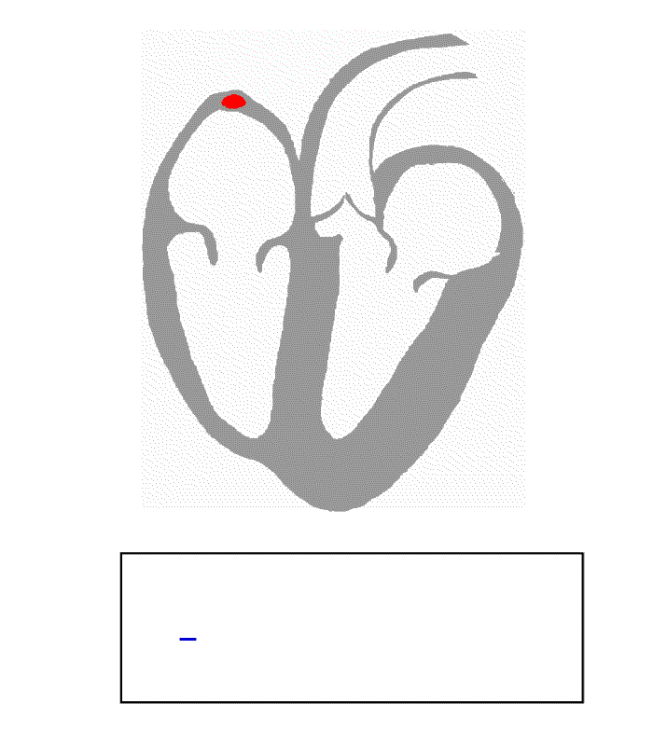
Electrocardiogram (ECG)

Slide 7
Our Design
Non-invasive and mobile
Monitoring result is transferable to medical professionals
Affordable

Slide 8
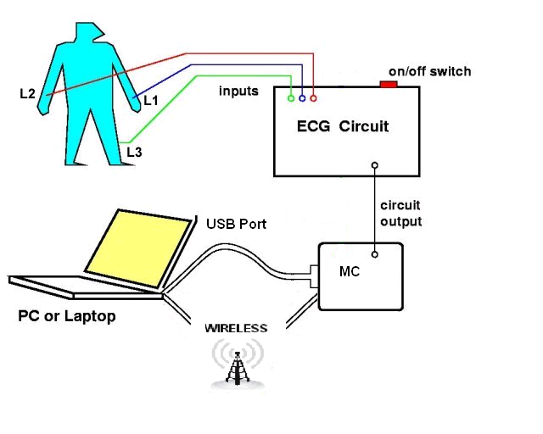
System Overview

Slide 9
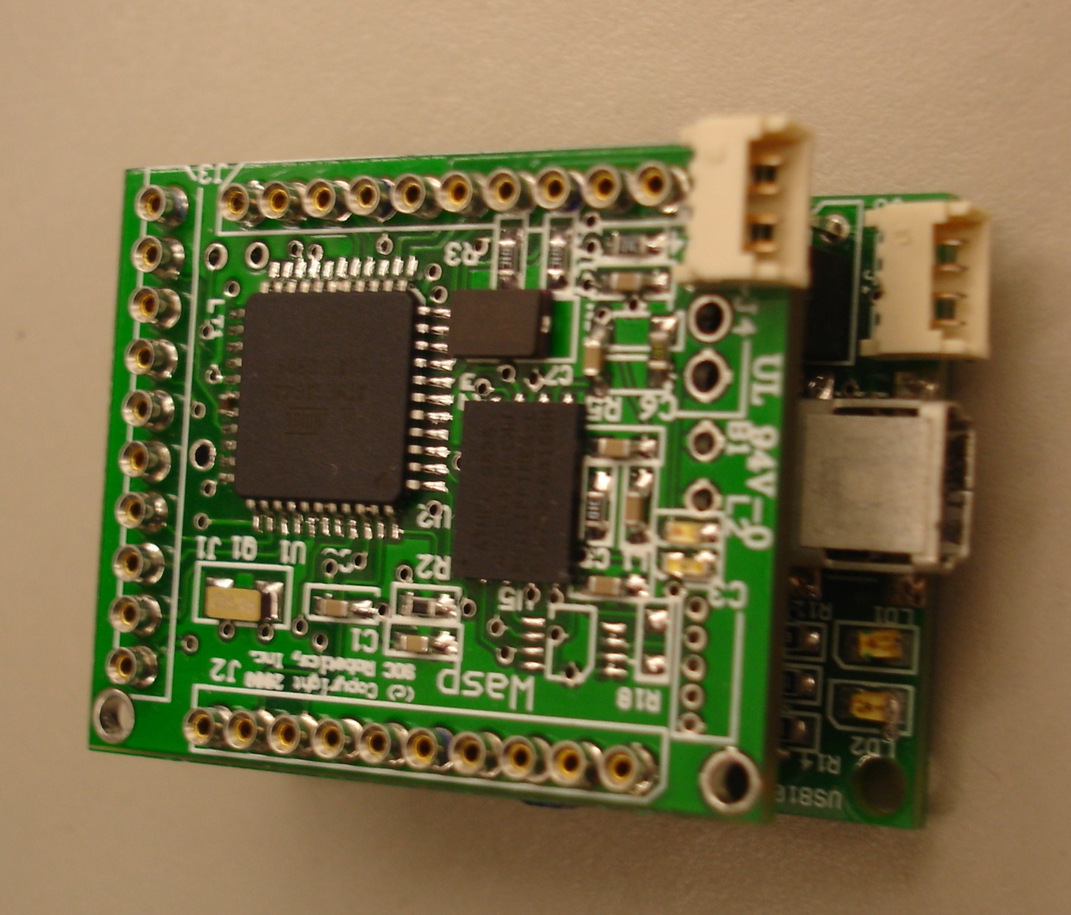
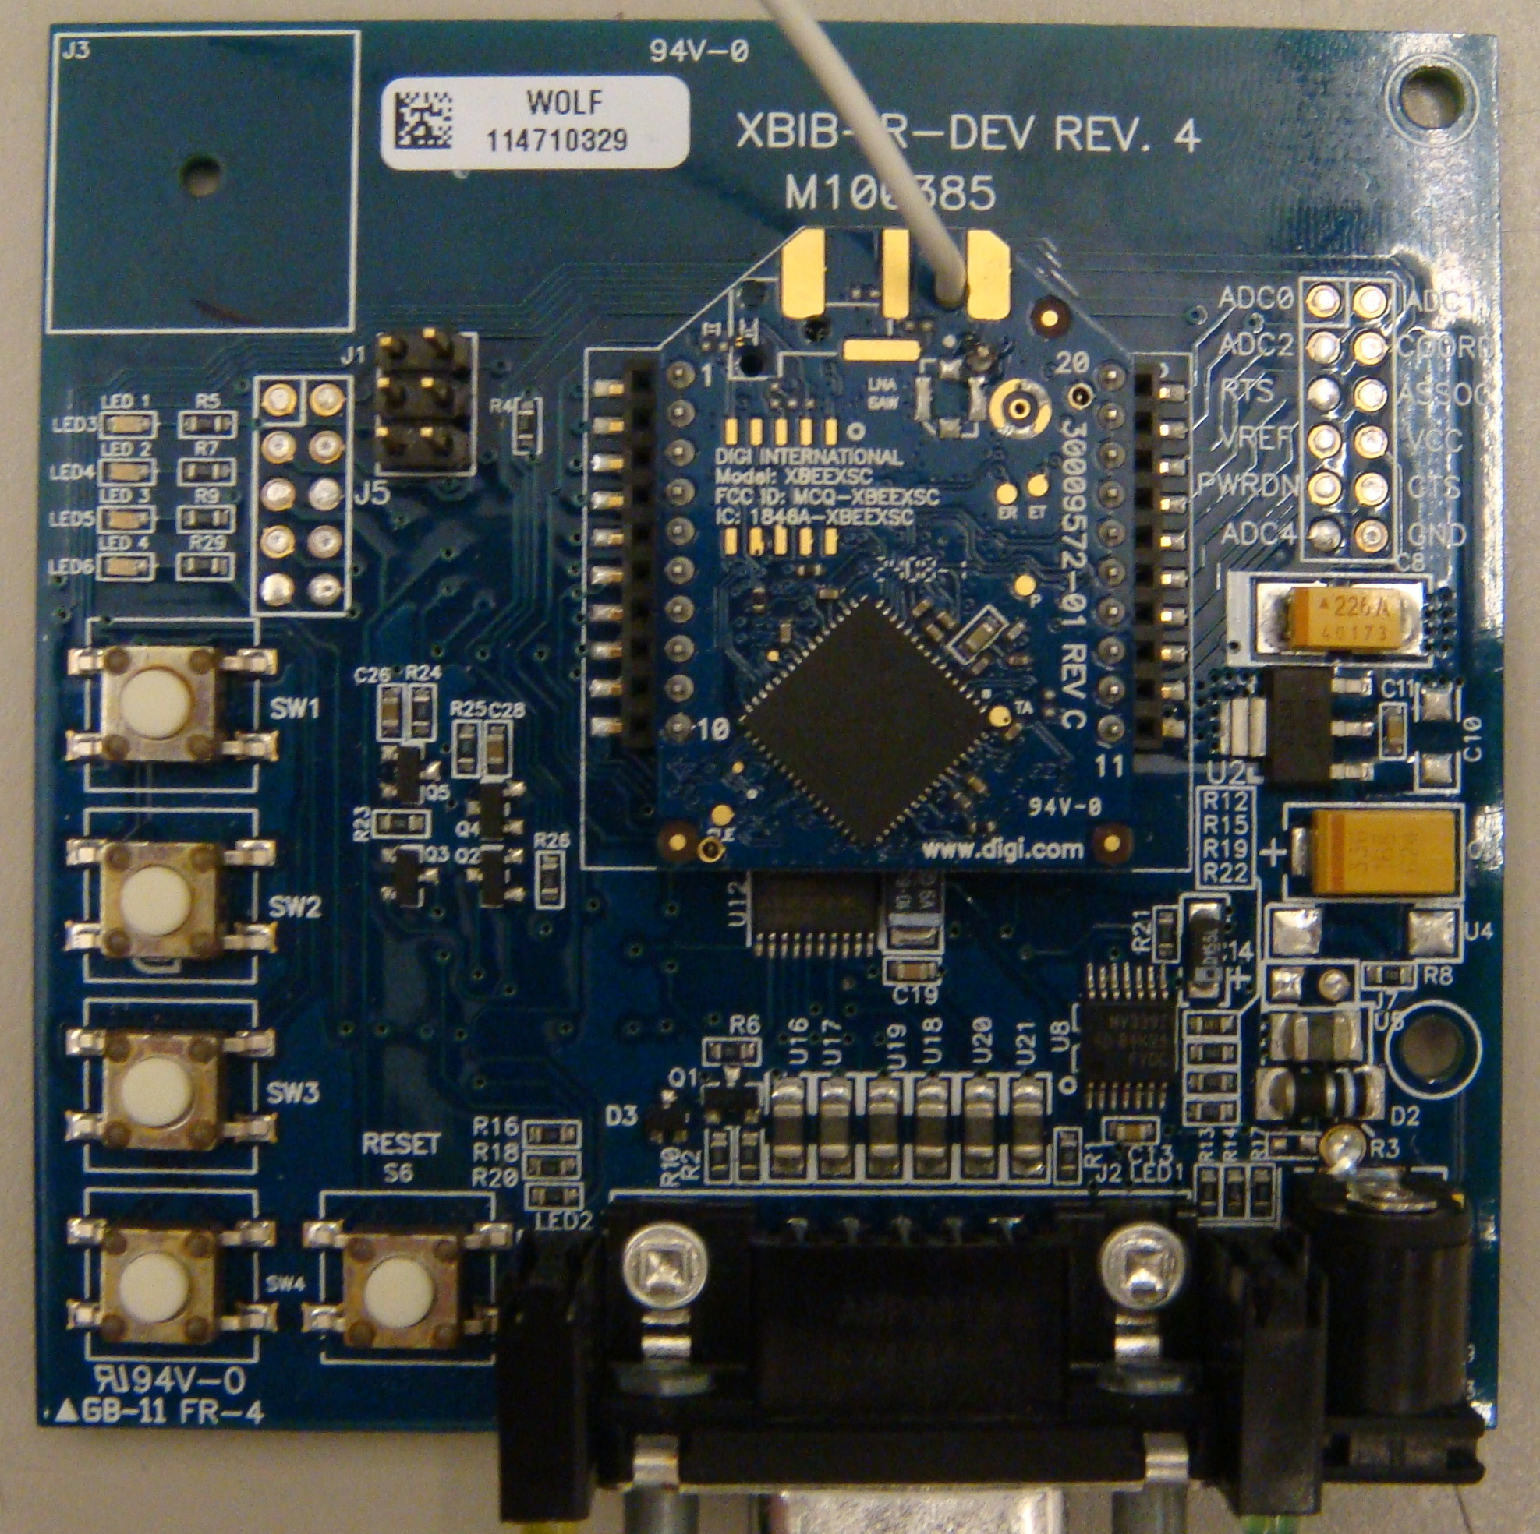
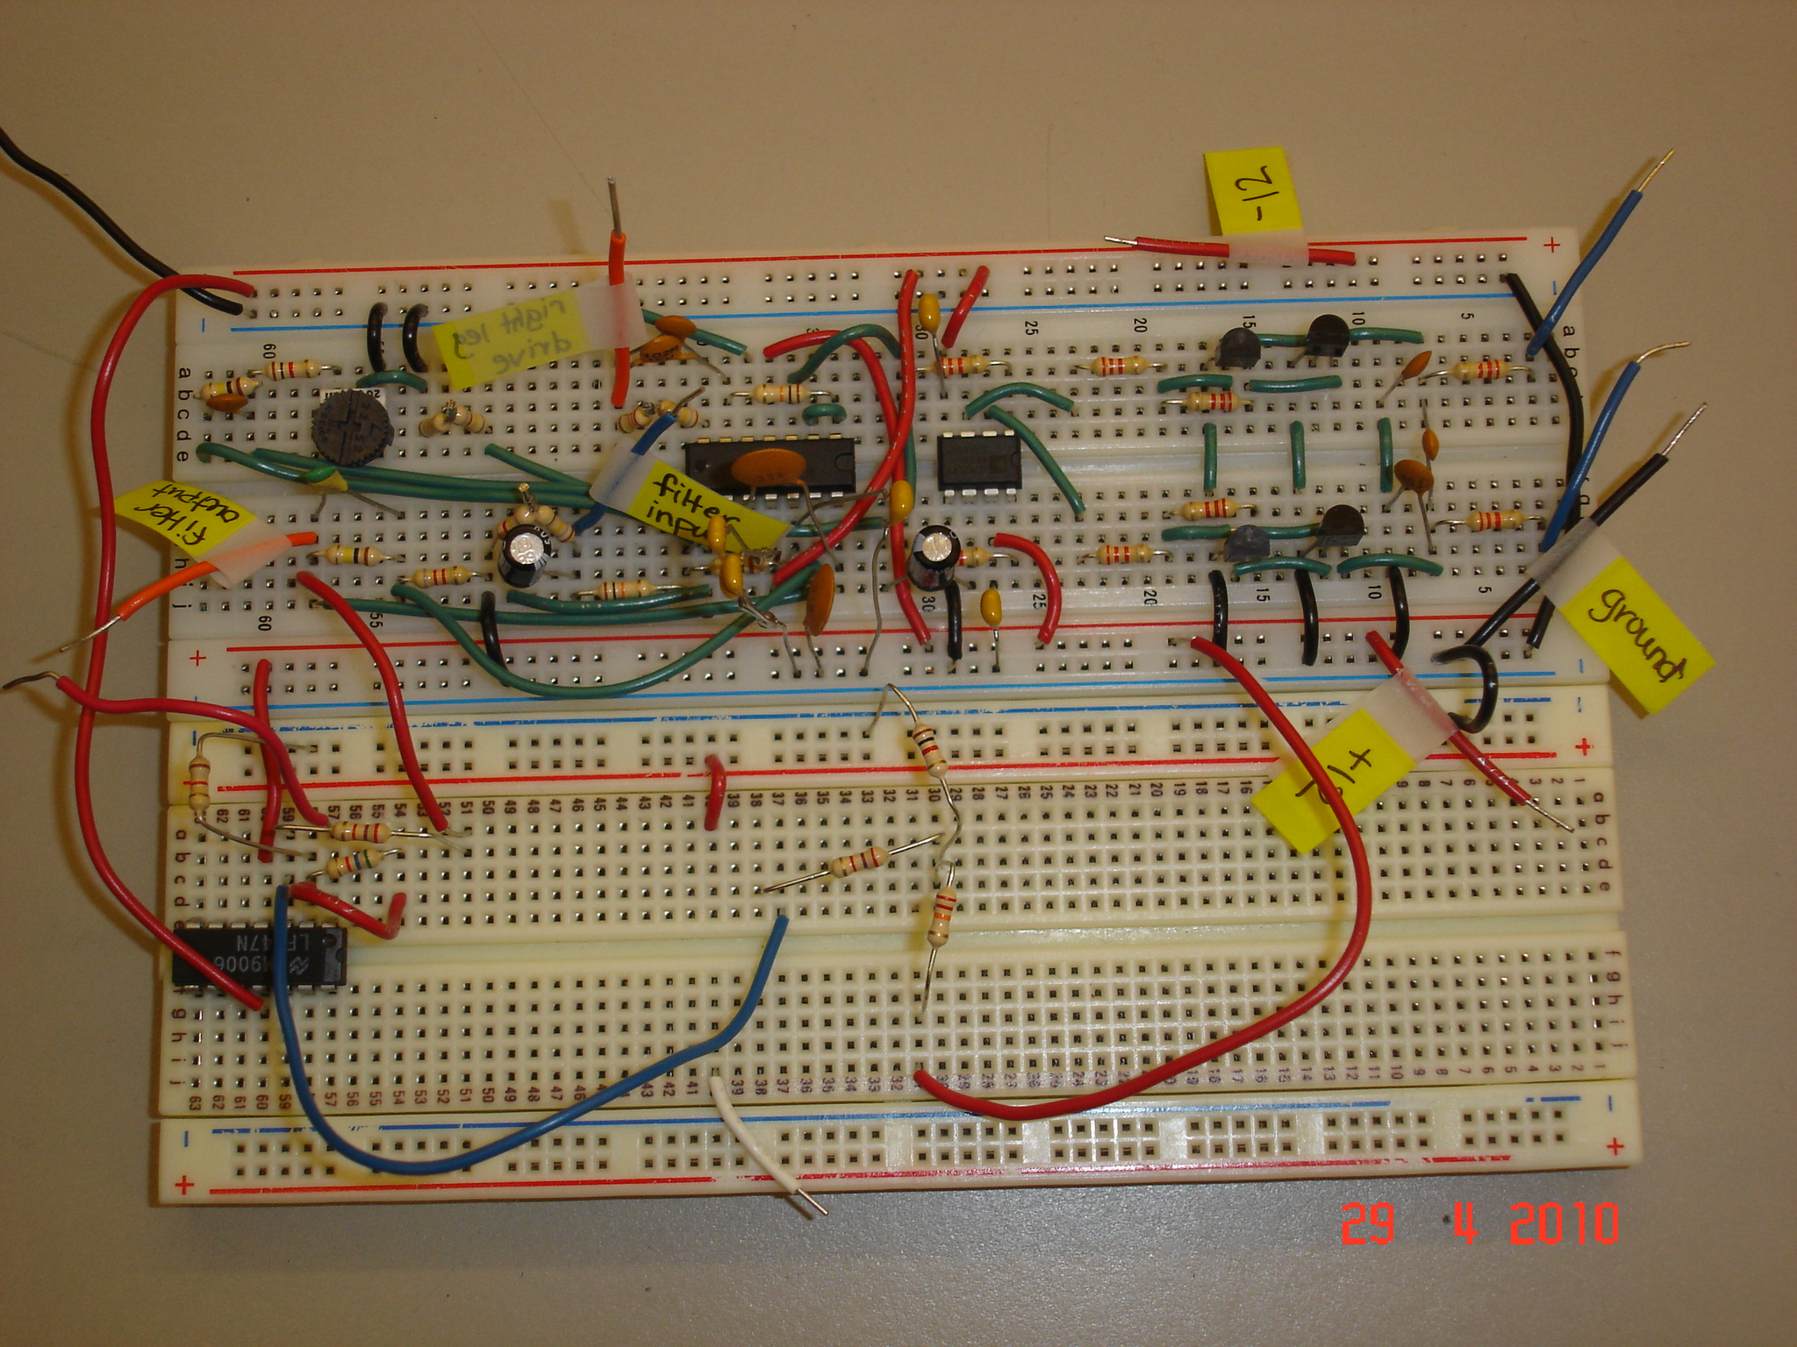
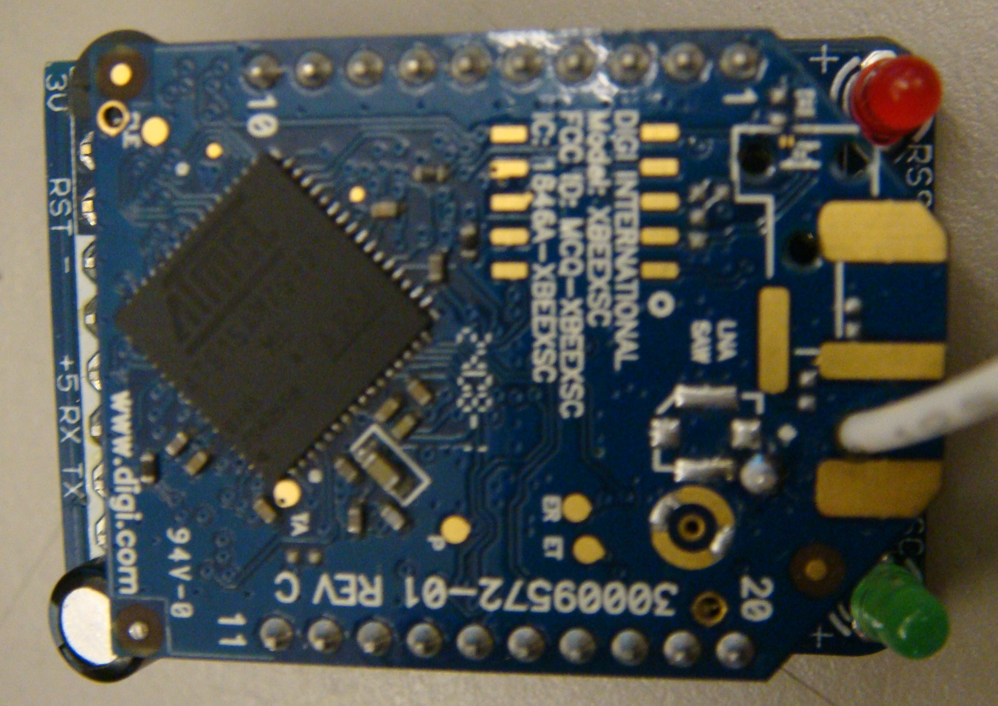
Hardware Overview

Slide 10
Hardware- ECG Circuit

Slide 11
ECG Circuit-Block Diagram
INPUTS
(Right & Left Hand Signals)
DIFFERENTIAL AMPLIFIER
(AD620)
PROTECTION
CIRCUIT
NOISE FILTERING & AMPLIFICATION
RIGHT LEG
DRIVE
OUTPUT

Slide 12
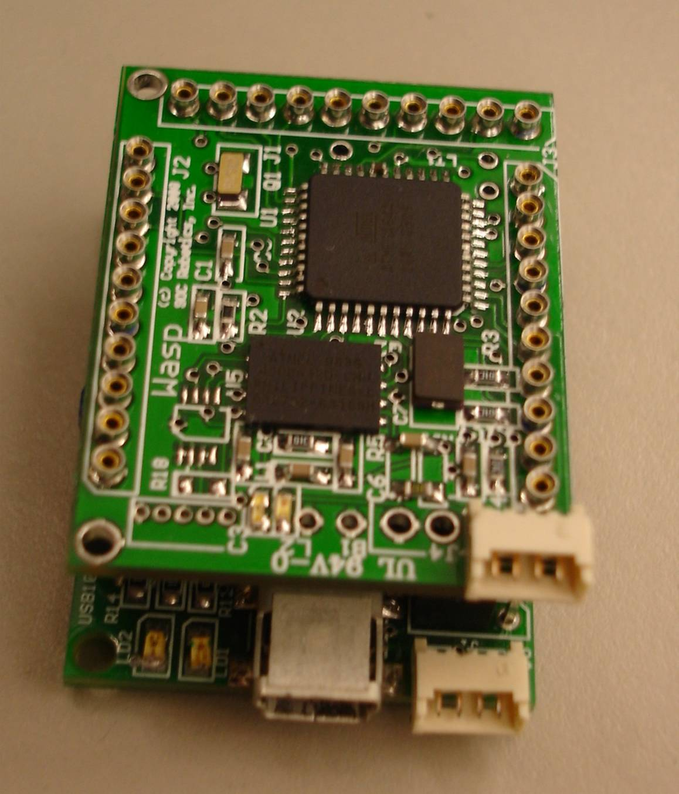
Hardware- Microcontroller
8bit RISC AVR Processor (A T mega644)
10MHz External crystal oscillator
8 digit to analog (ADD) 10 bit resolution
15 Digital Input/Output
UART interface
64K Internal Program Flash
2K Internal EEPROM
4K Internal SRAM
8 MB External Serial Flash: Suitable to save acquired data from sensor

Slide 13
Hardware- Wireless
Power Output: 100 mW (20 dBm)
Indoor/Urban range: Up to 1200 ft(370m)
Outdoor/RF line-of-sight range: up to 15 miles (24 km)
Receiver sensitivity: -106 dBm
RF data rate: 9.6 Kbps
Supply Voltage: 3-3.6 VDC
Frequency Band: 910-918 MHz

Slide 14
Software Overview
Graphical User Interface (GUI)
Wireless Module
Data Acquisition System
On-Board Flash Memory

Slide 15
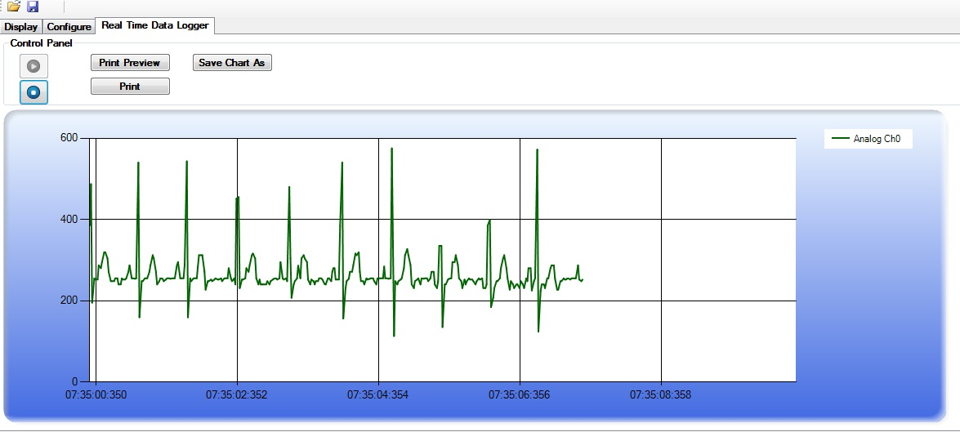
GUI

Slide 16
Software Overview
16
Graphical User Interface (GUI)
Wireless Module
Data Acquisition System
On-Board Flash Memory

Slide 17
Wireless
Acquire data from micro-controller
Send data to receiver
Receive data
Communicate with GUI

Slide 18


Slide 19
Business Plan
Estimated Cost For Mass Production:
Subsystem Estimated
Micro-Controller $15
Wireless Module-Dash7 VIII (Biomedical) $5
PCB $3
Total Cost $23

Slide 20
Proposed and Actual
Budget
Subsystem Estimated Actual
Micro-controller $40 $107
Daughter board module for USB connection $40 $66
Connector module for micro-controller and related wires $10 Borrowed
Heart beat sensor (ECG) leads and wires $250 Borrowed
Wireless (transmitter and receiver) $100 $100
Shipping costs $40 $20
Parallel port to USB converter $20 $10
ECG circuit parts $50 $180
Total cost $550 $483

Slide 21
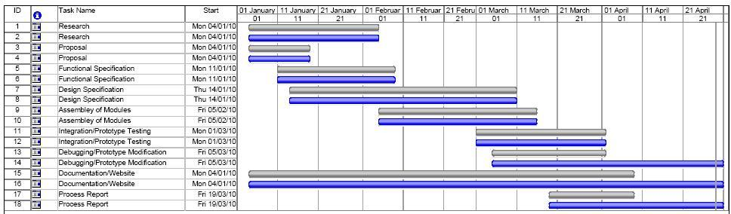
Schedule
Blue Line : Actual Time
Gray Line : Estimated Time

Slide 22
Problems Encountered
Micro-Controller Communication Problems
  Synchronization of data
Wireless Communication problem
  One UART port available
Graphical User Interface (GUI)
  CPU Usage
  Slow-motion graphing
ECG Circuit and Noise
  Noise reduction
  Differentiation

Slide 23
Future Extensions
Making the device more user-friendly and practical by using:
Printed Circuit Board (PCB) instead of breadboard
Bluetooth transmission instead of Xbee module
Additional electrodes
More efficient wireless module (Dash7)

Slide 24
Conclusion
Portable ECG monitoring device
  Wireless functionality
  USB Connectivity
  On-Board Flash Memory
  Custom ECG circuit
  Graphical User Interface (GUI)
Importance of team work & collaboration
Problem Solving

Slide 25
Thanks to
Dr. Andrew Rawicz
Steve Whitmore
Dr. Lucky One
Engineering Student Society
Dr. MehdiMoradi
Dr. Ash Parameswaran
Steve Swift
Ali Ostadfar
Sara Moghaddamjoo
Arash Ahmadi

Slide 26


Questions

