Slide 1
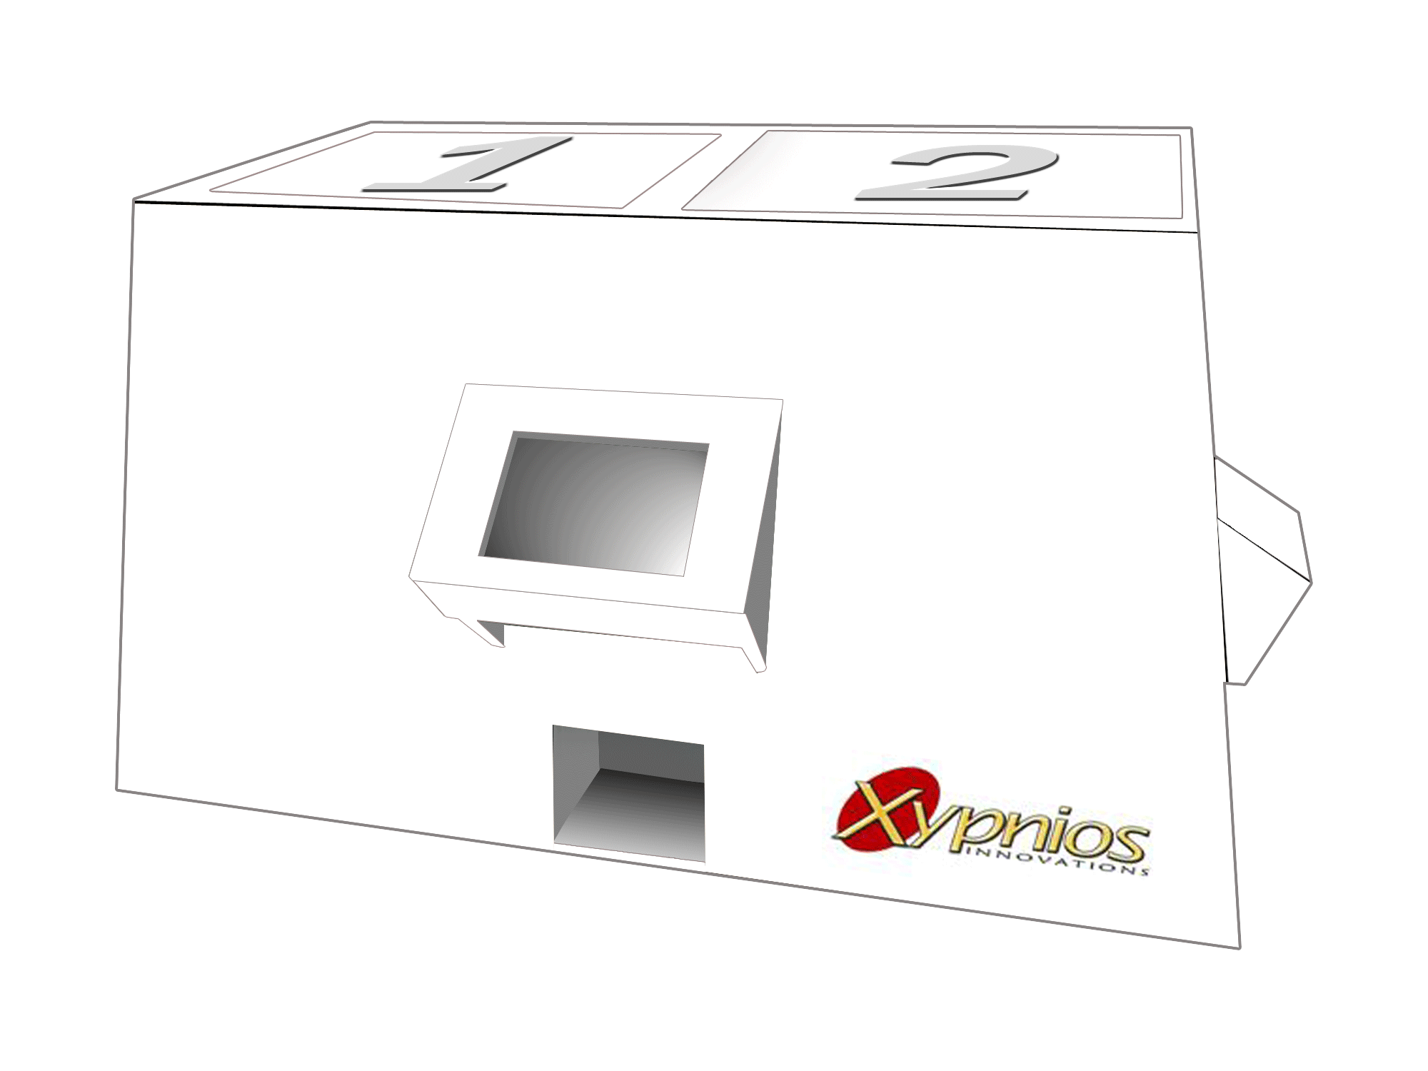
Dispensalert
Medicine Dispensing Alert System

Slide 2
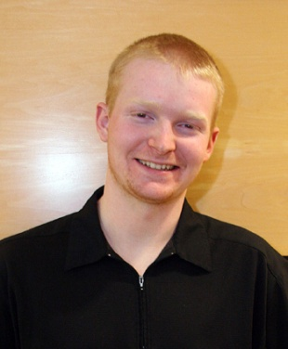
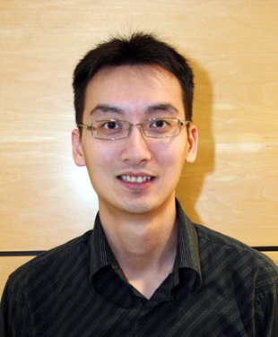
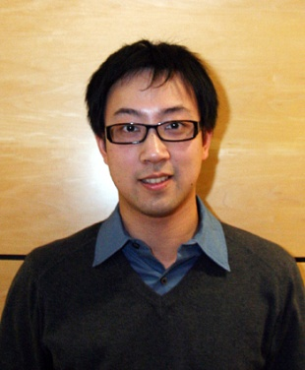
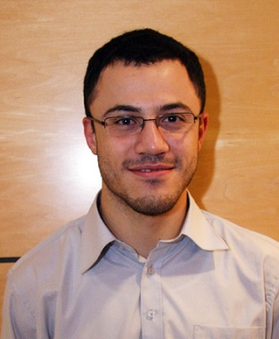
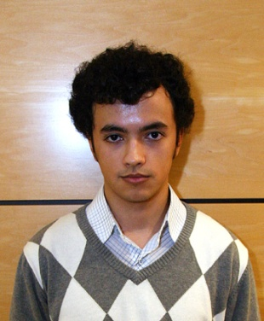
The Xypnios Team
Ryan Laing
Chief Executive Officer
Steven Horita
Chief Technical Officer
Joseph Liu
Chief Operations Officer
Gary Chiang
Chief Financial Officer
Mohammad Abu-Laila
Chief Science Officer
Trevor McCauley
Chief Marketing Officer
Notes:
Ryan Speaking:
Ryan: Chief Executive Officer
Steven: Chief Technical Officer
Joseph: Chief Operations Officer
Gary: Chief Financial Officer
Mo: Chief Science Officer
Trevor: Chief Marketing Officer

Slide 3
Outline
Introduction
System Overview
System Design
Market Analysis
Timeline and Budget
Future Development
Team Dynamics
Conclusion
Acknowledgements
Questions
Notes:
Ryan Speaking
Presenters:
Intro – Ryan; System Overview – ;System Design - ; Market Analysis - ; Timeline and Budget - ; Future Development - Steven; Team Dynamics - Steven; Conclusion – Ryan; Acknowledgements – Ryan;
Questions – No One;

Slide 4
Outline
Introduction
System Overview
System Design
Market Analysis
Timeline and Budget
Future Development
Team Dynamics
Conclusion
Acknowledgements
Questions
Notes:
Ryan Presenting.

Slide 5
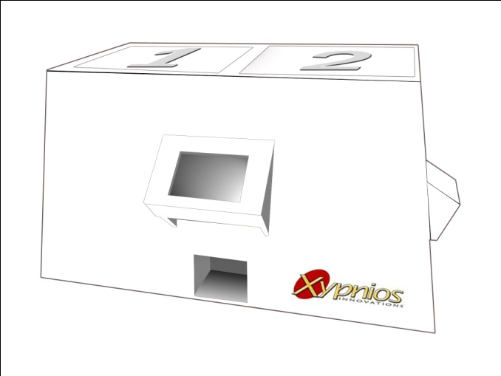
Introduction
Electromechanical device
Two Units
Main (Dispenser)
Wristband (Reminder)
Audible reminders
Force feedback reminders
Dispense medicine in a timely manner
Prevent over-medication
Prevent under-medication
Notes:
DispensAlert is an Electromechanical device which dispenses and alerts the user for all their medication needs. It is seperated into two devices, the main unit which holds and dispenses medications for the user. This prototype can contain up to two different types of medication. The wrist unit holds the times that medication is to be dispensed and uses audible and force feedback reminders for when the user needs to take medication. This system is made to help prevent over- and under-medication of the user.

Slide 6
Motivation
Canada’s Aging population
14% over 65
20% by 2021
87% on at least one medication
90% with age-related memory decline
Benefits elderly individuals
Increase independence
Maintain Health
Notes:
Our reasons for choosing this project are humanitarian in nature. The canadian population is aging and will continue to do so for years to come. As you can see from these numbers many elderly people take medications on a daily basis, beyond that, many of the elderly also have some level of memory decline. This device will help them remember to take the correct amount of medication at the right times. This will help to improve the standard of living of all the individuals who choose to use our device.

Slide 7
Outline
Introduction
System Overview
System Design
Market Analysis
Timeline and Budget
Future Development
Team Dynamics
Conclusion
Acknowledgements
Questions
Notes:
Ryan pass focus to Joseph who will cover system overview, and some of the hardware components of the main unit.

Slide 8
System Overview
Notes:
Here you can see the general system overview.
On the left you can see the main unit, the central part of the main unit is microcontroller which controls the barcode scanner, the touch screen, the mechanical system and the wireless transmitter. The transmissions from the main unit are then received by the wristband unit, which can be seen on the right. The wristband unit is also run by a microcontroller, which is connected to the wireless receiver and the sound and vibration devices.

Slide 9
Outline
Introduction
System Overview
System Design
Market Analysis
Timeline and Budget
Future Development
Team Dynamics
Conclusion
Acknowledgements
Questions
Notes:
Now we will delve into the system design.

Slide 10
Main Unit - MCU
LPC2148 MCU
512kB of memory
Barcode scanner (UART1)
Wireless transmitter (UART1)
GPIO pins for stepper motors
Touch screen display (UART0)
+5V power
Notes:
This slide shows the microcontroller unit of the main device. When choosing a micro controller we knew that we needed a device which could support multiple serial connections, which has a significant amount of memory, and was still relatively low power. In the end we chose LPC2148, which runs an ARM7 processor. As you can see from image shown we have connected the touch screen to UART zero, the barcode scanner and the wireless transmitter to UART one and the stepper motors to the general purpose IO pins.

Slide 11
Main Unit – Touch Screen
ezLCD-002 Touch Screen Display
240 by 160 pixels, 512 color LCD
Touch screen
Communication using RS-232
protocol
Built in commands for ease of use
Received data is easy to process
1MB+ of memory for storing bitmaps
and fonts
Notes:
This slide shows the touch screen that we chose for the main device. This particular screen was chosen for its high resolution despite its small size as well as the large number of colours which allows us to have a bright, professional, easily legible display. It communicates serially with the microcontroller that you saw on the previous slide. The device also contains all the storage of the bitmaps displayed on the screen which we used to create the graphical user interface. The GUI will be explained in further detail now by Moh.

Slide 12
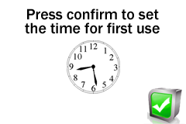
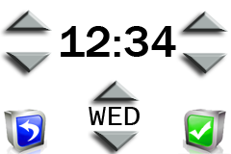
Main Unit - GUI
First time use
Notes:
The graphical user interface of the main unit is the primary means of communication between the user and the device. When the main unit is first turned on the touchscreen will display a company splashscreen. From there a screen asks you to confirm that you will be entering the current time. Beyond that screen you reach a display which allows you to set the current time. This step is necessary due to the fact that dispensing medications at the right time is based entirely on knowing the current time.

Slide 13
Main Unit - GUI
Main menu
12:34
Notes:
Once the current time has been set, you see the main menu. From this menu you are able to go to the settings menu which allows you to change the current time and date. You are also able go to the medicine menu.

Slide 14
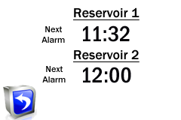
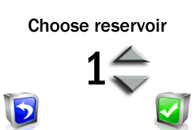
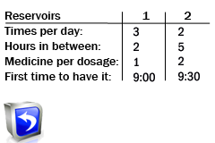
Main Unit - GUI
Medicine menu
Notes:
Once in the medicine menu, you are able to perform four functions. The first function simply displays the next alarm times for each of the two reservoirs. The second button performs a listing function. It allows you to see all information about the medications that have already been added. The next icon is to delete the information which has been entered about a particular medication. The final icon allows you enter a new medication. Within this menu, there are two options.

Slide 15
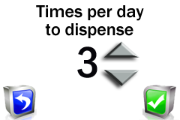
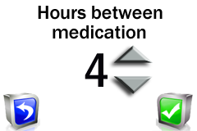
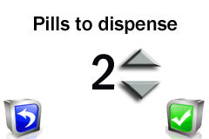
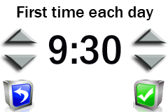
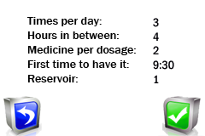
Main Unit - GUI
Manual method
Notes:
The first of the two options is to manually enter all the information. The user is prompted to enter each item of information in a sequence of screens. The first item is the reservoir that the medication has been loaded into, this has a maximum of 2. The next three screens are basic medication information. They are the number of times per day that medication should be dispensed, the hours in between dispensations of medication and the numbers of pills to be dispensed each time. Each of these has a maximum value of nine. The penultimate screen allows you to enter the first time that medication should be dispensed each day. Finally we have a review page which allows the user to make sure that all information entered is correct.

Slide 16
Main Unit - GUI
Barcode method
Notes:
The second method of entering the medication information is the barcode method. This method uses the scanning of a barcode to automatically enter the basic medication information, allowing the user to skip several steps of the manual method. Again you must enter the reservoir and the first time medication should be dispensed. Finally again you get a review page to verify that it is the correct information. At this moment these barcodes are not implemented on existing medication. However, the implementation would be fairly easy assuming we got it approved.

Slide 17
Main Unit – Barcode Scanner
IMAGETEAM 4410 2D Series Barcode Scanner
Communicates using RS-232 protocol
Serially triggered
Reads/decodes 2D barcodes (Aztec)
3
2
1
D
A
Times per day to dispense
Pills to dispense
Hours between medication
Special characters to make barcode unique
Notes:
The barcode scanner that we have used is our project is a serial communication scanner. It sends the data to the microcontroller as well as receiveing commands which allows us to turn the scanner on and off through the programming of the device. The type of barcodes that we scan are two dimensional aztec barcodes. The information is encoded as three single digit numbers followed by the letters D and A as a safety protocol so we only recognize our own barcodes. Now, to talk about the wireless communication and the running of the wristband unit is Trevor.

Slide 18
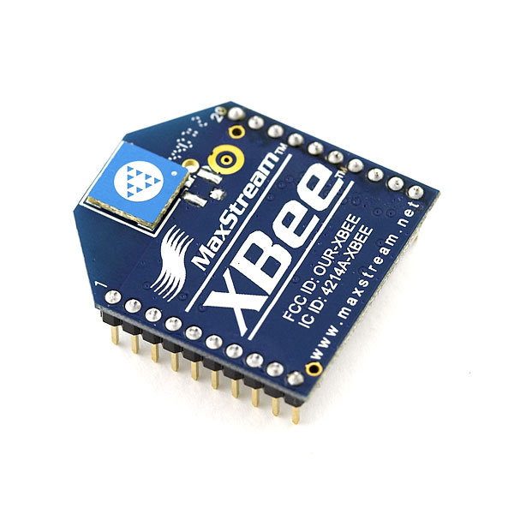
XBee™ RF Modules
Specifications
2.4 GHz frequency band
IEEE 802.15.4 standard
serial communications
error checking algorithm
Acts as a invisible wire between the two units
Notes:
Thank you Mohammad
In order to facilitate the wireless communication, we used two Xbee RF modules. These require a supply voltage of 3.3V which is provided from our 5V source and stepped down with a linear regulator. This model adheres to the IEEE 802.15.4 standard which defines the standard for the physical and media access control layers for low-rate personal area networks.
The main reason we selected this model was because it is designed for serial communication and has its own error checking algorithm.
Essentially this acts like an invisible wire that allows for the synchronization of data between the main unit and wristband unit whenever the data is modified
The output that comes out of switching circuit is 0V – 5V due to the TTL logic. This voltage level is stepped down through a voltage divide such that the Xbee RF module receives 0 – 3.3V inputs. On the wristband side, the received data is upscaled to true RS232 voltage levels to be compatible with the wristband MCU board

Slide 19
Wristband Unit - MCU
16kB FLASH
512B EEPROM
1kB SRAM
LCD
Joystick
UART
Piezo-element
ATmega169 MCU
PORT B
3V Coin Cell
Vcc
GND
32KHz Oscillator
Notes:
Here you can see a diagram of the development board found inside the wristband unit. The AVR Butterfly Evaluation board was chosen because it contains many of the peripherals that we wanted to use in our project. The board implements the 8-bit ATmega169 microcontroller by Atmel with 16kB of flash rom and 1kB of system memory. As for the peripherals, we use the built-in piezo-element and LCD to generate alerts, the UART to interface with the wireless transceiver and the built in joystick to manipulate the current state within the menu.

Slide 20
Wristband Unit - GUI
X
X
X
X
X
Notes:
This is a diagram of the state machine implemented within the wristband unit and seen to the right is the mapping of the joystick with the X representing pressing enter (pushing the button inwards). When the wristband first powers on, the user is presented with the current time. From there, by pushing the joystick in the indicated direction, they can either quickly see how long till the next alarm, change the clock format from 24 hour to 12 hour or go into the main menu. As you can see, in the main menu the user can enter any of the other wristband functions like adjusting the contrast on the LCD or entering power save mode. To clarify, in power save mode the device is placed in a lower power state where the LCD is turned off.
The only state that cannot be entered manually is the alert state. The alert state is entered when the alarm timer reaches zero. This will occur regardless of the current state that the device is in and that includes if the wristband is in power save mode. In the alert state, the vibrator and piezo element are triggered as well as a message indicating which medication the alarm is for. The user can dismiss the alarm by pressing enter (pushing down) on the joystick. When the alarm is cleared, a snooze alarm is automatically set to go off 5 minutes later, ensuring that the user is reminded to go back to the main unit to receive their medication. This snooze alarm will continue to go off every 5 minutes for the following half an hour or until they dispense or dismiss their medication at the main unit.

Slide 21
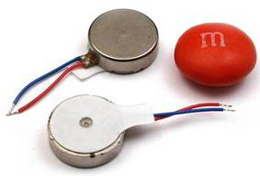
Wristband Unit - Vibrator
VPM2 Vibrating Disk Motor
No loose components
Low power
Very compact
Inexpensive
Notes:
We choose the VPM2 Vibrating Disk Motor from Solarbotics.com because it was low power, inexpensive and very small by comparison to other vibrating motors
I will now pass things onto my colleague Joseph who will tell you a little about the mechanical system implemented on the main unit
power (actuating at 2.5V-3.5V @70mA),

Slide 22
Wristband Unit – Piezo Element
Driven by PB5 on MCU
Two bytes of data per tone
First byte gives length of tone
Second byte gives frequency of tone
Uses Timer0 and Timer1
Timer0
Controls tempo and length of each tone
Timer1
Generates PWM signals to make frequency of tone
Notes:
The piezo element on the Butterfly is physically connected to Pin 5 on Port B. In our code, we define a tone by first giving the length or duration of the tone (controlled by the 8-bit timer 0) followed by the frequency of that tone (in the form of a pulse width modulated signal generated by the 16-bit timer 1). Implementation of sound on this evaluation board is made easy because the pin is physically attached to the element, and also, the pulse width modulated output of timer 1 is hard wired to that pin.
Now my colleague Gary will take you through the mechanical system implemented in the main unit.

Slide 23
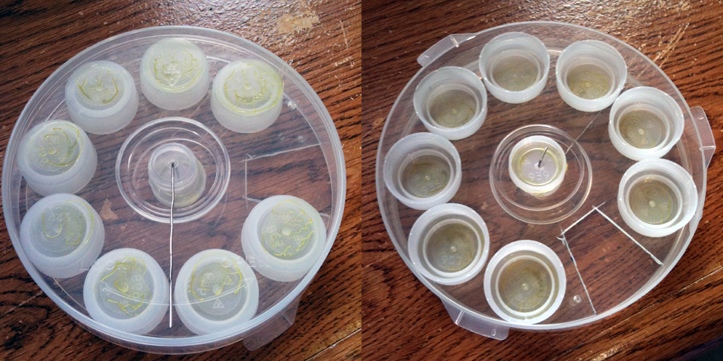
Main Unit – Mechanical System
Custom-made Cartridges
Replace traditional pill bottles
Pharmacy filled cartridge
Easy storage and re-usable

Slide 24
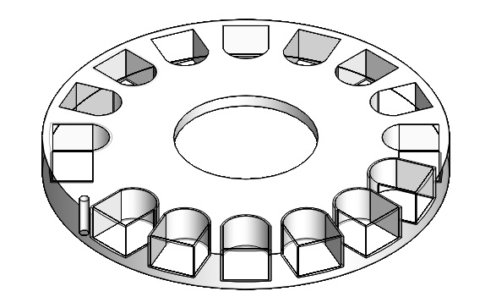
Main Unit – Mechanical System
Custom-made Cartridges continued
Variable sizes/number of compartments
Rotatable bottom opening
Attach to stepper motor

Slide 25
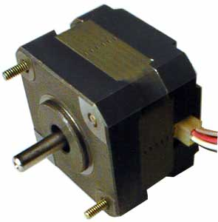
Main Unit – Mechanical System
2-Phase Stepper Motor
Operates under 5.16 V and 1.2 A
Fine incremental angular displacements
Increments of 1.8 degrees and 200 steps per revolution
Allows for maximum control for dispensing mechanism

Slide 26
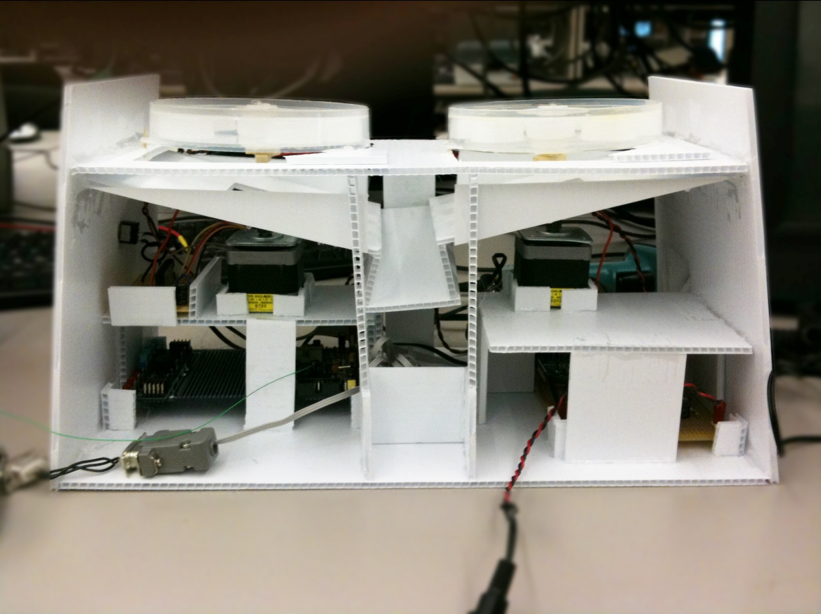
Main Unit – Mechanical System
Dispensing Mechanism

Slide 27
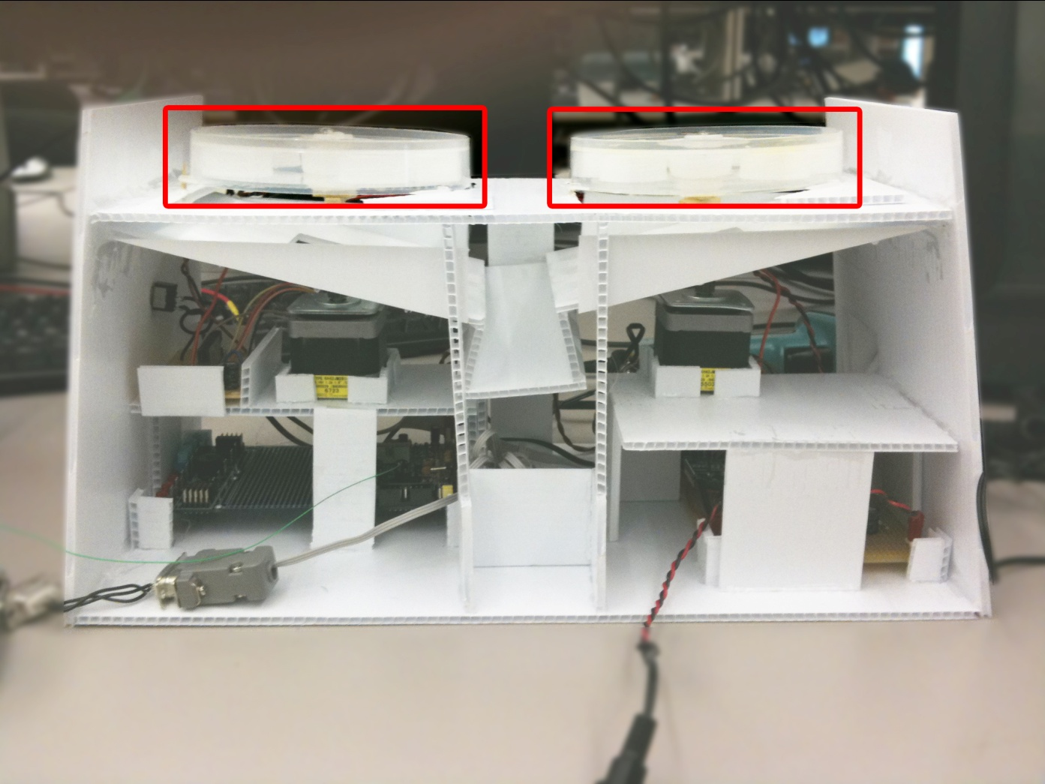
Main Unit – Mechanical System

Slide 28
Main Unit – Mechanical System

Slide 29
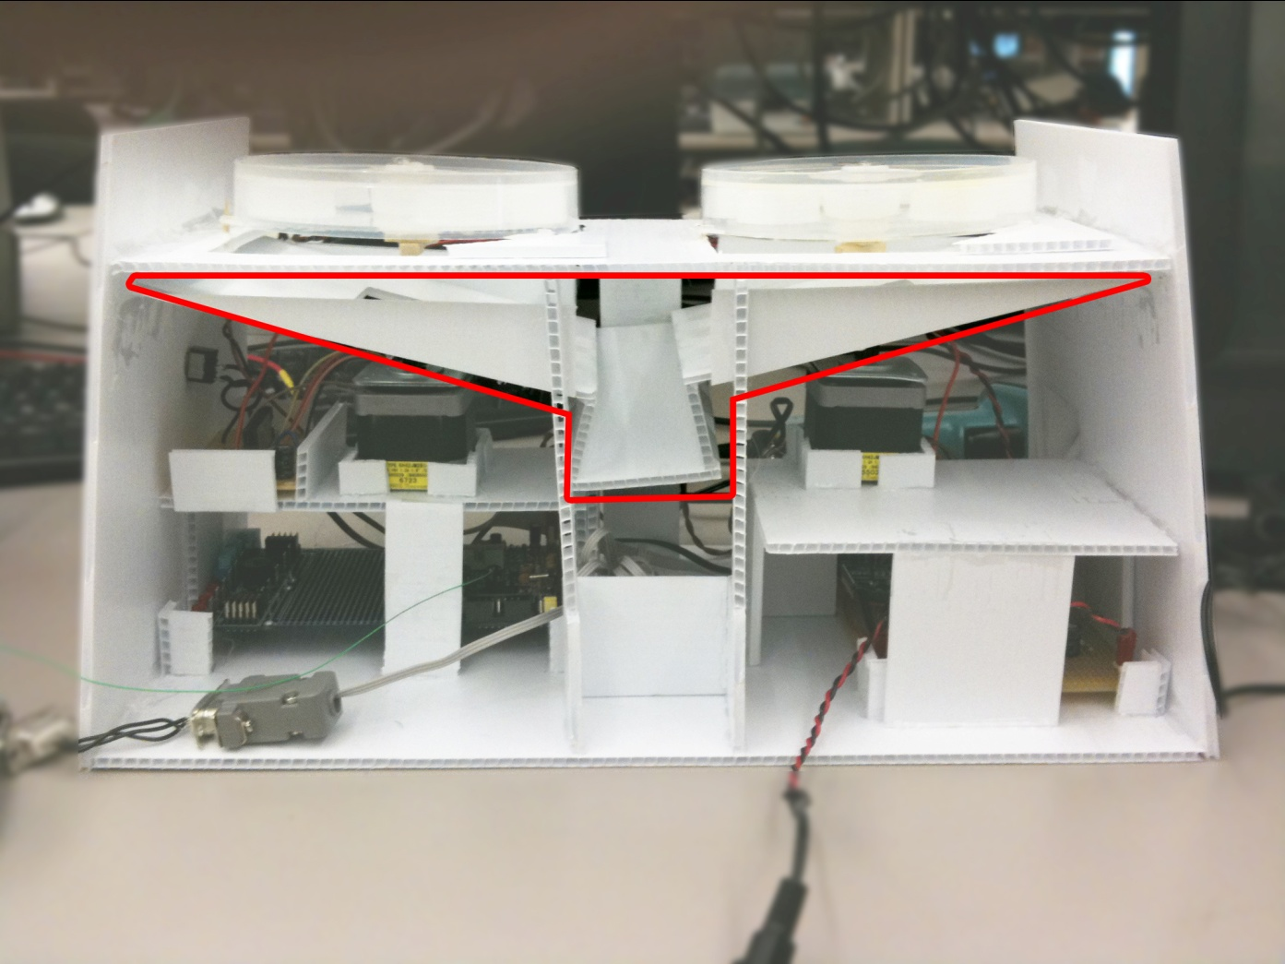
Main Unit – Mechanical System

Slide 30
Outline
Introduction
System Overview
System Design
Market Analysis
Timeline and Budget
Future Development
Team Dynamics
Conclusion
Acknowledgements
Questions

Slide 31
Market Analysis
Statistics Canada
87% of seniors (>65 years old) are currently taking at least one type of medication
33% of seniors are taking multiple medications (5+)
20% of Canadian population over age 65 by 2021
10% risk of developing dementia
90% expectation of age related memory decline
Notes:
Our market analysis has shown that there is a demand for this type of product for seniors. Most seniors take certain medications on a regular basis, many of them taking multiple types of medications. This market is growing as we speak, each day a larger percentage of the population are senior citizens. Of these people the vast majority of them have a declining memory, this includes a range from minor short term memory loss to full blown dementia.

Slide 32
Market Analysis
Target Consumers:
Households (Primary)
Seniors
Teenagers/Children
Everyone!
Care Centres/Senior Homes
Hospitals
Nurses
Alzheimer’s patients
Notes:
Our primary target consumers

Slide 33
Competitor Analysis
Current Solutions
Pill Organizers
Manually organize the pills into compartments
Dose Alert Pill Reminder
An alert will sound at a programmed time
Simple, cannot handle multiple pills
All current solutions require users to be within close proximity of the product during the alert

Slide 34
Competitive Advantages
Our solution: DispensAlert
Friendly user interface (touch-screen)
Automated dispensing
Barcode scanning feature
Wireless solution
Inexpensive

Slide 35
Marketing Strategy
COMPONENT | MASS PRODUCED PARTS | RETAIL PRICE
LCD / Touch Screen Panel | $25 | $50
Microcontrollers | $10 | $20
Enclosures | $1 | $2
Motors | $2 | $4
Miscellaneous Parts / Connectors | $1 | $2
Power Supply | $5 | $10
Barcode Scanner | $4 | $8
Wireless Transmitter / Receiver | $4 | $8
Force Feedback Device | $3 | $6
Grand Total | $55 | $110

Slide 36
Outline
Introduction
System Overview
System Design
Market Analysis
Timeline and Budget
Future Development
Team Dynamics
Conclusion
Acknowledgements
Questions

Slide 37
Project Timeline
Notes:
This is our project timeline. The blue lines represent the time that we had budgeted for each section of development. The green lines represent the actual time spent on each one. As you can see, our timeline got more and more out of sync as the semester progressed. Once we got close to the end we started working much harder and more efficiently forcing the timeline to compress significantly and allowing us to finish on time.

Slide 38
Project Budget
COMPONENT | PROJECTED COST | ACTUAL COST
LCD / Touch Screen Panel | $125 | $280
Microcontrollers | $100 | $120
Enclosures | $100 | $25
Motors | $100 | $30
Miscellaneous Parts / Connectors | Not Budgeted | $130
Power Supply | $100 | $50
Barcode Scanner | $80 | $30
Wireless Transmitter / Receiver | $95 | $130
Force Feedback Device | $50 | $25
Contingency | $100 | N/A
Grand Total | $850 | $820
Notes:
Here is projected and actual budget. There are a couple of things here that I would like to point out. First and foremost is that our touch screen was significantly more expensive than we had anticipated. This was mitigated by the fact that most of the rest of the parts are actually less than we predicted. Finally in the end, we came in slightly under budget.

Slide 39
Outline
Introduction
System Overview
System Design
Market Analysis
Timeline and Budget
Future Development
Team Dynamics
Conclusion
Acknowledgements
Questions

Slide 40
Future Development
Device Miniaturization
Custom PCBs
Lower Power Consumption (Wristband)
Optical Feedback
Wireless Protocol
Reservoir Locks
Custom Skins
Notes:
There are many items that can be added in the future that can help make DispensAlert™ more robust, practical, and more user-friendly. A couple things that we would like to implement for future iterations of our product are as follows. We would like to make both devices smaller, and in the case of the wristband unit, significantly smaller. We could use custom PCBs as one way to reduce the size of the units, this would also allow us to run the wristband unit with lower power consumption. We would like optical feedback during dispensation to guaruntee the correct number of pills are dispensed. We would like to have implemented a more robust wireless protocols adding handshaking to add reliability and security. We would like to add magnetic locks preventing the reservoirs from being opened when they shouldn’t be open. Finally as an expansion to our business we could create custom skins for both the main unit and wristband unit allowing consumers to customize the look of their system.

Slide 41
Outline
Introduction
System Overview
System Design
Market Analysis
Timeline and Budget
Future Development
Team Dynamics
Conclusion
Acknowledgements
Questions

Slide 42
Team Dynamics
Main Unit
Mohammad: GUI/touchscreen, barcode, stepper motors, wireless transmitter/receiver, parts sourcing
Gary: GUI, Mechanical Design, Enclosure
Steven: GUI/touchscreen, base code modifications, graphic design
Joseph: GUI/touchscreen, barcode, stepper motors, wireless transmitter
Wristband Unit
Ryan: Parts Sourcing, Wireless Receiver implementation, Enclosure, high level design
Trevor: FSM, Functions and Timer implementation
*Many Roles Shared
Notes:
Our team divided into two groups, each group working on one self contained device. From there we attempted to separate tasks so that each person would be using their own particular skills to help get the project done. That said, we did not really work separately, each task was worked on by multiple people, allowing the tasks to get done faster and mitigating the frustration which can factor in on tasks that start to require extended periods of time. Working together also spread the knowledge around so that if someone was missing from a meeting, someone else knew what was going on in that area of the project.

Slide 43
Lessons Learned
Set personal deadlines
Strictly adhere to deadlines
Be flexible with your time
Communication is paramount
Address internal tensions immediately
Via blood sport if needed
Devise a way to increase the hours per day
More time to get work done
Notes:
We learned several things by working on this project. Personal deadlines are a must, if they are not adhered to, very rarely will all the work get done on time, and punctuality is key. Often schedules don’t match up nicely, if your time is not flexible you may end up never actually seeing the rest of your group which leads to bad communication. Bad communication causes rifts and devices that don’t work together. Those aforementioned rifts often come from simple misunderstandings or badly worded jokes. Unless these tensions are addressed and released through honest and calm communication, they can quickly lead to team members facing off in the octagon. As for adding hours to the day, any device that do that might as well be our 440 project because that would be worth more than this device anyway. Now Ryan will return to present our conclusion.

Slide 44
Outline
Introduction
System Overview
System Design
Market Analysis
Timeline and Budget
Future Development
Team Dynamics
Conclusion
Acknowledgements
Questions

Slide 45
Conclusion
Xypnios’ DispensAlert™ prototype built successfully and functions properly
Real-world simulation
ENSC 440 is a self-motivating course
Notes:
After 4 months of work, we finally get to see a proposed design come to fruition. There are a couple of items which we feel sum up our experience in ENSC 440:
Time management is key for success in any endeavor. There will always be the challenge of balancing courses with ENSC440. Students need to make sure to manage their time efficiently and take a lesser course load if necessary.
Communication is another attribute that will help in the team’s success. Communication between everyone is needed to keep everyone up to date to last minute changes and also to have everyone offer opinions and forsee any problems that may arise before it happens.
ENSC 440 is an excellent course because it gives us a glance into what we will be facing when working for a high-tech company.
Finally, ENSC 440 is a self motivating course. The end project reflects how much time and effort is put into the course. No one is there to push you along but yourself and other team members. The course differs in other courses because you get to build something you are interested in, there are no boundaries (maybe cost). The experience gained from the course is what you make of it.

Slide 46
Acknowledgements
Engineering Student Society Endowment Fund (ESSEF) from ESSS
Jeff Sun (Engineering Undergraduate Student)
Mr. Steve Whitmore
Dr. Andrew Rawicz
Ali Ostadfar (Mechanical Design Consult)
Duncan and Sara (TAs)
Notes:
So we didn’t do this entirely on our own, we have had some help and advice throughout the semester.
First, we would like to acknowledge the ESSS for administering ESSEF funding to our group, we couldn’t have paid for our components without their help.
Our friend Jeff Sun, for brainstorming mechanical designs with us.
Our instructors: Mr. Steve Whitmore and Dr. Andrew Rawicz for teaching this course.
And our TA’s for their guidance throughout the semester.

Slide 47
Project Demonstration

Slide 48
Thank You
Questions?

Slide 49
References

