Slide 1
V-Cycle Pro Virtual Bike Simulator Project Presentation and Demo by
April 15th , 2010
Lukas-Karim Merhi | CEO
Mike Henrey | Communications/HR
Dan Edmond | Project Manager
Jack Qiao | CFO
Notes:
Mike

Slide 2
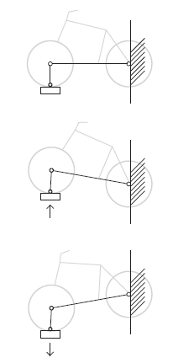
Outline
Background
Product Design
High-Level Project Details
Future Work
Conclusion
Acknowledgements
Questions
Notes:
Mike

Slide 3
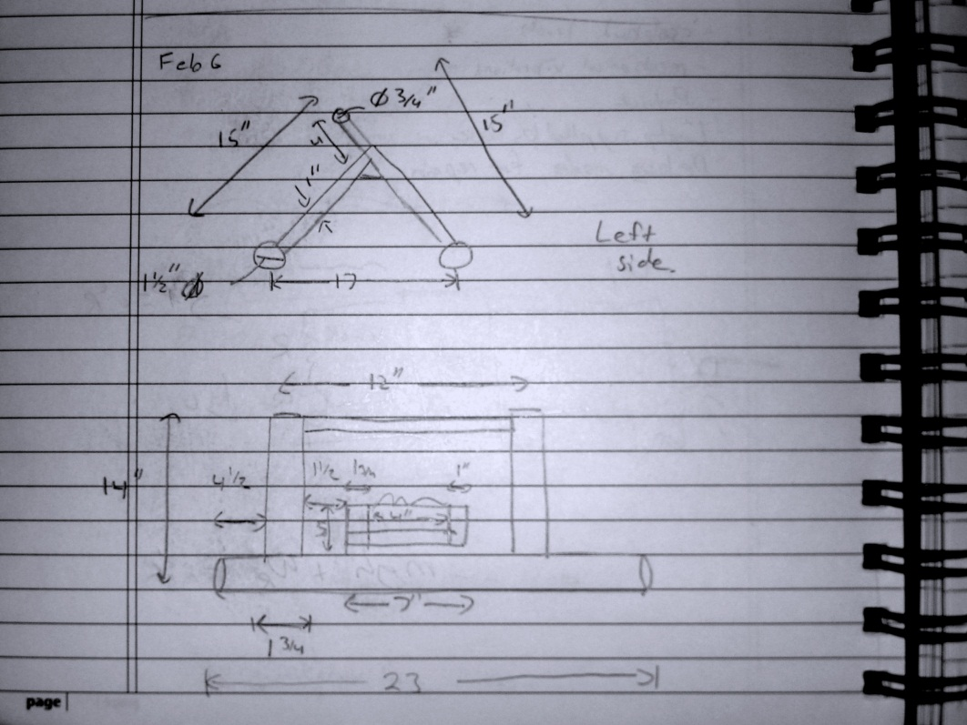
Background
Background
Motivation
Current Solutions
Goals
V-Cycle Pro
Notes:
Mike

Slide 4
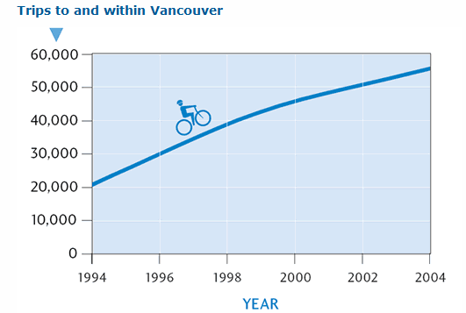
Vancouver Weather
Background – Motivation
166 days of rainfall per year in Vancouver
Market already exists – people love to bike
Notes:
Mike

Slide 5
Current Solutions
Background – Current Solutions
Tacx i-Magic Trainer
Kurt Kinetics Rock and Roll Trainer
Notes:
Mike
- need approx costs, feature breakdown

Slide 6
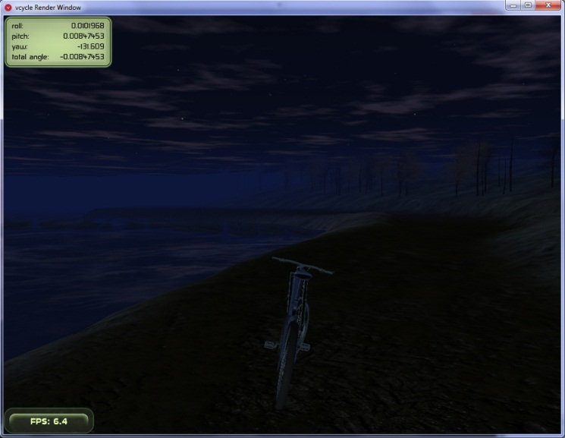
Goals and Objectives
Background – Goals
Using your own bike indoors to enjoy a realistic cycling experience | Achieved
Simulated terrain, elevation and resistance. | Achieved
Tilting and turning capabilities | Achieved
Provide user with favourite biking routes | Future work
Notes:
Mike
- Should be sexier, maybe rate how we did on each

Slide 7
Our Solution
Background – V-cycle
Notes:
Mike

Slide 8
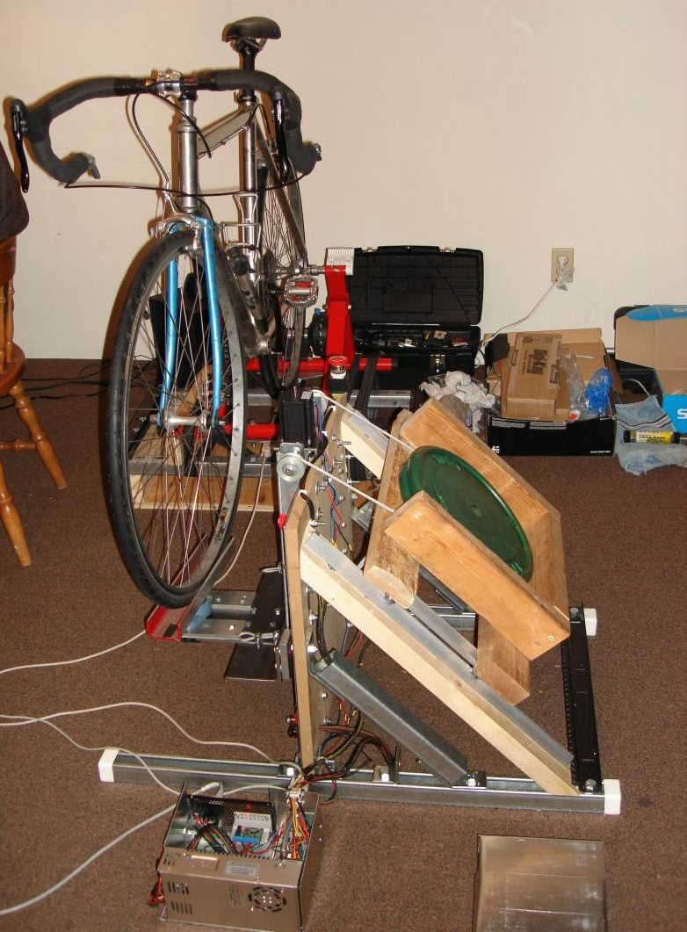
Product Design
Product Design
Overview
Structural
Mechanical
Software
Electronics
Safety
Usability
Sustainability
Notes:
Transition to Jack

Slide 9
System Overview
Product Design – Overview
Notes:
Jack
- User is central to our system
- Modules to the system, integration a critical step

Slide 10
Front and Back Platforms
Product Design – Structural
Notes:
Jack
Overview of the structural components
Discussion of use of metals for strength, existing trainer etc.

Slide 11
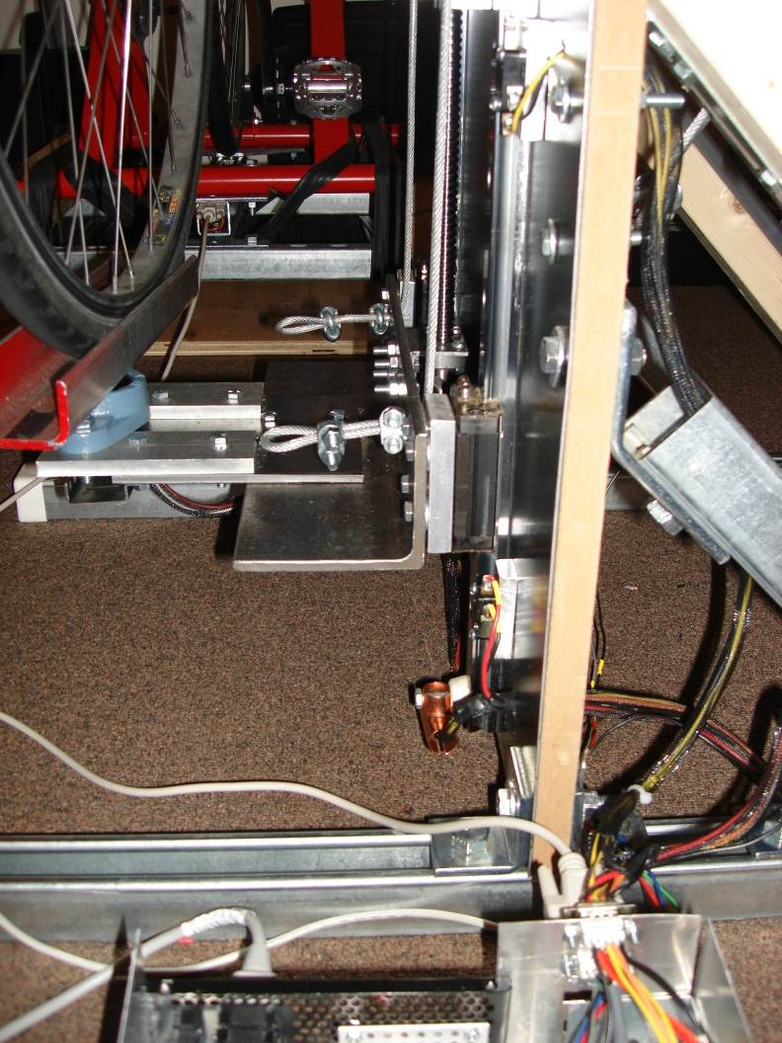
Front Lifting Mechanism
Product Design – Mechanical
Linear motion components
Integrated potentiometer
Retains proper bike tire freedoms
Notes:
Jack
Ballscrew and glides
Discussion of system efficiency etc.

Slide 12
Tilting Mechanism
Product Design – Mechanical
Notes:
Jack
Materials used
Passive system to engage core muscles

Slide 13
Gravity Assist
Product Design – Mechanical
Notes:
Jack
Purpose
Simplicity of design

Slide 14
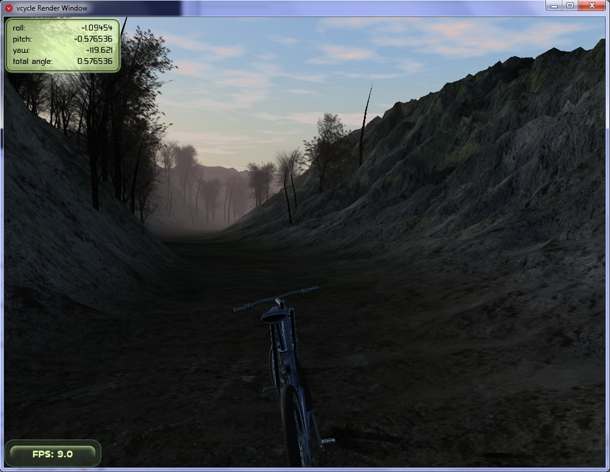
Software and Graphical User Interface
Product Design – Software
2 custom virtual terrains | Achieved
Mapping famous, real life routes | Future work
Integration with Google maps/street view | Future work
Notes:
Jack
Role visual feedback plays in virtual reality experience
Current and future implementation

Slide 15
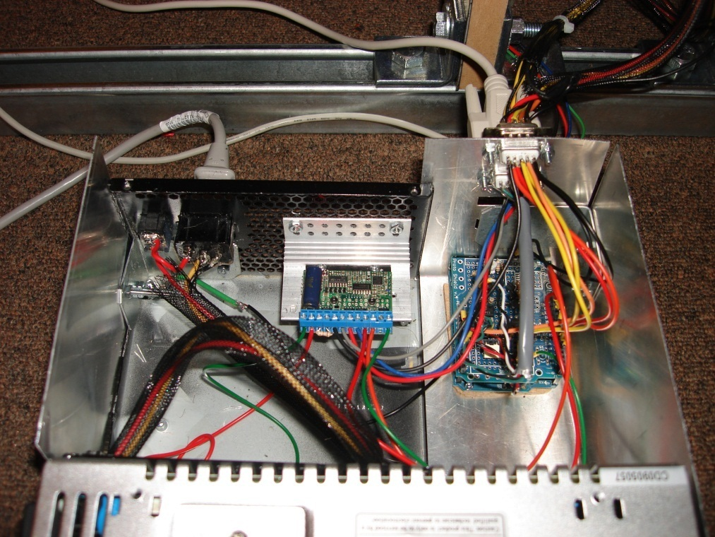
System Overview
Product Design – Electronics
Power supply
Microcontroller
Sensors
Motor driver
Notes:
Transition to Dan
- All electronics

Slide 16
Electronics Systems
Product Design – Electronics
Notes:
Dan

Slide 17
Safety Design
Product Design – Safety
Hard stops constrain linear movements
Limit switches guard linear components
Industrial emergency stop button
Electronics enclosed in grounded box
Fuse protection on power components
Insulated wiring and warning signs

Slide 18
Versatile Design
Product Design – Usability
Stand Alone Mode (no software)
Active Mode (software interface)
Tilting can be mechanically disabled
Modular Design
3 main components (back and front platform, control box)
Set of cables (2 serial, 1 USB, 1 Power)
Easily disassembled

Slide 19
Sustainability
Product Design – Sustainability
Use of recycled materials
Scrap wood
Scrap metal
Left over fasteners
Old popped bike tubes
Reused electronic components

Slide 20
High-Level Project Details
High Level Details
Costs
Teamwork
Time Management
Lessons
Future Work
Notes:
Lukas
- Teamwork and business aspects

Slide 21
Project Costs
High Level Details – Costs
 | Realized ($) | Budgeted ($)
Electronics Components | 479.02 | 465.00
Sensors and analog circuitry | 234.02 | 130.00
Digital circuitry | 245.00 | 335.00
Electro-Mechanical Components | 990.88 | 630.00
Structural (Metals, struts, wood, fasteners) | 409.52 | 100.00
Mechanical (Ball screw, linear actuators, motor, power supply, generator) | 376.69 | 380.00
Bike trainer | 204.67 | 150.00
Total | 1469.90 | 1095.00
Notes:
Lukas
Outline of the major expenses

Slide 22
Comments on Costs
High Level Details – Costs
Greatly underestimated structural costs
Fried a motor driver
Proposed budget limited purchases of better solutions such as a multi-functional variable resistance unit
Did not qualify for IEEE funding (no wireless components in the design)
Notes:
Lukas
- Discussion of the costs

Slide 23
Teamwork
High Level Details – Teamwork
 |  | Dan | Mike | Lukas | Jack
Design | Code and circuits | X |  | X
 | Structural and mechanical |  | X | X | X
 | Software |  |  |  | X
 | Variable resistance | X | X
Implement | Computer and MCU | X |  |  | X
 | Structural and mechanical |  | X | X | X
 | Sensors and circuitry | X |  | X
Notes:
Lukas
How we allocated the work
Teams of people worked on each section

Slide 24
Development Timeline
High Level Details – Time Management
Item | Proposed | Implemented
Order parts | February 3 | Ongoing
Sensors | February 5 | March 9
Front lift platform | February 19 | April 1
Resistance electronics | February 23 | Not implemented
Tilting system | February 26 | March 1
Stepper code | March 6 | April 14
Resistance mechanical | March 12 | Not implemented
1D acceleration | March 23 | March 22
Notes:
Lukas
May have to simplify this if it doesn’t show well on projector
Discussion of proposed vs. actual milestones

Slide 25
Lessons Learned
High Level Details – Lessons
Very ambitious project to undertake for a 3 month time period
Not enough mechanical experience at start of project, delayed integration
Proper tools, materials and precise measurements are super essential
Some of us were overloaded with other courses
Group organization should be flexible
Notes:
Lukas
- Discussion of our take-aways of the project

Slide 26
Future Work
High Level Details – Future Work
Multifunctional variable resistance unit
Realistic motion frequencies (i.e. gravel or pavement textures)
Improve gravity compensation system
Hydraulic platform for lifting mechanism
Realistic bike terrain maps
Google street view interfacing
Audible noise reduction
Notes:
Lukas
- How we see the ideal project

Slide 27
Excerpts from our Minutes
Conclusion
Oct 1: “Robot skyscraper window washer”
Jan 11: “Side to side tilting not really possible”
Feb 20: “Reed switch, serial Read/Write done… de-bouncing done…”
April 6: “Videos!!!”
Notes:
Transition back to Mike
Thank audience for time and interest
Key takeaways for us

Slide 28
Acknowledgments
Acknowledgements
Lucky One (electronics advice)
Fred Heep (electronics advice)
Professor Bernhard Riecke (VR advice)
Gianmarco Spiga (Arduino and pie)
Martin Berryman (metalwork assistance)
Brian and Physics Department (machine shop assistance)
Yeelen Merhi (mechanical design inspiration)
Rest of the Hewitt House (Audrey-Anne, Pier Alexandre, Sean Edmond)
ESSS (for ESSEF funding grant allocation and distribution)
Notes:
Mike

Slide 29
Questions?
Questions
Notes:
Mike

Slide 30
Please join us in the pub after the demonstration…

