Slide 1
A Low-Cost Landmine Detection System using Ground Penetrating Radar
ENSC 440 Presentation and Demo
April 16, 2010
Presented by: M. Ages, J. Berring, G. Cowan, J. Yoo

Slide 2
The Team
Michael Ages
  Radio Frequency Electronics and User Interface
John Berring
  Mechanical Components and Signal Processing
Graeme Cowan
  Low Frequency Electronics
Jeremy Yoo
  Microcontroller Interfacing and Communication Software

Slide 3
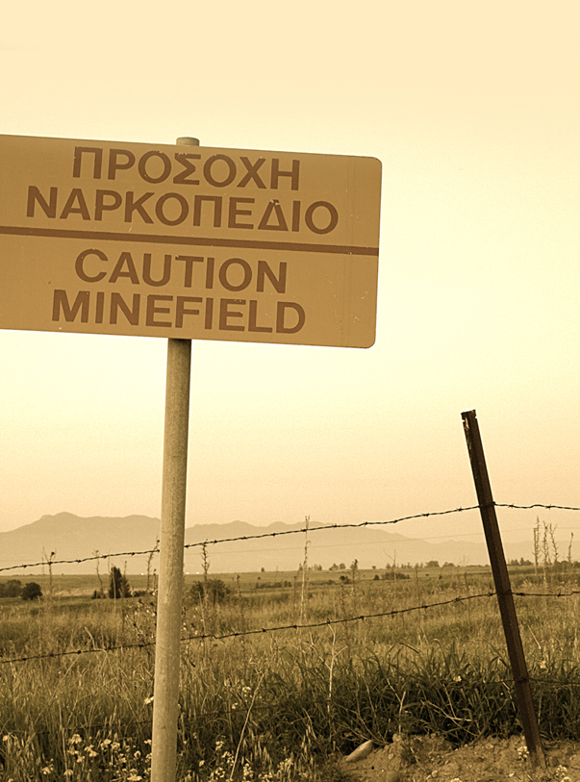
Outline
Background
System Overview
Device Components
User Operation
Demo
Test Results
Reflections
Q & A
Image Credit: LaRezistance (Flickr)

Slide 4
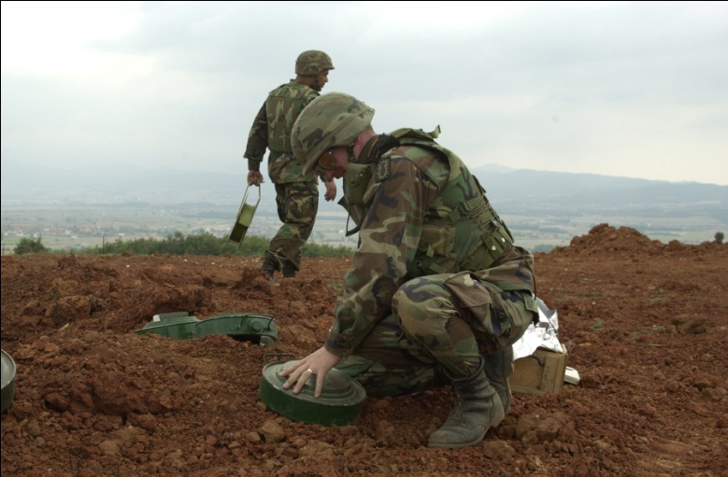
The Problem
According to Landmine Monitor:
  Over 70 countries are affected by landmines
  More than 5,000 casualties in 2008 caused by landmines, explosive remnants of war, and improvised explosive devices
Humanitarian organizations lack
in funding and equipment
Mine detection is difficult
and dangerous
  Extremely high false positive rate
  Modern mines are mostly plastic
Image Credit: US Army (Wikimedia Commons)

Slide 5
Design Constraints
“[It] is difficult, slow and expensive to transport heavy equipment over bad or non-existent roads … Spare parts are hard to get so reliability is crucial and there is a strong prejudice against sophisticated designs.”
Dr. S.H. Salter (in “Report on the Hidden Explosives Workshop, Rovereto June 1999”)
Portable
Easily maintainable
Made from common materials, where possible
Simple to operate
Robust
Low Power
Low Cost

Slide 6
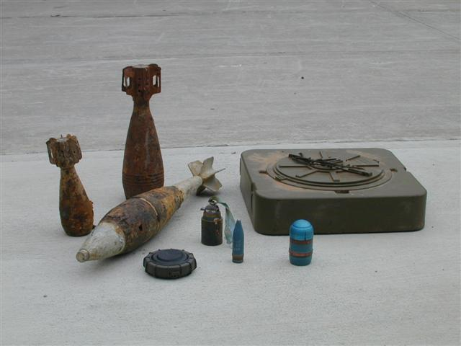
Design Constraints
Device must detect all
potential landmine materials
  Metal
  Plastic
Device must differentiate
between objects of landmine
size (5-30cm in diameter) and
other remnants of war (e.g. shrapnel with diameter < 5cm)
Image Source: SSPACISS @ Duke University (http://sspaciss.ee.duke.edu/landmine.php)

Slide 7
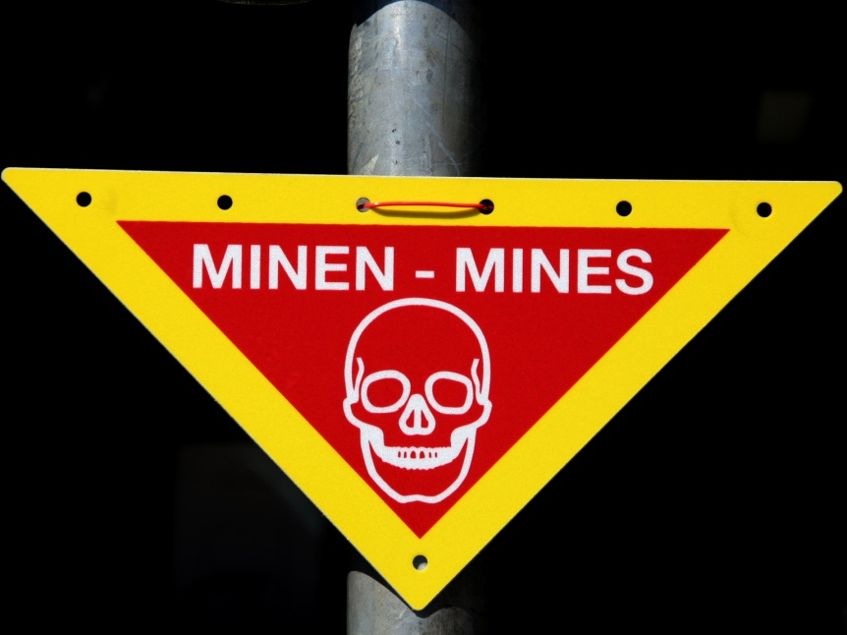
Our Solution
Low cost frequency modulated continuous wave (FMCW) radar scanner
Cantilevered frame with 2 DOF scanning head
Produces 3D image data
  Cross-sectional and top-down
  2D data displayed to user on
  laptop
Off-the-shelf RF components
Alternatives: Metal detection, infrared
Image Credit: MatthiasKabel (Wikimedia Commons)

Slide 8
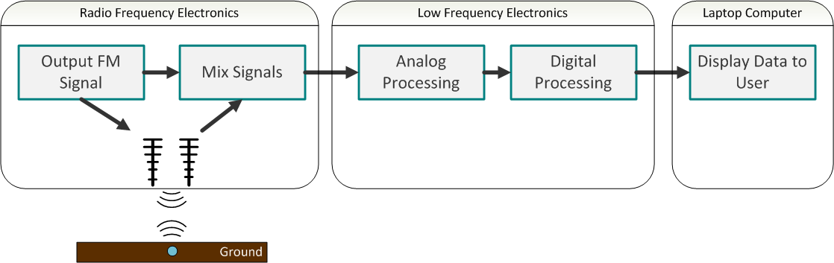
System Overview

Slide 9
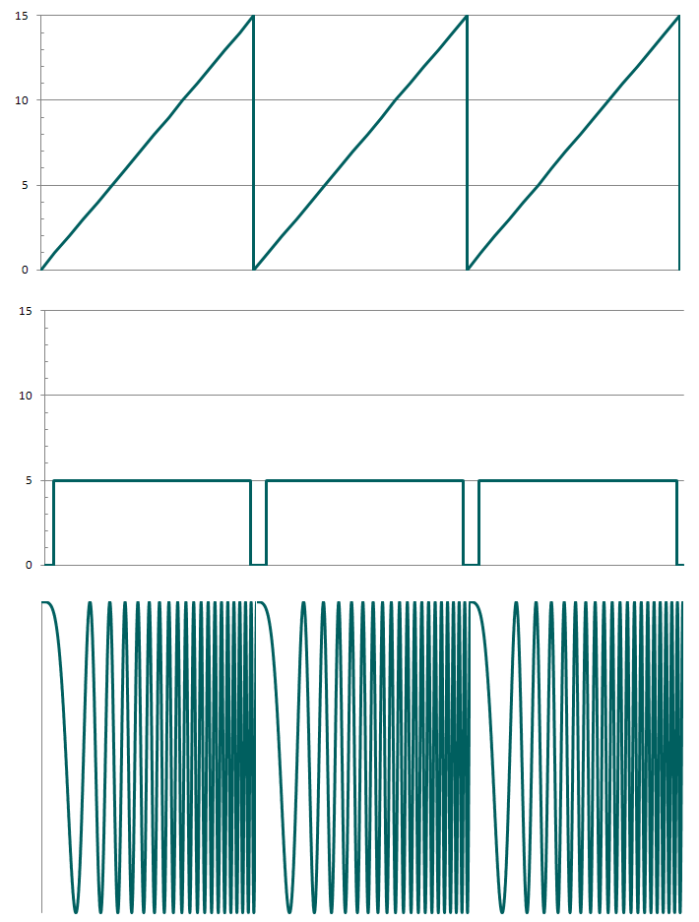
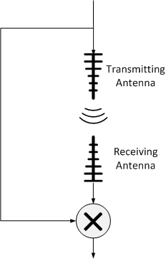
FMCW Fundamentals
A sine wave with a linearly varying frequency is transmitted into the ground
Signal reflects off buried objects and is read back by a second antenna
The distance is determined by comparing the received frequency with the currently transmitting frequency

Slide 10
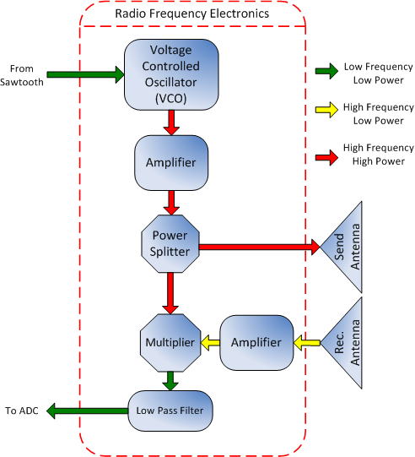
RF Electronics
Large bandwidth VCO sweeps over 1.2GHz range
Amplifier boosts signal strength
Signal split then transmitted by Yagi antenna
Signal received by second antenna and amplified
Mixer determines difference in signal frequencies
Filter removes all high frequency noise

Slide 11
Low Frequency Electronics
Analog sawtooth circuit controls the oscillator
Incoming signal is amplified and read by a analog to digital converter
  Specialized data collection enable signal
Gears on each side of the frame give the position of the scanning head
Position and signal data are sent to the user’s computer via USB

Slide 12
Software
All data processing is performed on the computer via MATLAB
Three separate applications
  Data listener application
    Collects the radar and position data
  Control and processing software
    Determines frequencies of radar signal and generates scan images
  Scan Viewer
    Graphical user interface for displaying scan images

Slide 13
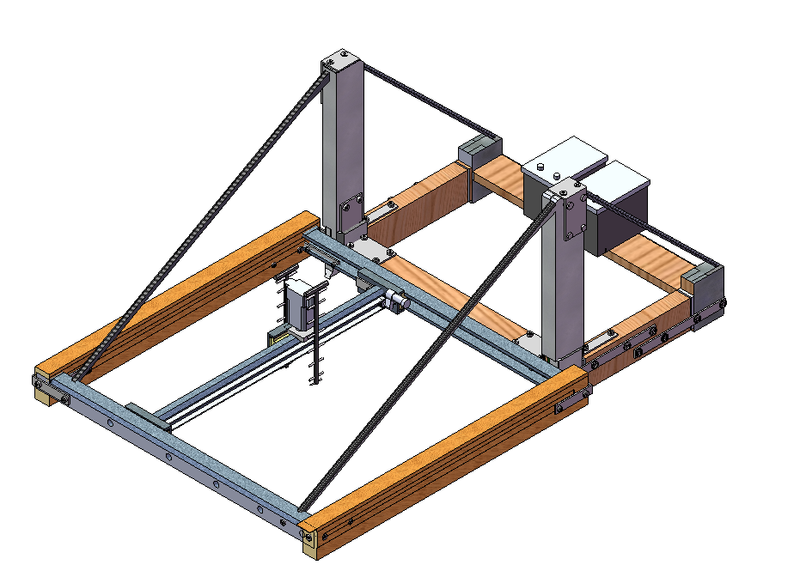
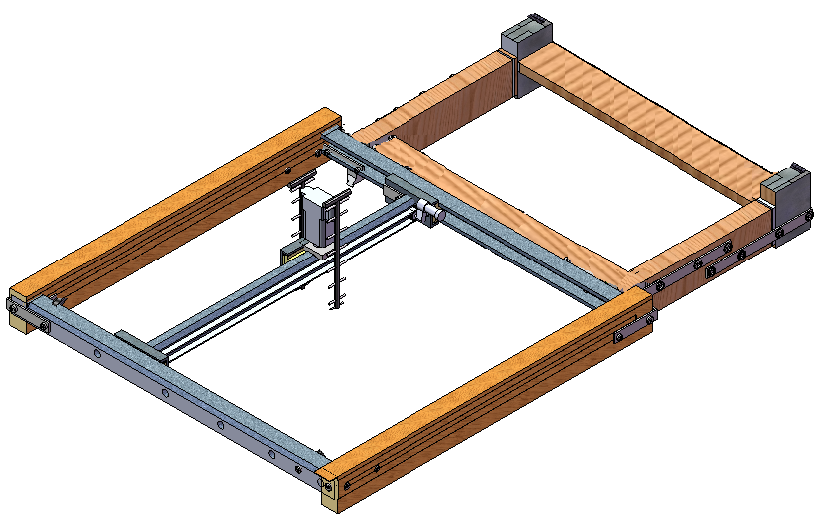
Scanning Device
Hand-driven mechanism
Portable power source for electronics
Suspended over 1m x 1m area
  Consistent with demining practices
Initial design called for suspension wires
Final design has frame
cantilevered above active area

Slide 14
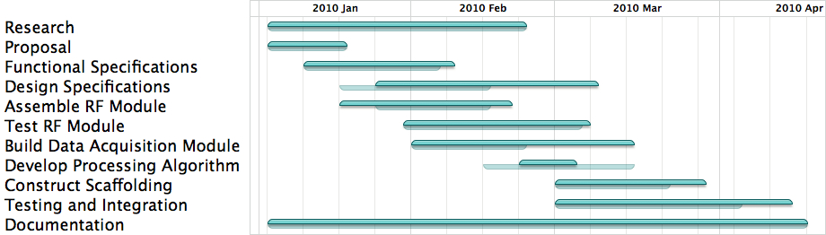
Timeline

Slide 15
Cost Breakdown
Component | Proposed Cost | Actual Cost
Radio Frequency Electronics | $700 | $545
Low Frequency Electronics | $20 | $95
Microcontrollers | $100 | $120
Power Sources | $80 | $40
Mechanical Parts and Components | $200 | $430
Total | $1100 | $1230

Slide 16
Business Opportunity
Competing technologies are far more expensive
  US Army: HSTAMIDS
  Lawrence Livermore Nat’l Laboratory: LANDMARC
  GSSI: GPR primarily for civil and environmental uses
  Various university research groups
Our target customer is humanitarian organizations
Other applications: civil engineering, archeology, paleontology
Financing via NGOs and private investors

Slide 17
- Demo -

Slide 18
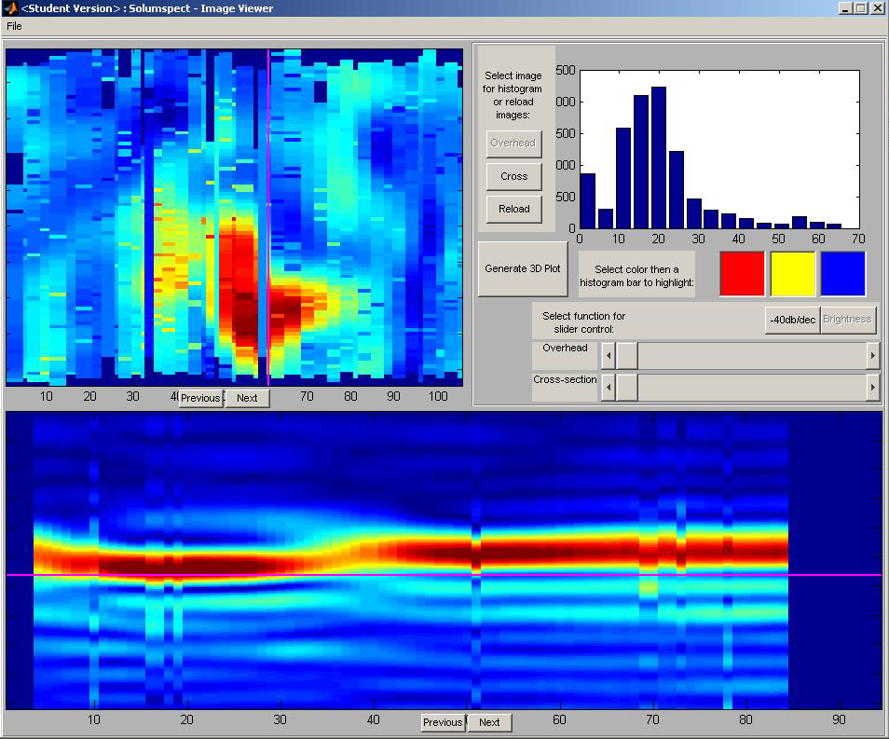
Test Results: Metal “Mines”
Outdoor, Shallow depth

Slide 19
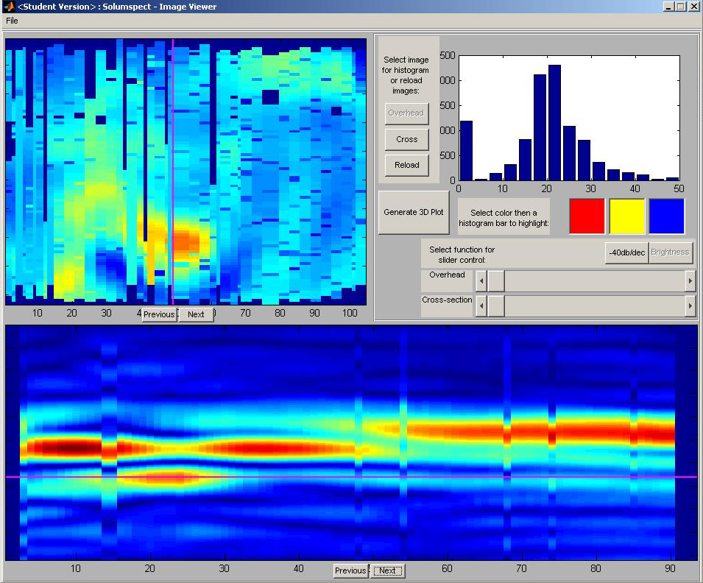
Test Results: Metal “Mines”
Outdoor, Medium depth

Slide 20
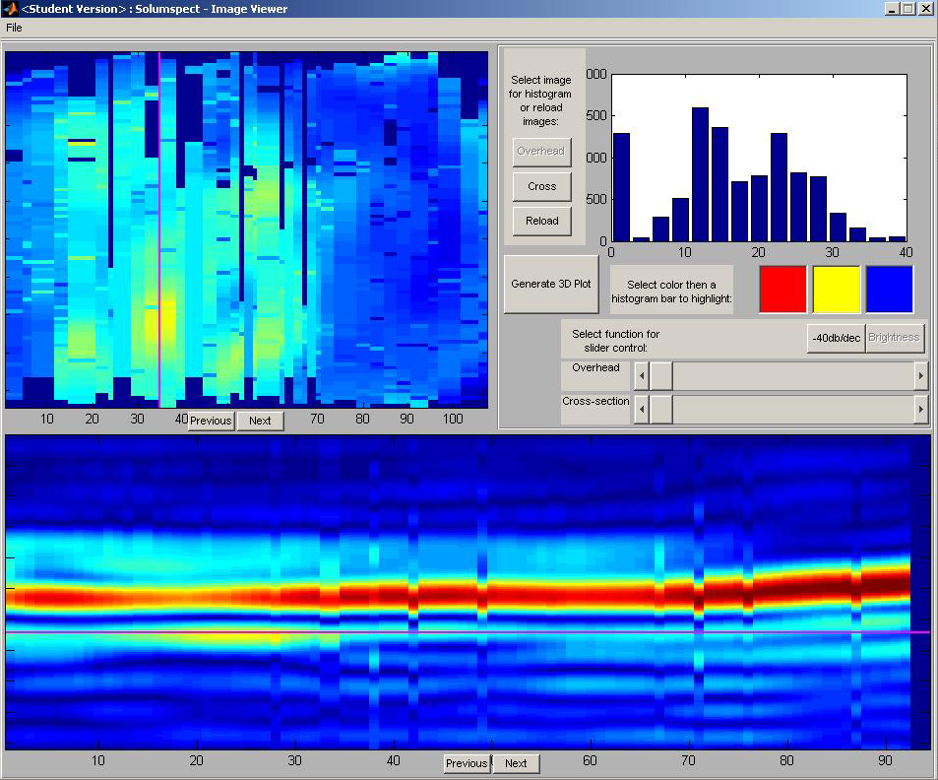
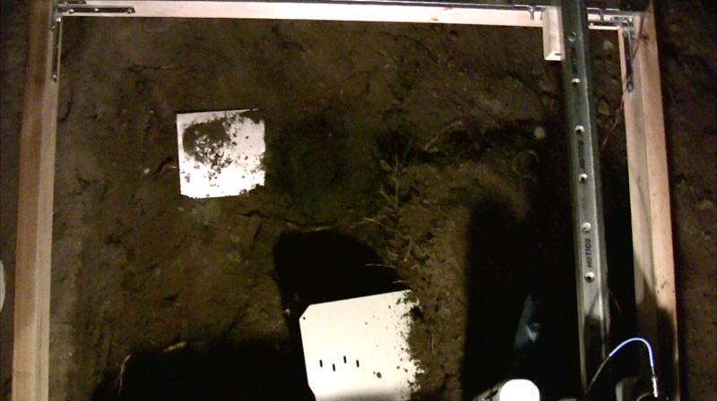
Test Results: Metal “Mines”
Outdoor, Multiple objects

Slide 21
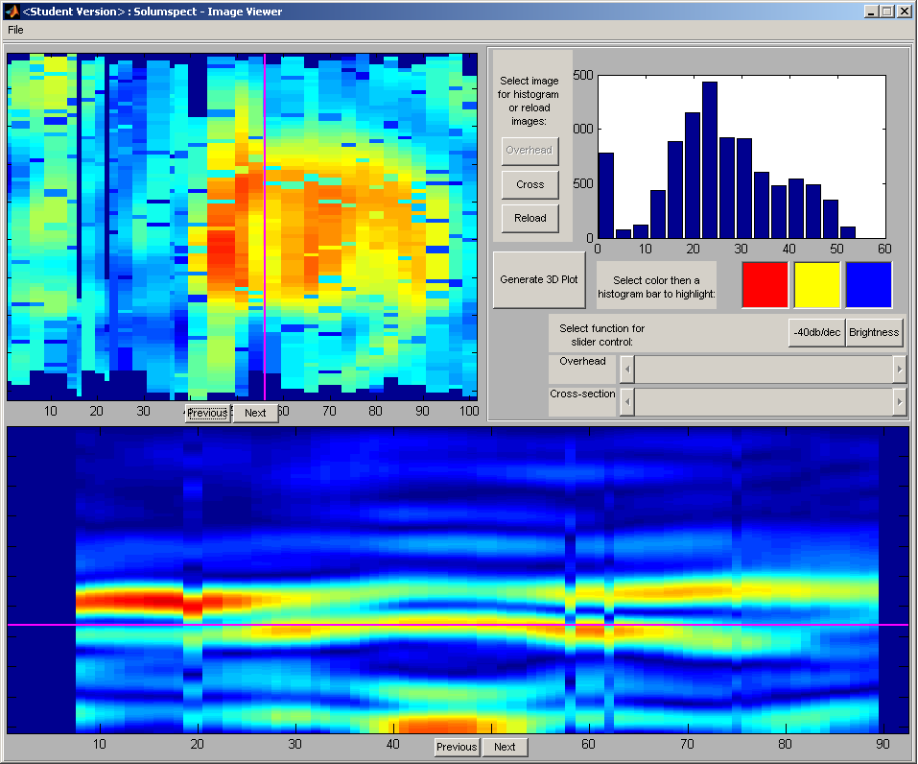
Test Results: Metal “Mines”
Indoor, Big metal plate

Slide 22
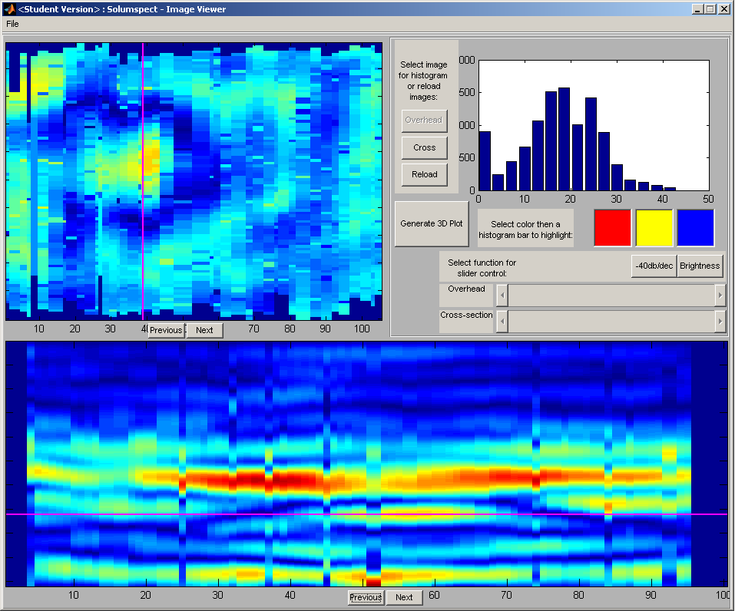
Test Results: Metal “Mines”
Indoor, Small metal plate

Slide 23
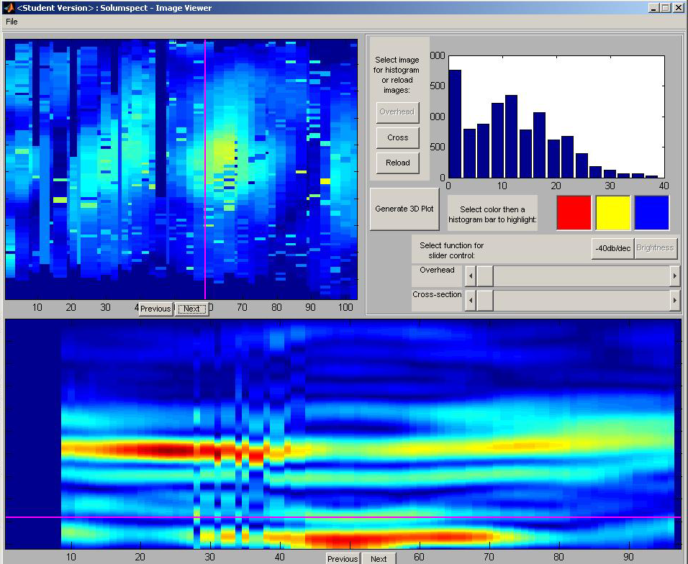
Test Results: Plastic “Mines”
Indoor, Medium depth

Slide 24
Progress: Single Signal

Slide 25
Progress: Single Image

Slide 26
Progress: Cross-Section

Slide 27
Progress: Overhead

Slide 28
Test Results: 3D View
Indoor, Large metal plate

Slide 29
Lessons Learned
Mechanical construction is time-consuming
Signals in the air are far more difficult to work with than signals in a wire
Suppliers don’t always follow through
Maintaining low cost, high speed, and high power requires a careful balance

Slide 30
Future Development
Increase portability of device
Implement improved image processing algorithms
Place all components onto a custom PCB
Increase depth resolution by increasing frequency range
Cheaper cross-talk elimination

Slide 31
Information Sources
Dr. Shawn Stapleton
Various theses and research papers
Textbook on GPR
  Ground Penetrating Radar 2nd ed. by D. J. Daniels
Humanitarian organizations’ websites

Slide 32
Conclusion
Successfully produced a low-cost GPR device with readily available components
Able to detect metal mines in soil and sand
Improvements to frequency range and image processing techniques could improve resolution
Costs could be further reduced in future iterations with what we know now

Slide 33
Acknowledgements
Dr. Shawn Stapleton
Dr. Rodney Vaughan
Mr. Gary Houghton
Dr. Andrew Rawicz and Mr. Steve Whitmore

Slide 34
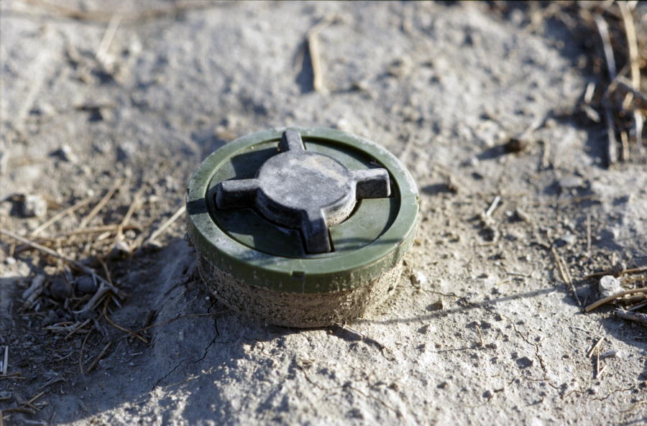
Questions?
Thank You.
Image Credit: UN Photo by Luke Powell (Flickr)

Slide 35
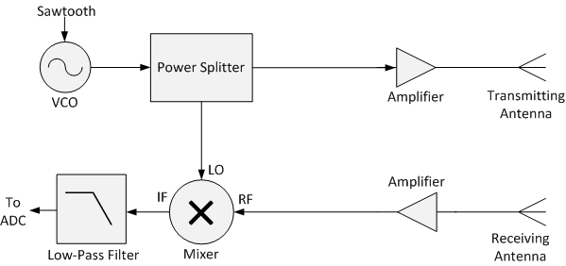


FMCW Theory in Detail
The VCO signal is
The VCO signal is transmitted and the received signal is
The mixer multiplies these two signals to give
A low pass-filter is applied, giving
This filtered has a frequency
We can then calculate the distance from the formula

Slide 36
Wave Propagation and Loss
Estimated power loss during transmission needed to define maximum depth and power requirements
Depth of wave penetration (range of device) dependant on a number of physical factors
Total estimated loss: 20 to 60 dB
0.5 m maximum depth limit for valid signals
  Sufficient for detecting anti-tank and anti-personnel mines

Slide 37
RF Safety
At operational frequencies, primary safety hazard is internal heating and shock
Exposure limits are 50 W/m² for these wavelengths
Transmit antenna emits under 0.25 W of power
At tip of antenna, estimated power output is around 25 W/m²

Slide 38
Sampling
Why sample only one sawtooth sweep?
Sampling Multiple Periods
Sampling a Single Period

Slide 39
Depth Resolution
Depth resolution depends only on the range of scanned frequencies

Slide 40
Maximum Depth
Sampling rate and frequency scan rate affect depth penetration without changing depth resolution

Slide 41
Reliability
Components in system are all in series
Most probable components to fail are the microcontroller and the voltage regulators
While redundancy can not be easily built into the system, we purchased replacement spares for most components

