Slide 1
Simon Fraser University
April 15, 2010
Kelvin Ho (CEO)
Luke Dang (CSE)
Ken Zheng (EM)
Peter Zheng (SMHE)

Slide 2
Agenda
Introduction
System Overview
Hardware
Mechanical
Software
Business Case
Market
Cost and Finacing
Timeline and Teamwork
Future Development
What We Learned
Conclusion and Acknowledgements

Slide 3
FlexiSys Team Members
Kelvin Ho
Software Developing, Documentation
Luke Dang
Firmware Design (Microcontroller), Testing
Ken Zheng
Hardware & Mechanical Design
Peter Zheng
Hardware & Mechanical Design

Slide 4
Motivation and Goal
Motivation
Current fire sprinklers:
Takes a significant amount of time to activate
Everything suffers from water damage
Does not always extinguish the fire
In extreme cases, may not activate

Slide 5
Motivation and Goal
Goal
To design a system that can automatically detect a fire and then proceed to extinguish it while minimizing water damage.
Either as a replacement to sprinklers, or
As a supplementary system to current sprinkler systems.

Slide 6
Example Video
http://www.facebook.com/video/video.php?v=105684576113471
Notes:
- Sprinkler system does not activate until about 2 minutes
Everything is now wet

Slide 7
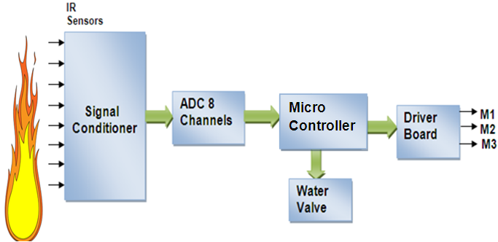
System Overview

Slide 8
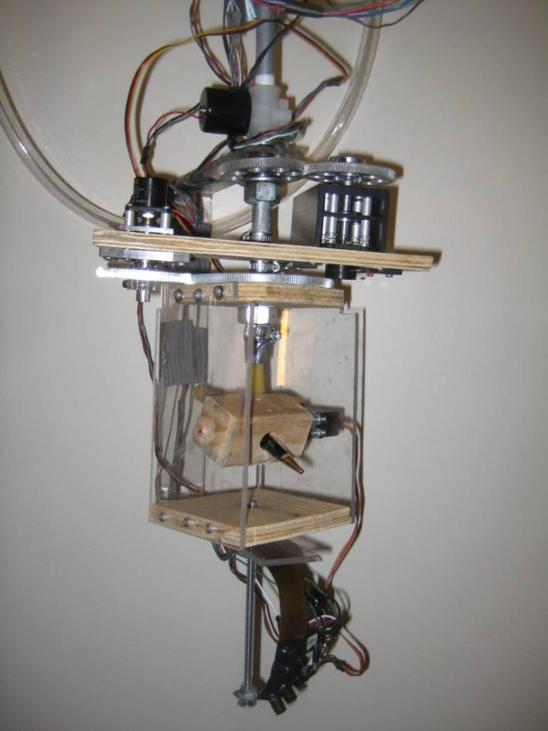
System Overview

Slide 9
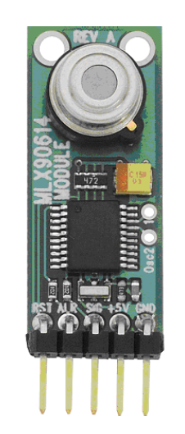
Hardware – Thermal Sensor
MLX90614 Infrared Thermometer Modules
10˚ Field Of View (FOV)
Serial Communication
Up to 12 meters range

Slide 10
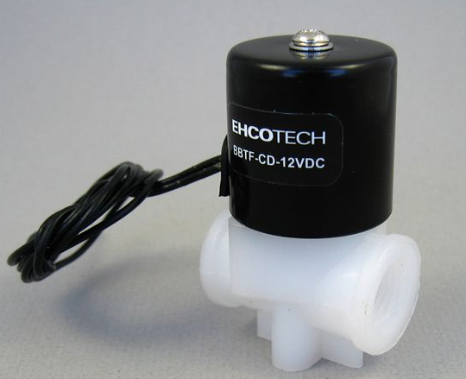
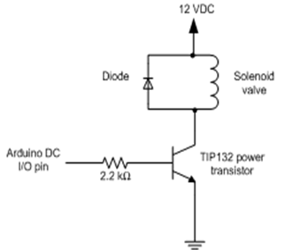
Hardware – Valve and Switch
¼ Inch Solenoid Water Valve from EHCHOTECH
12-Volt DC and 500 mA
140 psi pressure max
TIP132 Power Transistor
Max Vce 100V
Max Ic 4A

Slide 11
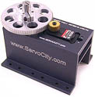
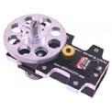
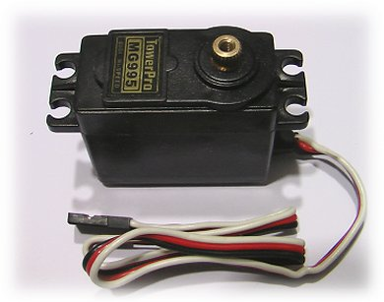
Hardware – Motors
Bottom and top mount multi-rotation SPG425 from servocity.com
5V Power supply
Maximum 1400˚ rotation
Maximum 769 oz-in
TowerPro MG995
5V Power supply
Maximum 180˚ rotation

Slide 12
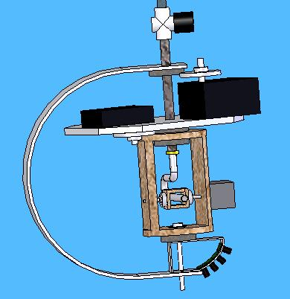
Mechanical - Overview
3 degrees of freedom. 3 servo motor.
Sensor
Gun casing
Hose casing

Slide 13
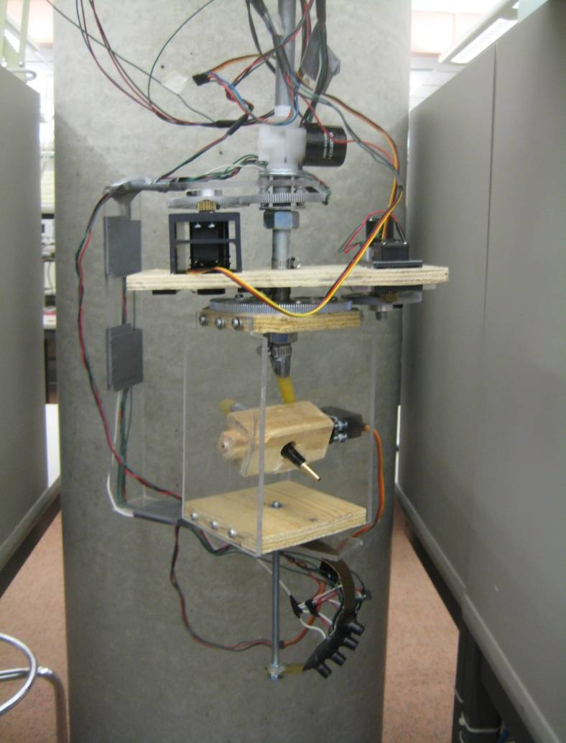
Mechanical - Overview
3 degrees of freedom. 3 servo motor.
Sensor
Gun casing
Hose casing

Slide 14
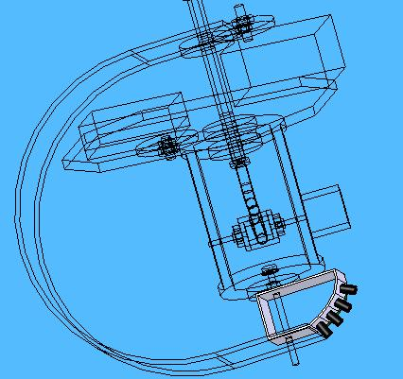
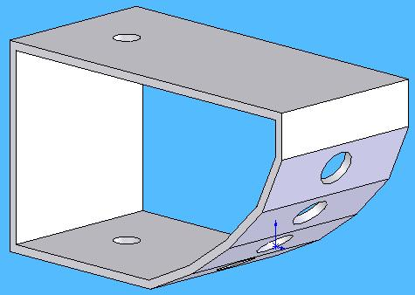
Mechanical – Sensor - Stack
Sensor stack
4 sensors – 25º to 65º

Slide 15
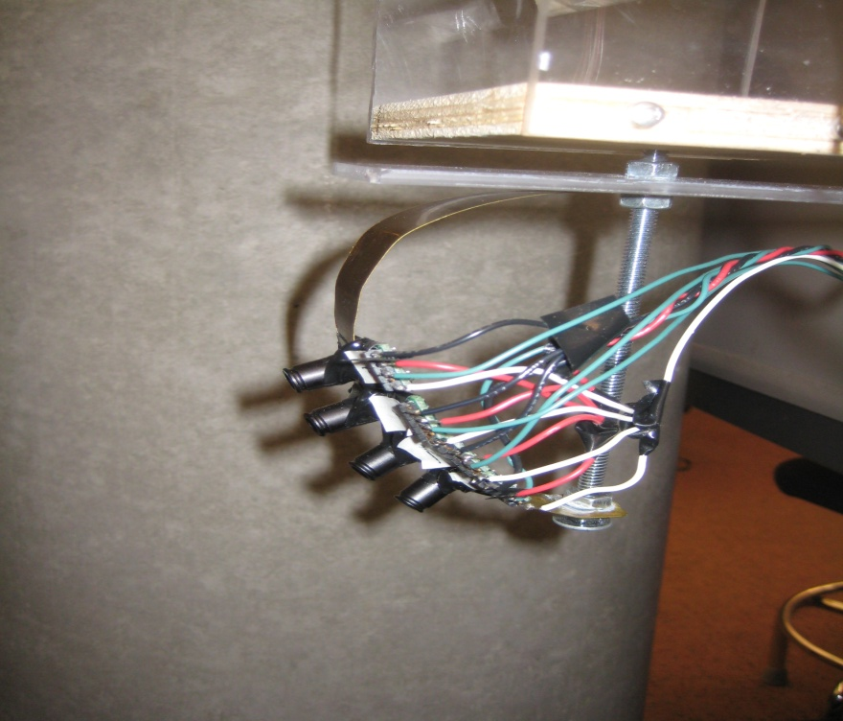
Mechanical – Sensor - Stack
Sensor stack
4 sensors – 25º to 65º

Slide 16
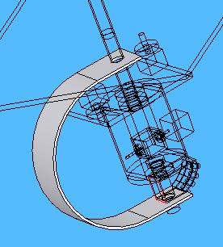
Mechanical – Sensor – C brakets
C-brackets
Attached to the sensor stack
Transmit rotation from motor

Slide 17
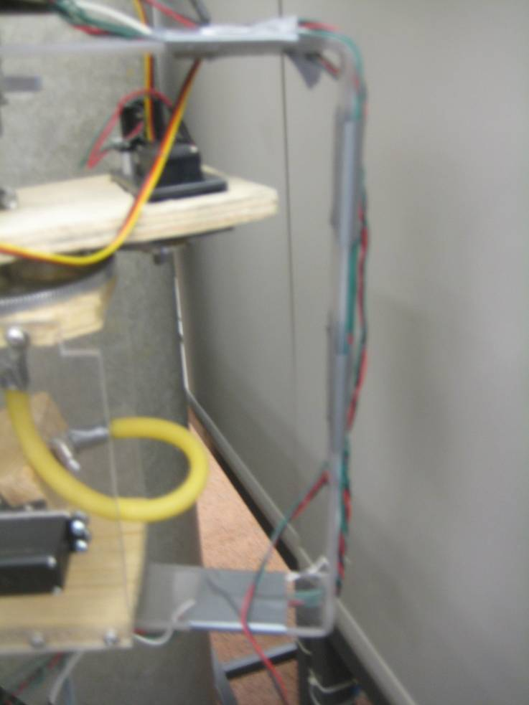
Mechanical – Sensor – C brakets
C-brackets
Attached to the sensor stack
Transmit rotation from motor

Slide 18
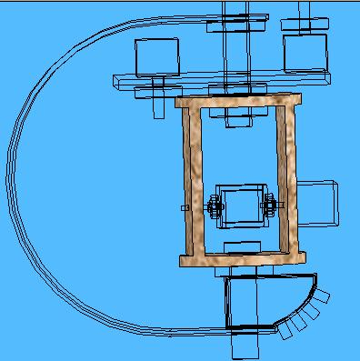
Mechanical – Gun casing
Gun casing
Holds the water hose
Gear attached to the top
Rotates the water hose to the direction of the fire
Water hose points in direction of the sensors

Slide 19
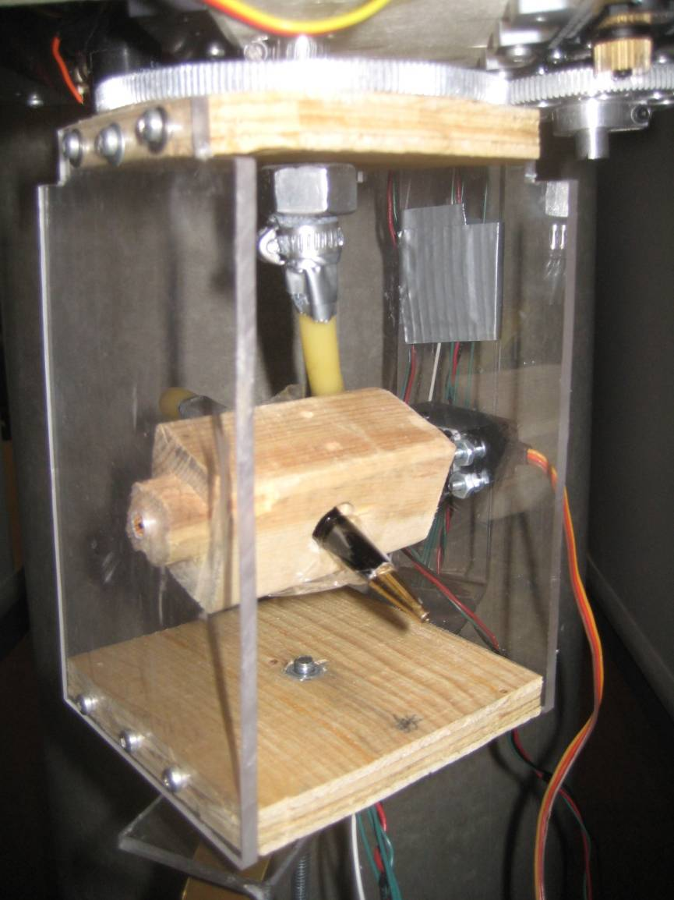
Mechanical – Gun casing
Gun casing
Holds the water hose
Gear attached to the top
Rotates the water hose to the direction of the fire
Water hose points in direction of the sensors

Slide 20
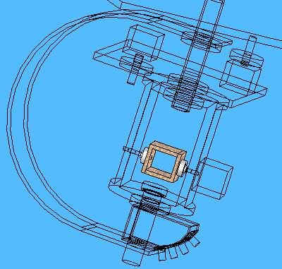
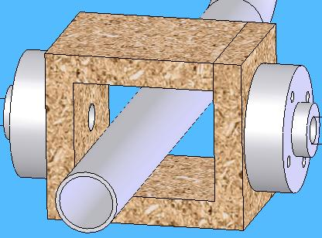
Mechanical – Hose casing
Hose casing
Make hose goes up and down

Slide 21
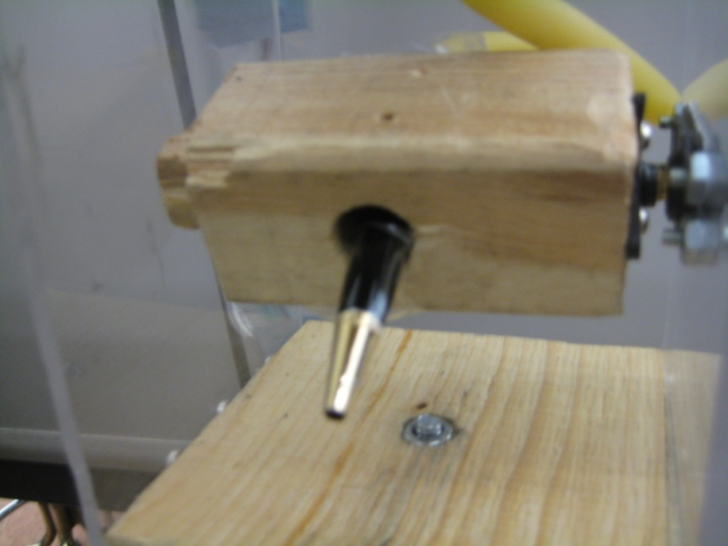
Mechanical – Hose casing
Hose casing
Make hose goes up and down

Slide 22
Mechanical - Problems
Pipe outer diameter non standard
Bore diameters of gears nonstandard
More friction
Uneven load
Accuracy
Uncertainties
Gears slipping
Shipping time
Budget

Slide 23
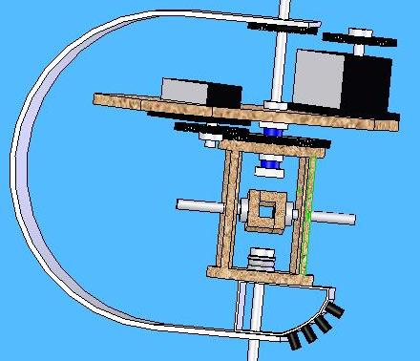
Mechanical - Solutions
Use Engineering (what we did) or
Alternative designs 1, 2
Aluminum tube instead of pipe
Bearings
Clamps
Shafts
Gears

Slide 24
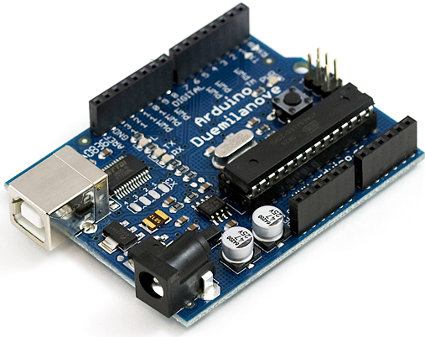
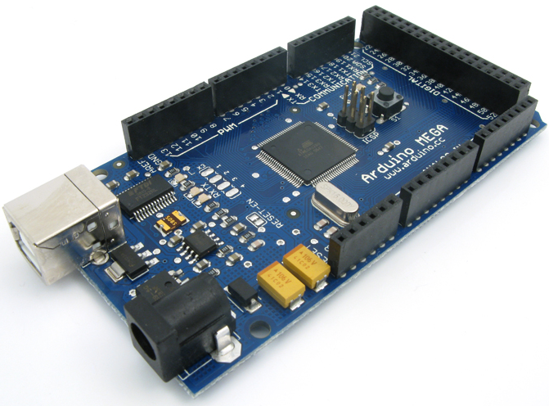
Software - Microcontroller
Arduino Duemilanove and Mega Development boards
Include digital I/O pins
Software serial communications from digital I/O pins
I²C communications between two boards

Slide 25
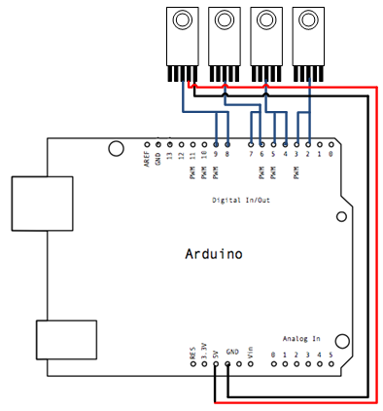
Software – MLX90614 Interface
Arduino NewSoftwareSerial library for software serial communication
Communicate at 4800 baud rate

Slide 26
Business Case – Market and Competition
Market
System has potential to replace the current fire sprinkler system for many places such as: computers, electronic labs, libraries,…
Potential target: insurance company, fire fighting department…
Competition
Unifire AB, Tokyo Bosai Setsubi and Rosenbauer fire detection and extinguishing

Slide 27
Business Case - Budget
 | Estimated Cost (CAD) | Actual Cost (CAD | Funding
Motor Driver | 56.64 | 0.00 | ESSS Funding : CAD 500 Wighton Fund: Unknown
Motors | 158.22 | 536.20
ADC | 16.42 | 0.00
Microcontroller | 100.00 | 74.32
Piping system | 50.00 | 90.00
Electronics misc. estimate | 50.00 | 20.00
IR sensors | 107.48 | 312.00
Water Pump | 50.00 | 0
Case | 50.00 | 0
Total without contingencies | 638.76 | 969.32
Contingencies 15% | 95.814 | 45.70
Total | 734.574 | 1032.52 | 500.00

Slide 28
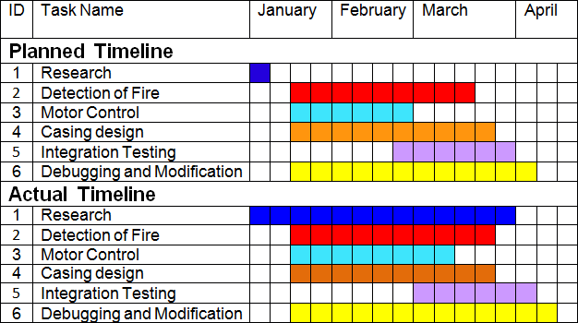
Timeline

Slide 29
Teamwork
Work individually
Communications: via email, phones, in person
Regular meetings
Work together
Assist each others when needed
Respect each other
Dine out time to time

Slide 30
Future Development
Different fire detection methods
Imaging sensor
CCD camera
Thermal array
Wiring issue fixed by custom-made water pipe

Slide 31
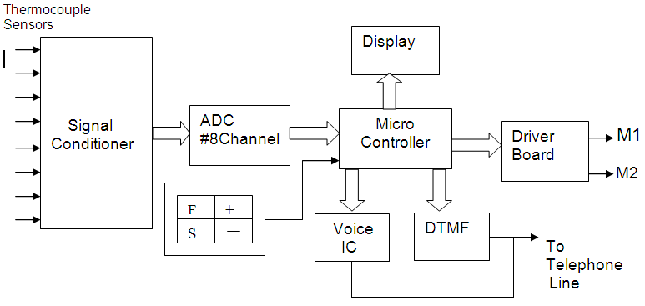
Future Development
Add fire reporting unit

Slide 32
Future Development
Minimization of system footprint
50% reduction with precision manufacturing and custom components
Power Design
Inclusion of power systems within standards
Water Pump & Nozzle
To increase the range of system
To have an area spray

Slide 33
What We Learned
Technical:
Arduino programming (I²C, serial communication,..)
Switching power transistor circuit
Mechanical part construction and assembling
Vertical turret machines
Budget management
Mechanical design techniques
Advanced SolidWorks techniques
Mechanical components selections
Mechanical suppliers
Non-Technical:
Working in a group
Professional documentation
Resources gathering
Patience

Slide 34
Conclusion
Address important concerns of water damage for fire extinguishing system
Working prototype model had been done to prove our concept
Future works can improve system accuracy, performance and features
Valuable knowledge, experience gained

Slide 35
Acknowledgements
Ali Ostadfar (technical advice)
Dr. Andrew Rawicz (technical advice)
ESSS (funding)
Fred Heep (technical advice)
Gary Houghton (demo assist)
Gary Sum (technical advice)
Steve Whitemore (demo advice)
Tze-Chien Chu (software advice)

Slide 36
References
[1] Servocity.com, SPG425A-BM-360 360º Rotation, 2008. [Online]. Available: http://www.servocity.com/html/spg425a-bm-360_360o_rotation.html. [Accessed:March 08, 2010]
[2] Parallax.com, MLX90614 Infrared Thermometer Modules, 2008. [Online]. Available: http://www.parallax.com/Portals/0/Downloads/docs/prod/sens/28040IRThermometer-v2.0.pdf. [Accessed: March 09, 2010]
[3] Arduino.cc, Arduino Mega, 2009. [Online]. Available:http://arduino.cc/en/Main/ArduinoBoardMega?action=diff.[Accessed: March 08,2010]
[4] Arduiniana.org, NewSoftSerial, 2010. [Online]. Available: http://arduiniana.org/libraries/NewSoftSerial/. [Accessed: March 05, 2010]
[5] Kpsec.freeuk.com, Transistor Circuits, 2010. [Online]. Available:
http://www.kpsec.freeuk.com/trancirc. htm. [Accessed: March 09, 2010]

Slide 37
Thank you!
Questions?

