Slide 1
ENSC 440 Capstone Project Spring 2010
Wirelessly Networked Faucet and Showerhead System
Sonca Teng, Michael Hou, Kwang-young Lee, Aaron Marcano

Slide 2
Outline
Who We Are
Motivation
Project Overview
Hardware
Software
Budget & Timeline
Future Development
Business Plan
Notes:
Print the outline for prof, TAS

Slide 3
Outline
Who We Are
Motivation
Project Overview
Hardware
Software
Budget & Timeline
Future Development
Business Plan
Notes:
Print the outline for prof, TAS

Slide 4
Who We Are
The Team:
CEO : SoncaTeng
Project Lead | Electronics Design | Wireless Development
COO: Michael Hou
Software Integration | Mechanical Design | Solidworks Modeler
CFO : Kwang-young Lee
Finance Manager | Software Lead | LCD and Flow Sensor Programming
CTO : Aaron Marcano
Systems Integration | Lead Wireless System Developer | Team Motivator
Notes:
brief introduction, slim it down “skills / duties”
Sonca Teng – Chief Executive Officer
Sonca is in his final year of studies in Electronics Engineering at Simon Fraser University. His senior electives in advanced digital and analog electronics design, as well as in communication systems, communication networks, and embedded systems design make him well suited to the design and implementation of Microflow’s premier line of networked faucets. His past roles as team lead in previous engineering projects makes him the ideal candidate for coordinator of Microflow’s R&D efforts toward success with its first commercial offering. Michael Hou – Chief Operations Officer
Michael is a fifth year System Engineering student at Simon Fraser University. His specialties are in reliable mechanical design and sustainability. His technical background includes electronic design with low and high level programming (HC11, FPGA, C++, JAVA, PERL), and system analysis. He has also gained communication and teamwork skills from previous work experience.
Aaron Marcano – Chief Technology Officer
Aaron is studying Systems Engineering in his final year at Simon Fraser University. His interests include programming, computer aided design (CAD), wireless communications, and integrated circuit fabrication. He has been part of many project teams in which robotic designs were made using SolidWorks CAD software. In his role with Microflow Aaron will be involved with the design, programming, and testing stages of the Networked Faucet System Project. Aaron enjoys leisure activities such as biking, snowboarding and cooking.
Kwang-young Lee – Chief Financial Officer
Kwang-young is in fifth year of Systems Engineering at Simon Fraser University. His interests are in mechanical design, computer aided design, and fabrication of mechanical and robotic systems. His previous work experience as a support engineer at Greenlight Innovation Corp, a hydrogen fuel-cell test equipment development company, gives him knowledge of billing and materials tracking, mechanical design processes, and computer aided design. It also gives him great teamwork and communication skills.

Slide 5
Outline
Who We Are
Motivation
Project Overview
Hardware
Software
Budget & Timeline
Future Development
Business Plan
Notes:
Print the outline for prof, TAS

Slide 6
Motivation
Currently in California there are mandatory water restrictions because voluntary conservation efforts have proved insufficient
“no restaurant [..] shall serve drinking water to any person unless expressly requested.”
City of Los Angeles Emergency Water Conservation Plan Effective 8-11-09
Notes:
Currently in California there are mandatory water restrictions because voluntary conservation efforts have proved insufficient
“no restaurant [..] shall serve drinking water to any person unless expressly requested.”
City of Los Angeles Emergency Water Conservation Plan Effective 8-11-09

Slide 7
Microflow System Overview
Water is a scarce resource, whether people choose to act accordingly or not
We choose to do something about this
Help people see how much water they waste on a day to day basis by putting the information in front of them
Guide people toward responsible water usage with our solution

Slide 8
Microflow System Overview
Two emerging groups in this world
In areas where there is a genuine shortage of water and there is a need for personal usage monitoring
In areas where people are socially inclined to be (or appear to be) environmentally consciencious
With our proposed solution, we cater to both groups
We will now demonstrate how

Slide 9
Existing Solution
Right now what you can do is run outside and look at your water meter
Difficult to read a water meter
Very inconvenient and most would not bother
Is not viewable in real-time
Combines all water usage, including that which is not under your control
Ie. Usage of washing machine, flushing toilets, etc

Slide 10
The Microflow Solution
The Microflow Solution
A wirelessly linked system of faucets and showerheads around the household
Microflow faucets and showerheads are drop-in replacements to be purchased right off the shelf next to existing units at Home Depot or Rona
Single unit will show you water usage in real time
More than one unit: will wirelessly link and show a network total in addition

Slide 11
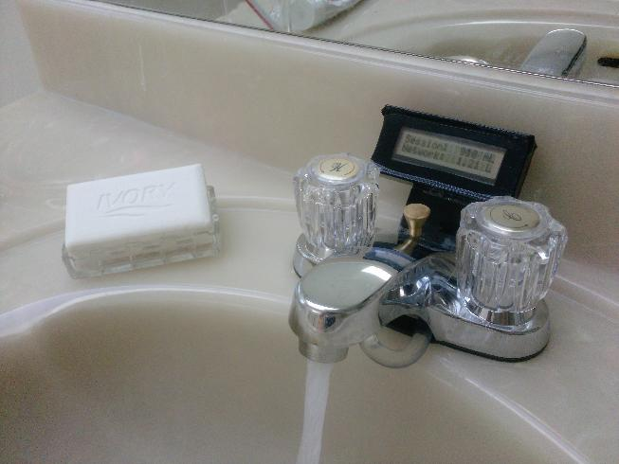
The Microflow Solution

Slide 12
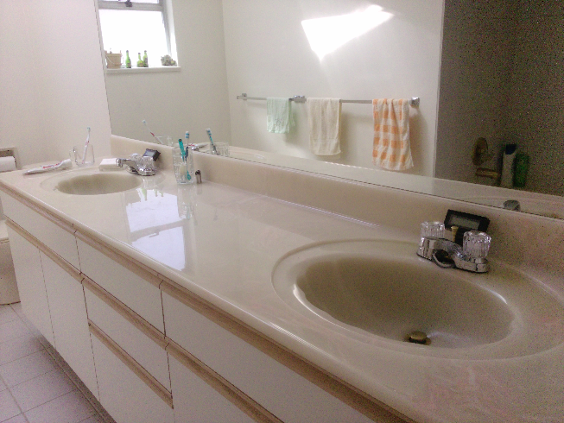
The Microflow Solution

Slide 13
Video Demo - Introduction

Slide 14
Outline
Who We Are
Motivation
Project Overview
Hardware
Software
Budget & Timeline
Future Development
Business Plan
Notes:
Print the outline for prof, TAS

Slide 15
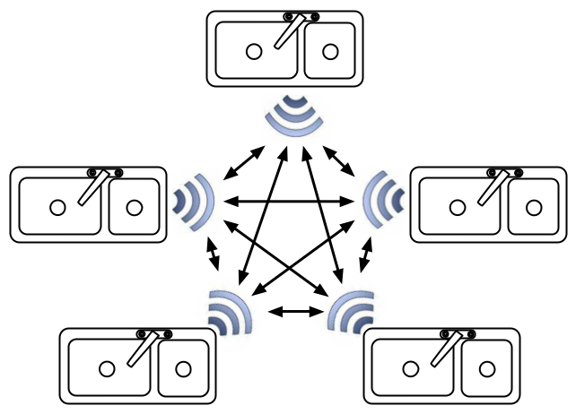
System Overview

Slide 16
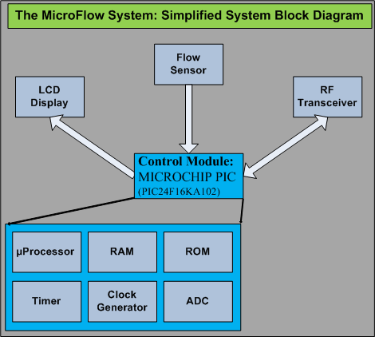
High Level System Design

Slide 17
Outline
Who We Are
Motivation
Project Overview
Hardware
Software
Budget & Timeline
Future Development
Business Plans
Notes:
Print the outline for prof, TAS

Slide 18
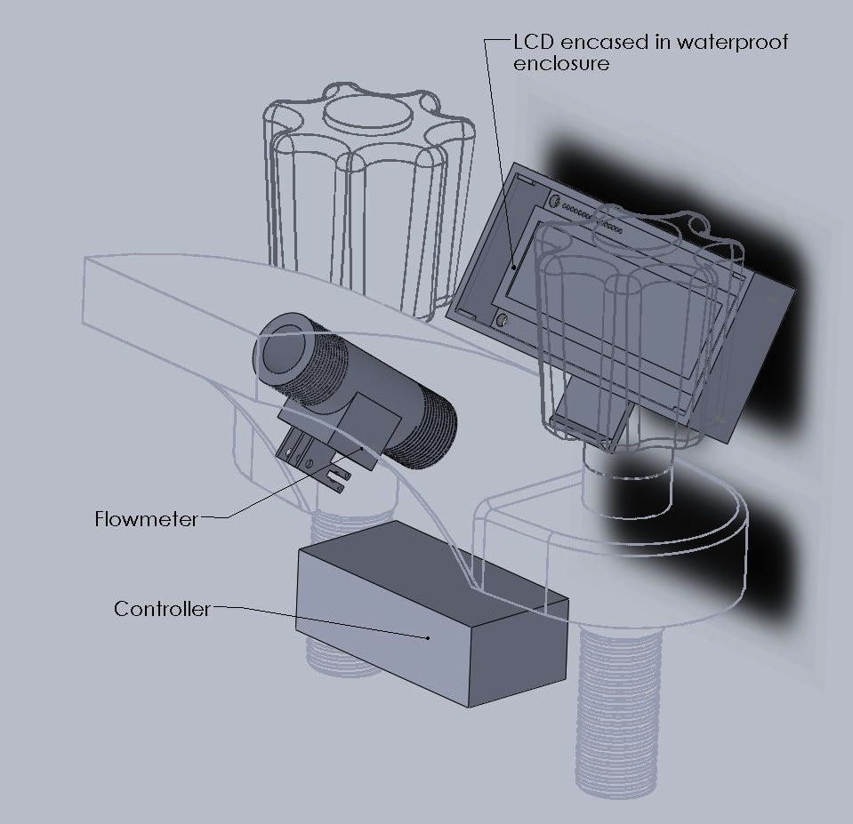
Faucet
Start with generic Home Depot faucet as base
Watertight LCD enclosure
In-line flow sensor
Controller / transceiver enclosure

Slide 19
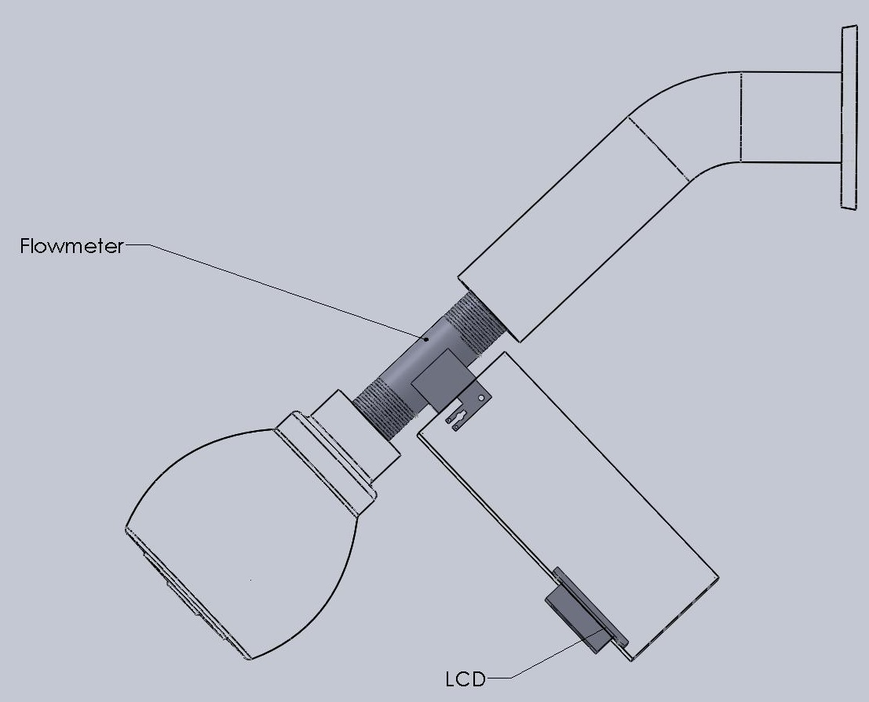
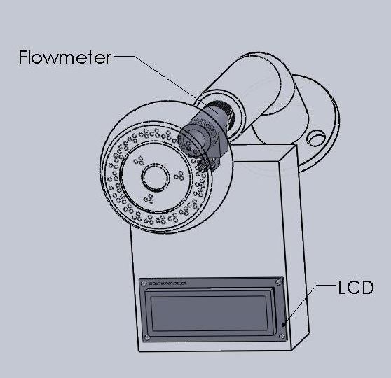
Showerhead

Slide 20
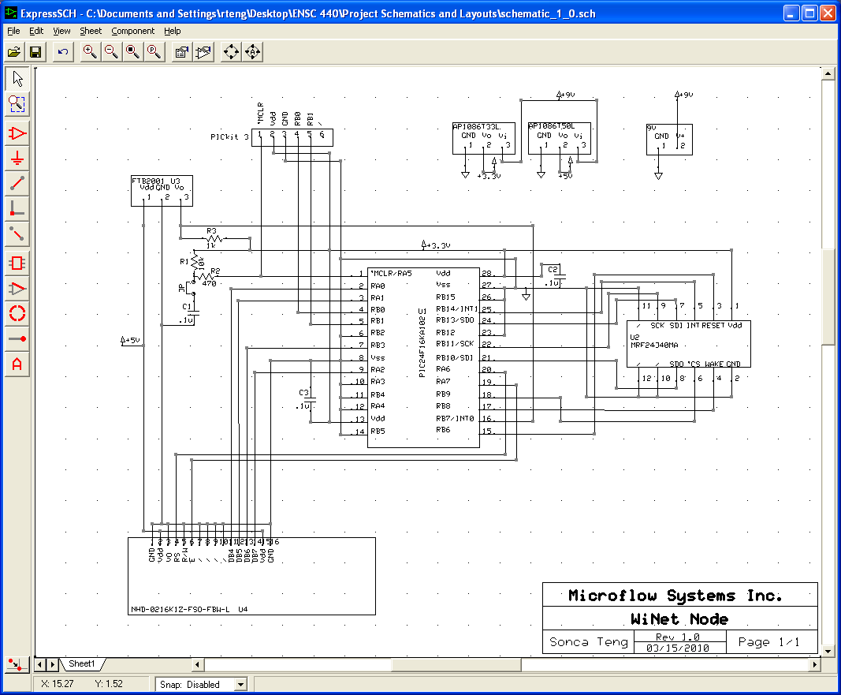

Slide 21
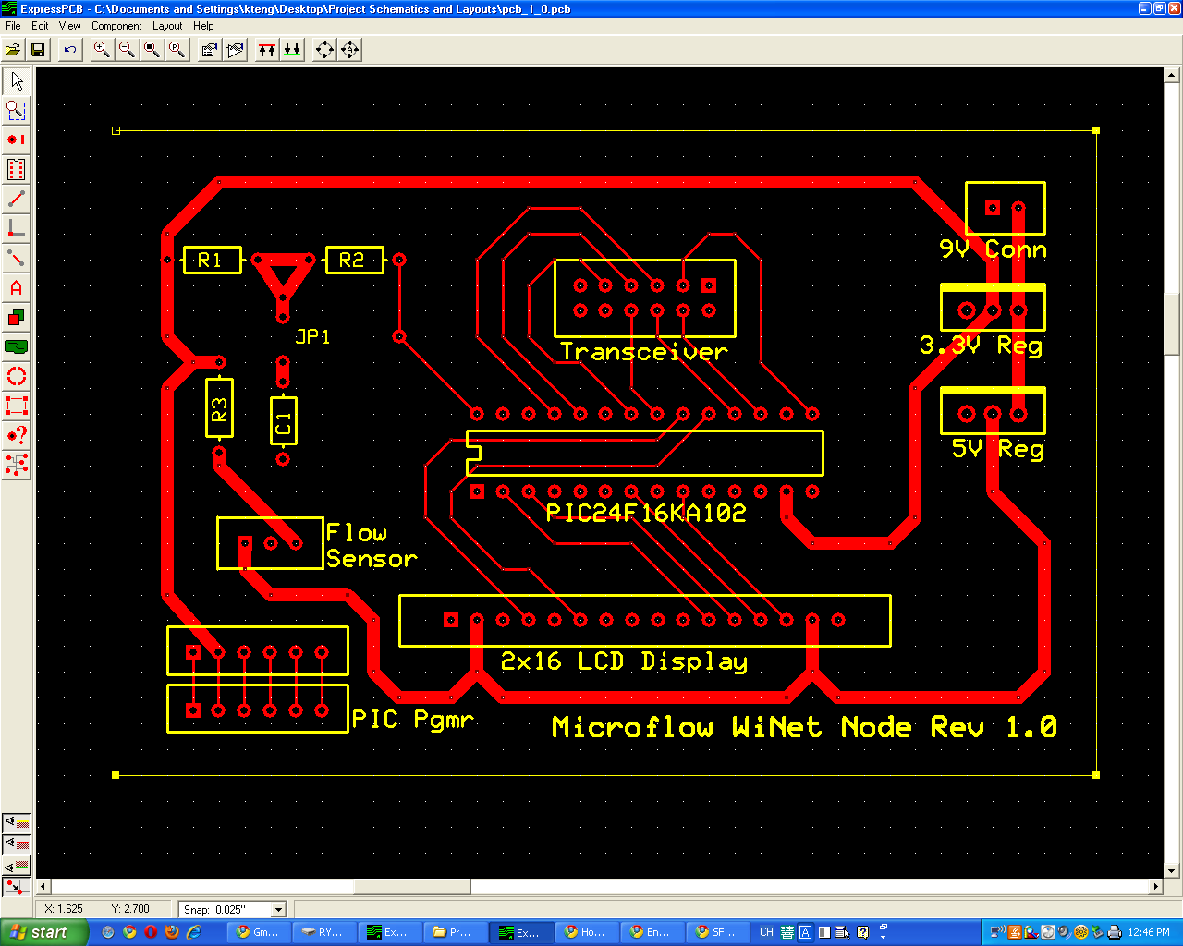

Slide 22
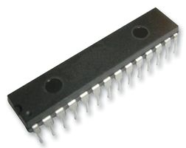
Microcontroller
Control All Other Components
Low Power Consumption
Easy to Program and Use
CHEAP!
Notes:
The integrated microprocessor is both powerful in function and low in power consumption, which represents the perfect solution for our innovative new device.
It has many built-in peripherals, such as general digital I/O, interrupt service routines, real-time clock and calendar, and SPI.
It’s quick and easy to program and use, as it only requires a PIC programmer, such as the PICKit3, and C programming. This enable us to further pursue product development and flexible programming. And since it’s very reliable (can keep its programming for more than 10000 hours), reliability isn’t an issue.
And the microcontrollers are very affordable in large quantities. $0.50 per unit for 1000+ batch. It substantially reduced our manufacturing costs, as you will see later.

Slide 23
Microcontroller
Control LCD Module (I/O)
Receive Input from Flow Sensor (Interrupt0)
Control Wireless Transceiver (SPI)
RESET OR START-UP
INITIALIZATION
DISPLAY LCD
CURRENT VALUE
INTERRUPT
FLOW SENSOR
N
NETWORK VALUE AVAILABLE?
INTERRUPT
TRANSCEIVER
DISPLAY LCD
NETWORK VALUE
Y
Notes:
The diagram on the left is the basic control flow of the microcontroller. The microcontroller follows this behavior. After a reset, or startup, the microcontroller initialize all the components, the LCD, the flow sensor, and the transceiver.
After initialization is complete, the microcontroller is ready to control the LCD module, the wireless transceiver, and receive input from the flow sensor.

Slide 24
LCD Display
2 x 16 Character Display
Controlled by the Microcontroller (4-bit)
Controllable LED Backlight
Notes:
2 by 16 character display LCD. Simple control methods.
4-bit mode requiring only total of 6 wire connection needed to control the LCD module (excluding power and ground wires). Compared to 8-bit implementation, it has its drawbacks, such as slower display, no 2-way communication between the microcontroller and LCD module. However, its simple connections, and resultant simplified software control methods needed for it outweighs the other method’s benefits.
The backlight LED, 20mA at 5V, can be controlled by a switching circuit controlled by the microcontroller. With this, it is possible to save additional power for it.

Slide 25
User Interface
During Water Usage
After 10 Second Delay
Also Programmable for American Market: Fluid OZ, Gallon Display
Notes:
During water usage, the LCD screen will display the current session’s water usage in mL. In different application, this may change to L due to scaling issue.
After the water flow has stopped for 10 seconds, the LCD screen will change to the day’s total water usage in L. When the water flows again, the screen will change back to current session’s water usage, starting at 0mL.
The network total will be displayed continuously.
There is a programmable option that displays the Session, the total, and network water usage in imperial units, fl oz, and gallons.

Slide 26
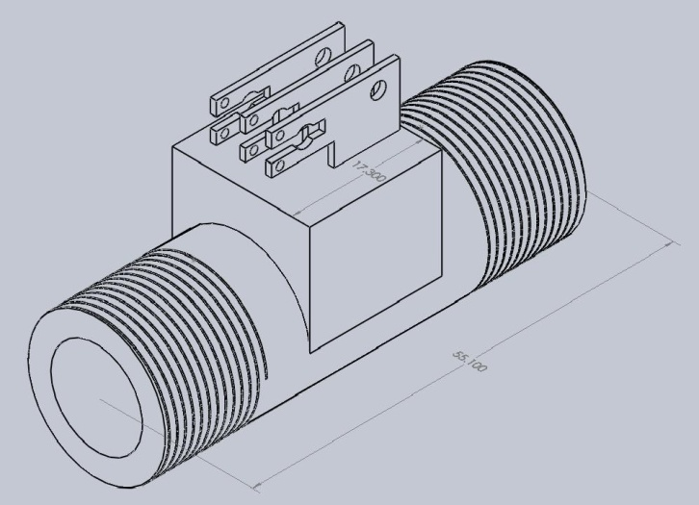
Sub parts –Flow Sensor
Hall-effect Sensor Attached to Turbine In Stream
Limited Flow Range
Fixed Number of Pulses Per Liter (or Gallon)
N=2200 Pulses/Liter (8300 Pulses/Gallon)

Slide 27
Sub parts – Transceiver
Wireless Transceiver
MiWi™
Zigbee™
Connected to Microcontroller via SPI

Slide 28
Outline
Who We Are
Motivation
Project Overview
Hardware
Software
Budget & Timeline
Future Development
Business Plans
Notes:
Print the outline for prof, TAS

Slide 29
Software
Initialization
LCD
Transceiver
Flow Sensor
Transceiver Mode

Slide 30
Transmission Format
Source Address – Used to Identify Node
Payload
Format
Water Usage Data
TimeStamp
CheckSum

Slide 31
Transmission Format
Message Received
Calculate and Verify Checksum
After Checksum, Check Format
After Format, Check Received Water Usage Data
If Same as Old, Ignore. If New, Update.

Slide 32
Potential Network Problems
Lost Power, and Reset
Transceiver Will Reconnect to Network
Receiving Node Out of Range
Indirect Messaging as Potential Solution
Receiving Bad or Incorrect Messages
Check Consistency of Data and Ignore If Bad

Slide 33
Potential Network Improvements
Enhanced Network Security
Encoded Message Using CRC and Encryption
Increased Range
Device Hopping.

Slide 34
Video Demo - Installation
Notes:
Video demo of product working
Shower head
Compare faucet

Slide 35
Video Demo – Network Update
Notes:
Video demo of product working
Both them on 0 liter one goes to 500ml wait for it to update, and check that the network is broadcasted,
Shows Zena broadcasting

Slide 36
Video Demo – Test 1
Notes:
Video demo of product working
Both them on 0 liter one goes to 500ml wait for it to update, and check that the network is broadcasted,
Shows Zena broadcasting

Slide 37
Video Demo – Test 2 Simultaneous Update
Notes:
Video demo of product working
Using 2 device at the same time

Slide 38
Video Demo – Accuracy Test
Notes:
Video demo of product working
Using 2 device at the same time

Slide 39
Further Applications
Cooking
Gardening, Lawn Watering
Industrial Use, Leak Detection, Municipal Monitoring
Suite management for Landlords
Notes:
Volume measuring for cooking, baking.
Used for garden hose so you can control how much water you want to dispense and know when to stop
Factory water management can be integrated with recycling water waste to reduce costs.
One of the major water resource waste is from old and leaking pipes, with our device in place, we can pinpoint the sections of leaking pipe and reduce both time and efforts to fix the problem before the pipe eventually bursts.
Landlords can install the units for utility tracking. With our device in place, the tenants can make sure that they aren’t being over charged and the landlord can held the tenants accountable when the bill comes.

Slide 40
Outline
Who We Are
Motivation
Project Overview
Hardware
Software
Budget & Timeline
Future Development
Business Plan
Notes:
Print the outline for prof, TAS

Slide 41
Proposed Budget
Part Name |  | Number of Units | Individual Cost | Total Cost
Mechanical Parts
OMEGA Flow Sensor (FTB2004) |  | 3 | 95.00 | 285.00
RONA Faucets |  | 3 | 25.00 | 75.00
Various Fittings, Hoses, Tubes, Clamps |  | 1 | 40.00 | 40.00
Electronic Parts
MICROCHIP 16bit PIC (PIC24F16KA102) |  | 3 | 2.00 | 6.00
MICROCHIP RF Module (MRF24J40) |  | 3 | 20.00 | 60.00
MICROCHIP PIC Programmer (PICkit 3 ICD) |  | 1 | 50.00 | 50.00
MICROCHIP RF Dev Board (PICDEM Z) |  | 1 | 110.00 | 110.00
NEWHAVEN 2x16 LCD |  | 3 | 15.00 | 45.00
Miscellaneous Parts |  | 1 | 50.00 | 50.00
Taxes & Shipping |  | 1 | 100.00 | 100.00
TOTAL |  |  |  | $821.00

Slide 42
Actual Cost - Mechanical
PART | SUPPLIER | PIECES | PRICE PER UNIT | UNIT | TAX | SHIPPING | TOTAL
Mechanical
RONA 4IN FAUCET | RONA | 2 | $22.98 | CAD | $5.52 | $0.00 | $51.48
1/4" Hose | RONA | 1 | $4.54 | CAD | $0.54 | $0.00 | $5.08
1/4" Hose Clamp | RONA | 4 | $0.68 | CAD | $0.33 | $0.00 | $3.05
3/8FNPT to Hose Barb Fittings | McMaster | 1 | $9.45 | US | $0.00 | $0.00 | $9.45
FLOW RATE SENSOR | OMEGA.CA | 3 | $92.00 | CAD | $14.40 | $12.00 | $302.40
ShowerHead | HomeDepot | 1 | $17.49 | CAD | $0.00 | $0.00 | $17.49
Showerhead Base | HomeDepot | 1 | $15.47 | CAD | $3.96 | $0.00 | $19.43
Vinyl Tubing | HomeDepot | 1 | $4.49 | CAD | $0.53 | $0.00 | $5.02
1/2MIP to 3/8 Fitting | HomeDepot | 1 | $3.49 | CAD | $0.00 | $0.00 | $3.49
BR. Reducer | HomeDepot | 1 | $4.49 | CAD | $0.96 | $0.00 | $5.45
Plexiglass 3/8" thickness | HomeDepot | 1 | $5.00 | CAD | $0.00 | $0.00 | $5.00
4" FAUCET | HomeDepot | 1 | $22.98 | CAD | $2.76 | $0.00 | $25.74
Hose Clamps | HomeDepot | 2 | $0.66 | CAD | $0.00 | $0.00 | $1.32
Teflon Tape | HomeDepot | 1 | $0.69 | CAD | $0.00 | $0.00 | $0.69
1/4 Copper Coupling | HomeDepot | 1 | $0.74 | CAD | $0.00 | $0.00 | $0.74
3/8 Copper Coupling | HomeDepot | 1 | $0.84 | CAD | $0.00 | $0.00 | $0.84
Braided Hose for Faucet | HomeDepot | 3 | $6.99 | CAD | $4.75 | $0.00 | $25.72
Notes:
Eddie me and aaron spend most of our money here, the major compoents here is the $92 flow sensor. However, we believe we can save cost in future product by making the hardware components ourself for better integration. Another unexpected cost is that we have to purchase a third faucet due to manufacturing defect. Most of our accessories comes from home depot and Rona

Slide 43
Actual Cost - Electornics
PART | SUPPLIER | PIECES | PRICE PER UNIT | UNIT | TAX | SHIPPING | TOTAL
Electrical
ZENA Network Analyzer | Digikey | 1 | $147.27 | CAD | $0.00 | $0.00 | $147.27
0.10microF Capacitors | Digikey | 10 | $0.08 | CAD | $7.80 | $8.00 | $16.55
RF Transceiver Modules | Digikey | 3 | $21.47 | CAD | $0.00 | $0.00 | $64.41
PICKit3 PIC Programmer | Digikey | 1 | $50.93 | CAD | $0.00 | $0.00 | $50.93
PICDEM Z MotherBoard | Digikey | 1 | $101.95 | CAD | $10.86 | $0.00 | $112.81
RJ11 Programmer Cable | Digikey | 1 | $11.32 | CAD | $0.00 | $0.00 | $11.32
3.3V Voltage Regulators | Digikey | 3 | $1.82 | CAD | $0.00 | $0.00 | $5.46
10microF Capacitors | Digikey | 5 | $0.35 | CAD | $0.00 | $0.00 | $1.74
9V Battery Holder | Digikey | 3 | $1.50 | CAD | $1.55 | $8.00 | $14.05
PICDEM Z MotherBoard Return | Digikey | 1 | -$101.95 | CAD | -$5.10 | $16.52 | -$90.53
LCD Display Green | NewHeaven Display | 3 | $16.00 | CAD | $0.00 | 12.16 | $60.16
PICDEM Z Board Connector | Digikey | 1 | $20.86 | CAD | $0.00 | $0.00 | $20.86
Diode 20V 1A | Digikey | 4 | $0.46 | CAD | $0.00 | $0.00 | $1.84
Radial Inductor 100uH 1A | Digikey | 4 | $0.66 | CAD | $0.00 | $0.00 | $2.64
100uF 6.3V Mini Alum Elect | Digikey | 10 | $0.11 | CAD | $1.72 | $8.00 | $10.83
New Switching Regulators | Maxim | 1 | $0.00 | CAD | $0.00 | $15.00 | $15.00
New Switching Regulators | Maxim | 3 | $2.50 | US | $0.00 | $0.00 | $7.50
The Letter Carrier Service Charge | The Letter Carrier | 5 | $4.00 | US | $0.00 | $0.00 | $20.00
5V Linear Voltage Regulators | RPElectronics | 3 | $1.25 | CAD | $0.00 | $0.00 | $3.75
Double Row Header | RPElectronics | 1 | $1.70 | CAD | $0.00 | $0.65 | $2.35
Miscellaneous | RPElectronics | 1 | $20.00 | CAD | $0.00 | $0.00 | $20.00
6-Pack 9V Batteries | HomeDepot | 1 | $14.99 | CAD | $0.00 | $0.00 | $14.99
Notes:
Bought picdemz but returned it cuz it’s not workng with our microcontroller pic processor, another major cost is the ZENA network analyzer, it analze the transceiver we have and are able to give us valuable information about the packets being transmitted. We bought this because we need the analyzer help tremendously with the development process because you can visuallze the packet transfering through air

Slide 44
Actual Cost - Individual
Notes:
Sonca spends the most because he paid for all the electronic including the microcontroller, the power regulator and the , eddie flow sensors major costs

Slide 45
Cost Summary
Total:
$876.56
$50 Over-Run
Shipping
Failed Devices and Their Replacements
Network Analyzer
Extra Showerhead Design and Implementation

Slide 46
External Funding
ESSEF Funding
Presented Idea To ESSS Execs
Received $400. Used to Order More Parts
Witen Fund?
Provide Additional Funding for the Project
Apply After the Project is Complete

Slide 47
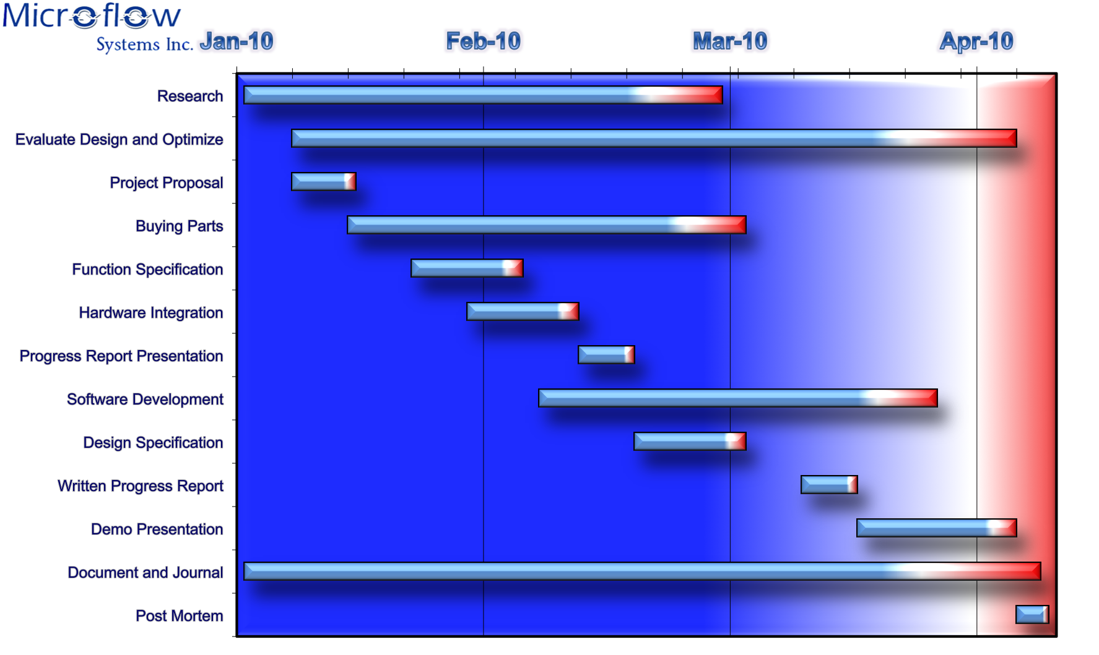
Timeline - Proposed
Notes:
This is the proposed timeline for our project. During the whole semester, we keep evaluating our design and optimizing our software, and hardware design as needed. We expected software development phase to take the longest time follow by the hardware development which includes buying parts and actually putting everything together.
We also spend a week of time for each of the documents we are to submit. We break down the task and work together or separately as needed. We find that the fastest way to communicate is by email and if an issue needs further discussion we arranges meeting.
Thoughout the whole semester, we each keep a journal for our work and a team journal. After the demo, we still need to prepare for the post mortem within the week that follows.

Slide 48
Timeline - Actual
Notes:
This is the actual timeline that we have used to complete the project. The major difference is in hardware integration and software implementation. We knew the software integration will take the longest time so we started early while waiting for the hardware components to arrive.
We have followed our timeline in a weekly order, however, hardware integration took longer than expected because of the extra adapters we need to order and modification to the enclosure is also changing with the development while refining the details. Moreover, in the process of modifying the faucets to meet our needs, one of the faucet had suffered damage beyond repair and a new one has to be bought and modified. Despite all of the set backs, we have conquered the obstacles and are able to finish the prototype on time.
One of the cosmetic setback is due to transaction error. Sonca designed a PCB but the order to manufacture it did not go through. However, with the breadboard setup we are still able to show the intended functions that we require for the project.

Slide 49
Outline
Who We Are
Motivation
Project Overview
Hardware
Software
Budget & Timeline
Future Development
Business Plan
Notes:
Print the outline for prof, TAS

Slide 50
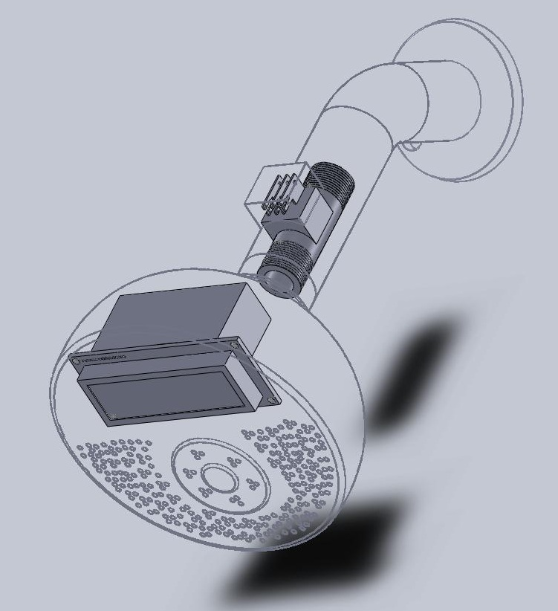
Future Development
Notes:
Display of future solidwork concept model.
Everything will be integrated into one unit and fitted properly…..

Slide 51
Future Work
Custom flow sensors (high flow / high accuracy)
Memory chip to store daily / weekly / monthly usage
Flow management software
Notes:
2 lines of product, outside (garden/shower) with high flow volume meter
Inside (faucet/kicthen) with low(sufficient) flow volume but accurate
Integrate a memory
Software to monitor the flow and usage of water resources.

Slide 52
Future Work
Use of switching regulators vs linear regulators currently in use
90% efficient vs 50%
Reliability (heat generation)
Halved battery power consumption
Battery use efficiency with step-up voltage regulators
Further revisions to software to support shutting off LCD backlight, and putting PIC controller and wireless transceivers into sleep mode
Notes:
2 lines of product, outside (garden/shower) with high flow volume meter
Inside (faucet/kicthen) with low(sufficient) flow volume but accurate
Integrate a memory
Software to monitor the flow and usage of water resources.

Slide 53
Outline
Who We Are
Motivation
Project Overview
Hardware
Software
Budget & Timeline
Future Development
Business Plan
Notes:
Print the outline for prof, TAS

Slide 54
Business Plan
Immediately apply for provisional patent
Conduct extensive market research
Present at trade shows
Speak to building developers, see what features are in demand
See if they would like to install these for demonstration run
Contact retail chains such as Costco and Home Depot to gauge demand
Speak to incumbents, attempt to negotiate IP / manufacturing agreement

Slide 55
What we learned!
Communication is key
Ask questions
Talk to component manufacturers, they give great advice and sometimes they give things for free
Plan for the worst, because things won’t go as planned
Suppliers may let you down (Ie PCB manufacturer), must have backup plans
Notes:
We have learned that working as a team is the most important, good communication and humorous attitude can take us through rough and down times. Everyone needs to be clear about what they need to do and how to do it.
We also learned to ask questions. During the development phase, we have to keep asking ourselves what would it do under a certain situations and we also ask ourselves that if it is what the customer wants. We learnt that asking questions often can save us more time than dive into the problems and fix it later.
Things never go as planned, so we learn to always leave room for error and time to correct the errors.

Slide 56
One More Thing…

Slide 57
Conclusion
The Verdict….
Notes:
It just WORKS!,
Looking at our finished prototype, we are confident that we have developed a product with great market potential and direct customer focus to help us gain a good share of market when people are looking for a way to help the environment without spending big money.
There are no bells and whistles on this product so we can suck more money out of the customers. The idea behind our product is

Slide 58
Questions
?
Notes:
Freedom 500

Slide 59
Bloopers
Notes:
Freedom 500

