Slide 1
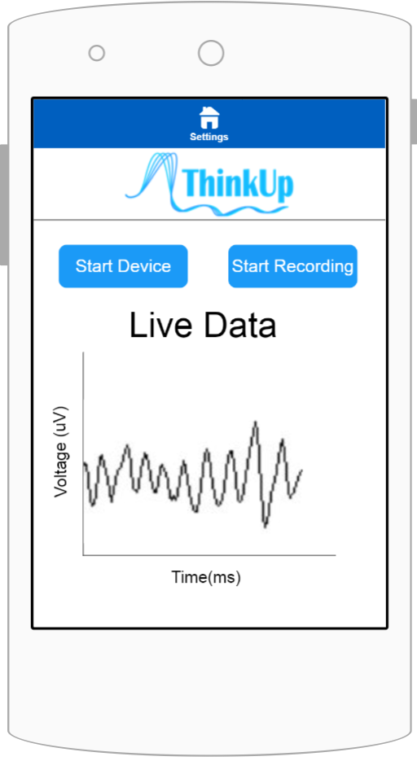
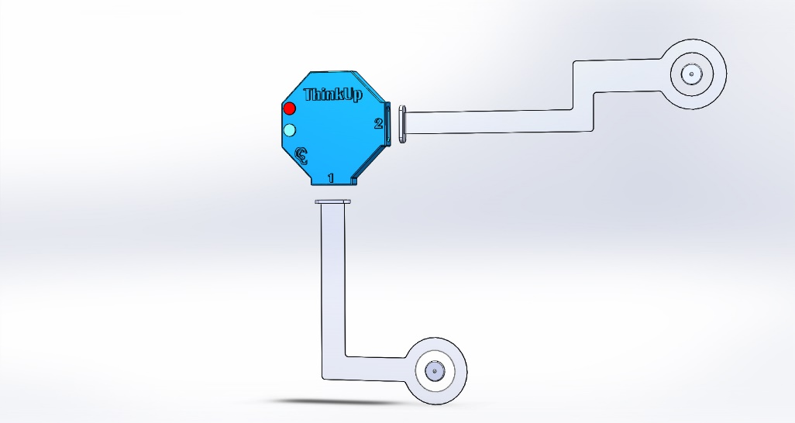
Portable | Easy to Use | Comfortable | Lightweight | Accurate | Versatile | Safe
The EZG
The EZG: An EEG Made Easy
Affordable EEG designed for research groups and commercial users wanting to see their thoughts in action.
Proof of Concept:
Collects simulated brain signals
Signals are displayed via user interface on computer
Prototype:
Picks up brain signals from frontal lobe via electrodes on forehead
Signals sent securely and wirelessly
Entire lightweight EZG sticks to forehead with hypoallergenic adhesive
Hardware
Detachable wings
Single use, pre-gelled Ag-AgCl electrodes
Preamplification circuit to increase SNR
Reusable Communication Hub
Bias driven differential amplification to reduce common mode noise
60 Hz notch filter to reject mains AC noise
Microcontroller with ADC and Bluetooth communication
EZG Main Body
Proof
-
of
-
EZG Wings
concept
T
Power
x
Line
Hardware
Pre
Electrodes
-
Tx
Instrument
ADC
amplifier
Amplifier
Bias Drive
SoC
Computer
Display
Software:
Android application monitors and collects data
Connects via Near Field Communication (NFC) and communicates via Bluetooth (4.x & 5.x)
Structure of Prototype:
Electrodes connect via snap leads to wings
Wings carry signals from electrodes and use magnetic connectors to interface with hub
Hub contains electronics that process and transmit signal
Conclusion: Looking Towards the Future
Fills the gap between full cap, wet electrode EEG and the portable, dry electrode consumer EEG.
Combines the best of both worlds
High SNR
Light weight
Long battery life
Easy setup
Comfortable
Bias ear clip connects onto hub with jack to power bias driven CMR
April 9, 2018
Contact: nzavagli@sfu.ca
The Team (#5): Michael Chyziak, Chloe Hill, Isaac Tan, Elizabeth Pieters, Nathan Zavaglia
Notes:
Our Vision:
Simple Setup
No need for messy and cumbersome full gel head cap
Connections between components (snap lead, jack, magnetic connector) are commonplace and intuitive to use
Adhesive attaches the EZG securely and comfortably to the forehead
Easy to Use
Connect via Bluetooth with your favourite device
Control start and stop of EZG with the simple EZG app
Have instant access to live data right from your mind to device
Accurate
Preamplifiers reduce noise in leads
Electronics filter 60 Hz noise from signal
Pre-gelled electrodes and adhesive provide high quality, stable contact with forehead
Portable and Long Lasting
Adheres comfortably to your forehead and sticks with you wherever you go
12 hour battery life gives a full day of data – or night for sleep studies
Versatile
Wing design allows users to select which brain signals to pick up
Portability and long life allows use in a wide range of studies
Safe
Safety of users is our highest priority
Electrode gel and adhesives are hypoallergenic and medical grade
Electronic components contained within protective plastic casing of EZG
I scaled the slide up to 89x50 cm (Aspect Ratio of TV, 1.78:1 or 16x9) – should give us more room to work with -NZ

